Slide 1
ND 280 upgrades
with help by Etam Noah, Jeanne Wilson, Mark Hartz, Leila Haegel, Mark Rayner,
Minamino, Ichikawa, and many others

Slide 2
Preamble : ND280 detectors
On axis: INGRID absolutely essential for good knowledge of the flux!
Off axis: ND280 for normalisation of experiment and cross-section measurements
1- a magnet (gift of CERN to Japan)
2- a number of detectors P0D, TPC, FGD, TPC, ECAL , SMRD from the whole T2K collaboration
3- a know-how of reconstruction, systematics , etc... still progressing.
4. typical fiducial volume (FGD1) is 1.75x1.75x0.35 = 1.07m³ ~1 ton.
5. FD/ND flux ~ 0.6-0.8 10⁻⁶ i.e. statistics at 280 m in 1ton is equivalent to ~1.4 Mton @HyperK
➔ for muon neutrino events statistics are amply sufficient (+ they disappear!)
➔ for electron neutrino events statstics to be
6. Uncertainty on FD/ND flux is ≤ 2% (T2K, Phys. Rev. D 87, 012001 (2013)
and improving.... detector being close to target is probably not a fundamental limitation.

Slide 3
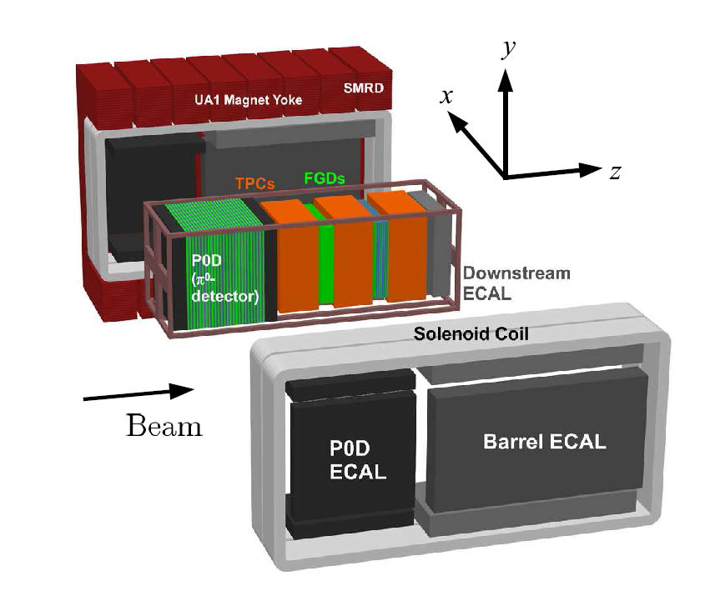
B
side view:
➔
beam
scale approximate
fiducial volume: 2.4long x 1.7wide x 0.35m high= 1.4 m³
= 0.6 (plastic) + 0.8 (0.1plastic + 0.7 H2O) tons
can be increased by improved design of TPC field cage.

Slide 4
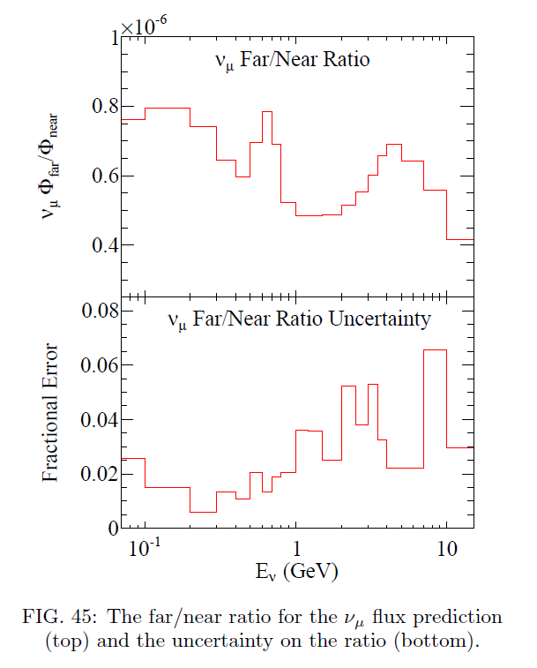
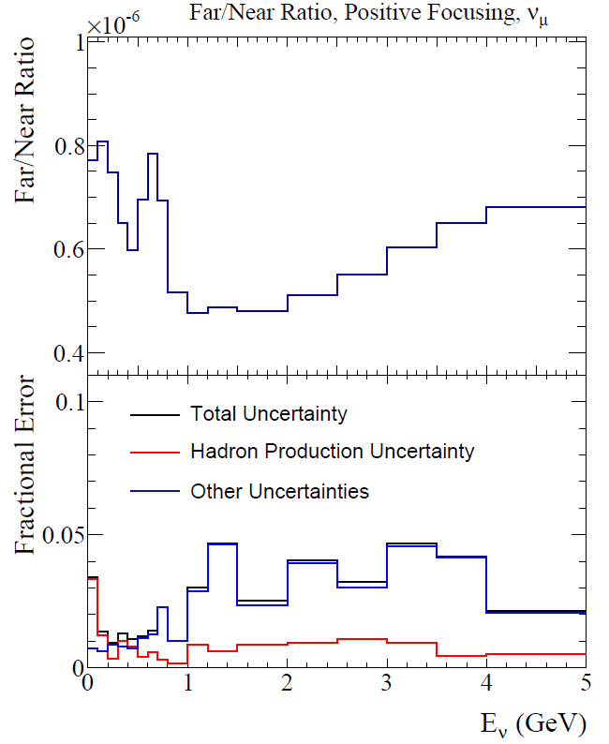
2%
2015 version with 2009 NA61 data
2012 with 2007 NA61 data
NA61 performance will be further
improved with LT+Kaon measurements

Slide 5
Preamble (II)
When the T2K near detector was designed, aim was ‘discover ν_{μ}→ν_{e} appearance’
even if θ₁₃ is very small (sin²2θ₁₃ -> 0.006)
➔ emphasis on accurate background prediction rather than signal
With a large value of θ₁₃ things have changed:
-- background is a small fraction of ν_{μ}→ν_{e} appearance
-- we are able to look for CP violation earlier,
-- CP asymmetry is smaller ➔ importance of cross-section systematics.
This leads naturally to envisage a ND280 detector upgrade, with advantage of experience
in addition: (Alain)
-- we will run T2K for a factor 9x (maybe 25x)more statistics:
update is very wortwhile!
-- we will certainly want to keep ND280 for HyperK information that it provides is quite unique.
-- Also, if we want to keep ND280 alive we should update /upgrade it.

Slide 6
max. shift O(100 MeV)
RATE → sinδ CP-violating, different for neutrino and antineutrino
Average energy → cosδ CP conserving, same for neutrino and antineutrino
Back of envelope: statistical errors on both sinδ and cosδ :
with full HyperK exposure ~0.08, with T2K2 0.3
➔ with T2K2 can tell at 3 sigma if CP is violated,
OR even if CPV is not observed if delta is non zero (i.e. cosδ=-1)
sinδ and cosδ have VERY DIFFERENT SYSTEMATICS!

Slide 7
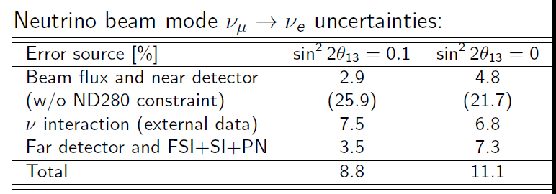
What is missing?
Present systematics in prediction of number of far detector events
is presently of order 8.8%.
AIM is ~2 %
signal background
11% uncertainty on 15% background is 1.7% of signal -- small compared with 8.8% on signal
(this is dominated by intrinsic beam ν_{e})
➔ In this particular beam, Water Cherenkov is very well suited
to do the ν_{μ}→ν_{e} oscillation measurements

Slide 8
What are the limitations?
A. Near detector and far detector are different
A0. flux at near detector and far detector are different.
The FD/ND ratio is however quite well known
A1. Near detector is scintillator not water -> nuclear systematics
A2. Near detector has different acceptance than far detector.
tracker part limited to 57 degrees forward, miss >30% of cross-section (E-dependent) + syst
A3. ND has different E_{v} resolution and PID ability.
Aim is to be better. Difficult for photons!
A quantitative re-projection of
these causes of errors is underway
to understand better what to improve.

Slide 9
B. Even if near and far detector were the same:
B1 Energy response function P(E_{v}(rec)-E_{v} ) contains uncertainties
how can we measure this? This affects atmo parameters, cos(δ)
B2 ν_{e} and ν_{μ} cross-sections are different due to muon mass interplay with nuclear effects
already knowing response for one species would be great help. (nuPRISM)
second class currents?
can we measure them?
How to re-design ND280 to improve on these aspects A&B?
C. one way to solve many problems would be to have a muon storage ring nuSTORM...
and place a large Water Cherenkov detector on it.
-- produces known flux of (μ⁺ decay) ν_{e} and ‾ν_{μ} and (μ⁻ decay) ‾ν_{e} and ν_{μ}
-- well known end-point of spectrum provides energy response
e.g. difference between two decay spectra from different muon momentum
gives nearly monochromatic primary beams

Slide 11
+CERN, Valencia, Glasgow and Sofia for Baby MIND

Slide 12
WAGASCI WORK PLAN
A. Minamino

Slide 13
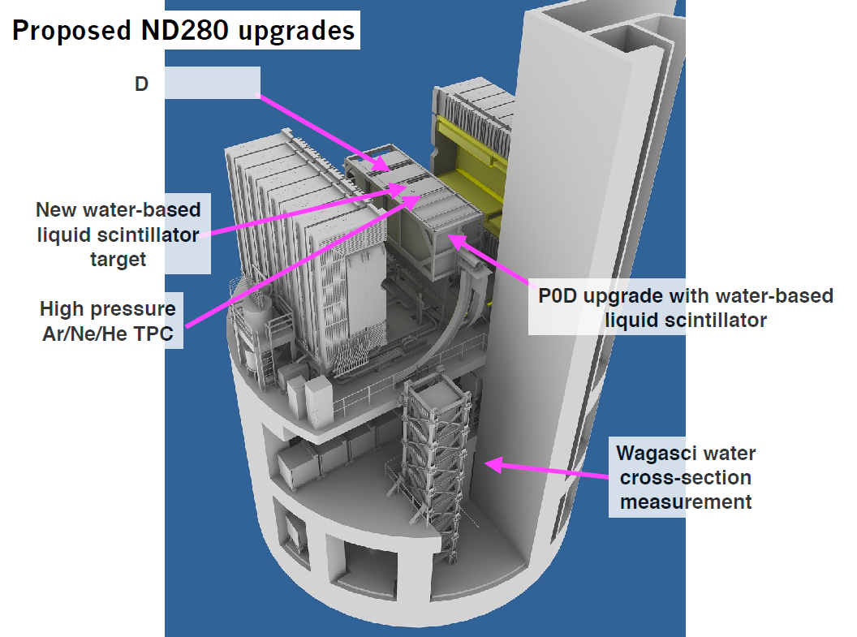
regular ND280 upgrade
meetings since 2013
Yokoyama

Slide 14
The ideal near detector (Ichikawa)

Slide 15
ND280 like implementation
$$\vec{B}$$
active water target
MIND
Gas tracking volume(TPCs)
pointing and timing calorimeter for photons and neutrons
But .... this looks a lot like ND280 with a different configuration!
Downstream MIND (or simply ranger) allows cross-calibration of TPC momentum scale
for μ+ vs μ- ! (calorimeter allows calibration of e+ vs e-)

Slide 16
B
side view:
➔
beam
scale approximate
fiducial volume: 2.4long x 1.7wide x 0.35m high= 1.4 m³
= 0.6 (plastic) + 0.8 (0.1plastic + 0.7 H2O) tons
can be increased by improved design of TPC field cage.

Slide 17
water
example:

Slide 18
ND280 - upgrade
suggested reconfiguration
TPCs 1 and 2 rotated around
B field
Or prefer new TPCs
side view:
B
➔
beam
Simply rotating geometry improves/solves angular acceptance issue

Slide 19
TPC MEETING IN BARCELONA (16-17 July 2015)
Several presentations on motivations for high pressure and atm pressure TPCs
https://indico.ifae.es/conferenceDisplay.py?confId=169
interested groups:
Saclay
Italian groups
Polish groups
Barcelona
Geneva
5 UK groups
1. for ND280 a High Pressure TPC cannot replace the water target.
-- it is not possible to make H2O out of various gases.
2. so tracker upgrade should be made around water target.
3. nevertheless some interest expressed in
the high pressure TPC as a way to investigate re-interractions in nucleus
does not solve the issue of the energy response function
4. will thus prepare a ‘white paper’ based on included (so far EU centric) ‘work packages’
5. General idea for Geometry agreed, but many details to optimize by simulation
6. aim is to upgrade ND280 as part of T2K upgrade, include in proposal.
7. this does not solve the issue of detecting the neutrals!
(importance, what needs to be done exactly, can we collaborate to help etc...)
JOIN US!

Slide 20
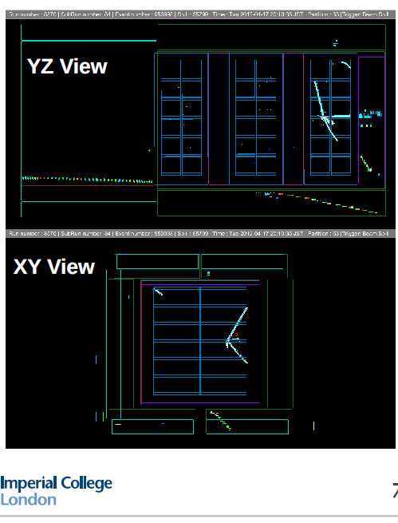
Asher Kaboth
Existing TPC ‘Argonuts’ analysis
☺ nice events
☹ 4X fewer events selected than expected
➔ obviously TPCs are too small
(fiducial volume is nearly 0)
➔ need to think about selection method
if we want to make use of TPCs for this.

Slide 21
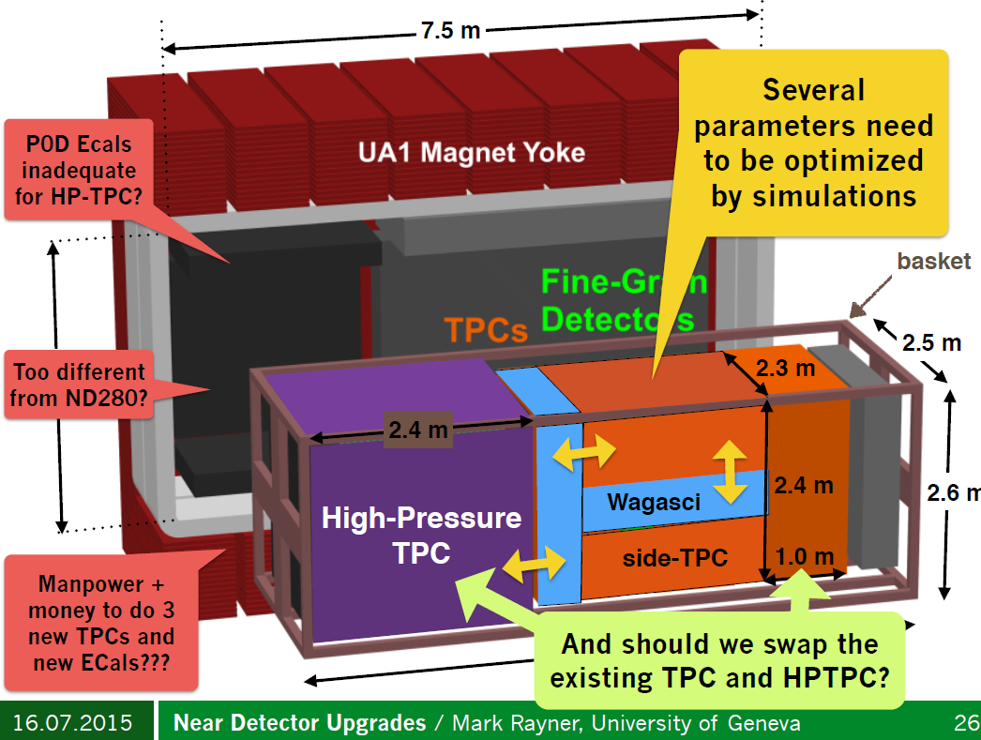
another possible set-up

Slide 23
ND280 upgrade:
Many things to look at:
-- water target design mechanics and geometry
is Wagasci enough to tell electron from photon for ν_{e} cross-section measurement?
or should we go for Water based scintillator in straws?
-- best arrangement for TPCs
-- P0D
-- ECAL
improve/refurbish existing calorimeter?
add a preshower/pointing layer?

Slide 24
CONCLUSIONS
1. High value of θ₁₃ gives us a shot at CP violation already with T2K2, with T2HK
-- but it places high premum on syst. errors, both on rate and energy response
➔ revisit ND280!
2. a number of systematics can be traced back to experimental set-up
Geometry, target material, target geometry
3. First measurement of the water to scintillator ratio can be measured with WAGASCI
4. European collaborators keen to work on ND280 off-axis upgrade
5. ND280 off-axis magnetic detector is irreplaceable.
Very complementary with Intermediate Water Cherenkov detector

