Slide 1
Non-Gaussianity, spectral index and tensor modes in mixed inflaton and curvaton models
arXiv:0802.4138 [astro-ph]
Teruaki Suyama (Institute for Cosmic Ray Research)
In collaboration with
Ichikawa Kazuhide, Tomo Takahashi and Masahide Yamaguchi

Slide 2
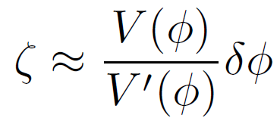
Introduction
Inflation works well.
It can produce spatially flat and homogeneous universe.
It can generate the primordial fluctuations.
Primordial fluctuations
Quantum fluctuations
The primordial fluctuations are almost scale invariant and almost Gaussian.
Consistent with observations.

Slide 3
However, the primordial fluctuations may be generated after inflation.
Light scalar fields during inflation
After inflation, fluctuations of these fields can also produce the primordial fluctuations.
One possibility: curvaton
(Moroi&Takahashi 2001, Lyth&Wands 2001, Enqvist&Sloth 2001)

Slide 4
The primordial fluctuations from curvaton is also almost scale invariant.
But the primordial fluctuations from curvaton can be strongly non-Gaussian.
Though the WMAP data is consistent with Gaussian fluctuation, future observations may detect large non-Gaussianity.
(e.g. For Planck)

Slide 5
In general, the primordial fluctuations are the sum of the contributions from the inflaton and the curvaton.
Although limiting cases have been investigated in detail, combination of two fluctuations is relatively unexplored.
(Langlois&Vernizzi 2004, Moroi et al. 2005)
What are the observational consequences if both two fluctuations contribute to the primordial fluctuations?
Spectral index of the scalar fluctuations.
Tensor-to-scalar ratio.
Non-Gaussianity: bispectrum, trispectrum.

Slide 6
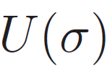
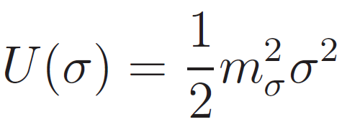
Curvaton model
: curvaton field
Curvaton mass
Hubble during inflation
Hubble friction
stays almost constant during inflation.

Slide 7
Curvaton model
: curvaton field
Curvaton mass
Hubble during inflation
Hubble friction
starts to oscillate when .

Slide 8
Curvaton model
: curvaton field
Curvaton mass
Hubble during inflation
Curvaton energy density behaves as dust.

Slide 9
Curvaton model
: curvaton field
Curvaton mass
Hubble during inflation
radiation
Curvaton decays into the radiation when

Slide 10
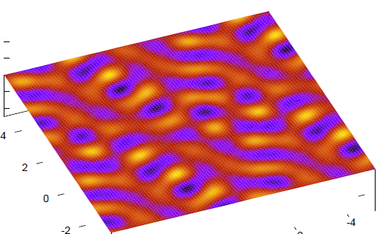
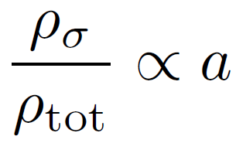
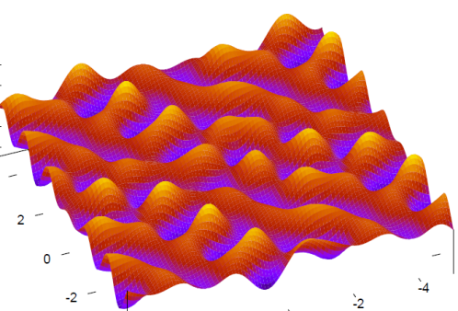
Energy density
time
Inflation
Radiation dominant

Slide 11
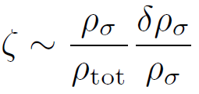
Primordial fluctuation
(Lyth&Rodriguez 2005, Sasaki et al. 2006)
For example, if the curvaton energy density is 1% at the time of the curvaton decay, then

Slide 12
General formula
Primordial fluctuation
(e.g., Starobinsky 1985, Sasaki&Stewart 1996, Sasaki&Tanaka 1998, Lyth et al 2005)
Power spectrum (two-point function)
Bi-spectrum (three-point function)
Tri-spectrum (four-point function)

Slide 13
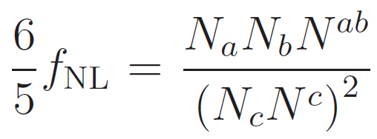
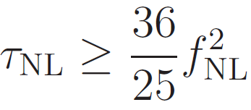
Three non-linearity parameters
(Lyth&Rodriguez 2005)
(Alabidi&Lyth 2006, Byrnes et al. 2006)
(Byrnes et al. 2006)
General inequality for local type non-Gaussianity
Trispectrum must be at least this lower bound.
For Planck
(TS&Yamaguchi 2007)

Slide 14
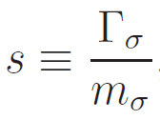
The primordial fluctuation
Contribution from the inflaton fluctuations
Contribution from the curvaton fluctuations
Parameters in the model
:Expectation value of the curvaton
:Mass of the curvaton
:Decay rate of the curvaton
Dimensional analysis shows that

Slide 15
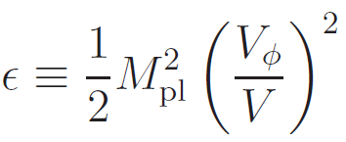
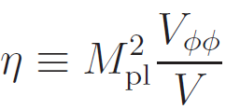
Cosmological parameters
If curvaton contribution is very large, the spectral index becomes red-tilted.
Curvaton contribution always reduce
the tensor-to-scalar ratio.
All parameters can be written as the slow-roll parameters and .

Slide 16
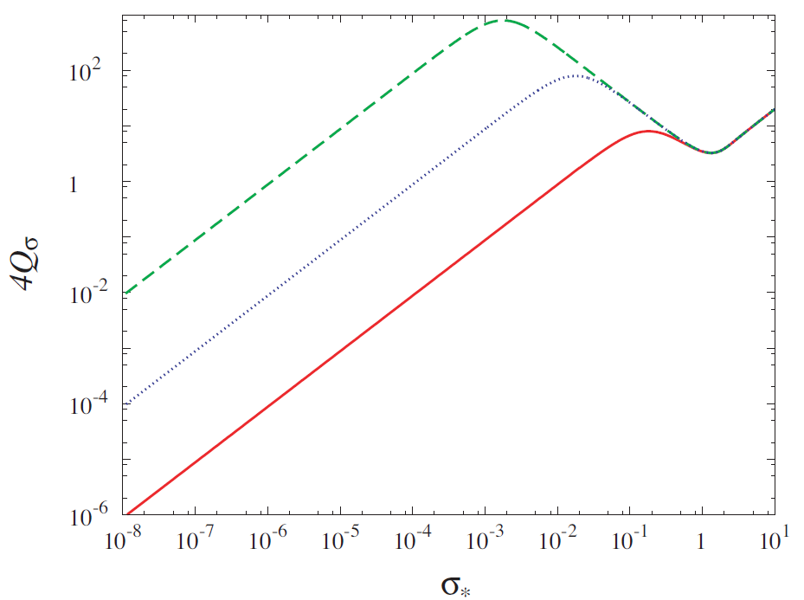
Plots of Q_sigma (horizontal axix is in Planck units.)
B
A
C
A. Second inflation occurs.
B. No inlation. But, the curvaton once dominated the universe.
C. Curvaton is always a subdominant component.

Slide 17
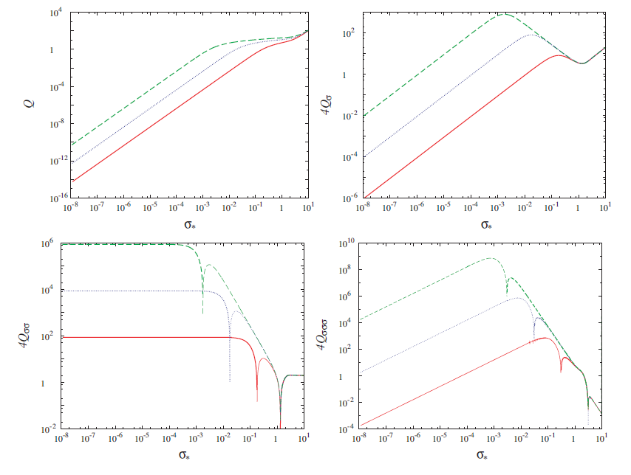
Plots of Q and its derivatives (horizontal axix is in Planck units.)

Slide 18
When the curvaton is always subdominant.
Small expansion parameter: p
We can expand Q with respect to p as

Slide 19
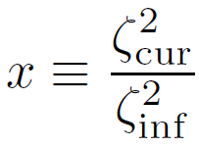
When the curvaton is always subdominant.
Non-linear parameters

Slide 20
Consistency relation between bispectrum and trispectrum
We can discriminate other scenarios that also generate large non-Gaussianity by using these consistency relations.

Slide 21
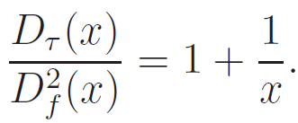
The magnitude of the non-linear parameters becomes the largest when, i.e.,
First detection of non-Gaussianity may come from the trispectrum.

Slide 22
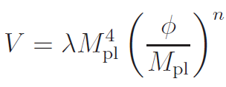
Observational quantities in mixed inflaton and curvaton models
1. Chaotic inflation
WMAP normalization
(Liddle et al. 2006)
Time of horizon crossing
In chaotic inflation, two free parameters and are fixed by these two conditions.

Slide 23
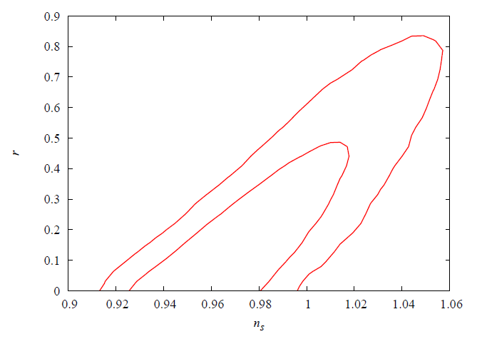
WMAP 3yr only
WMAP data used.

Slide 24
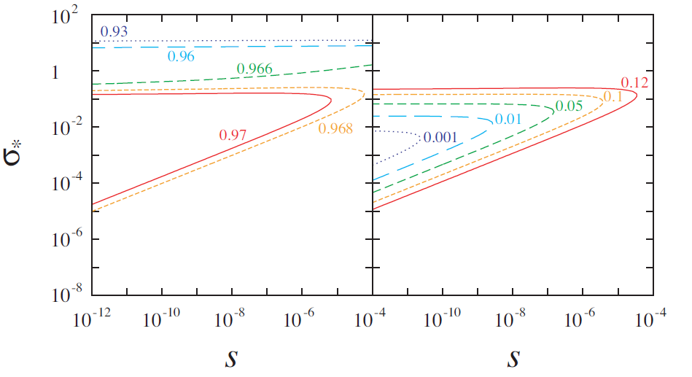
Spectral index and tensor-to-scalar ratio for

Slide 25
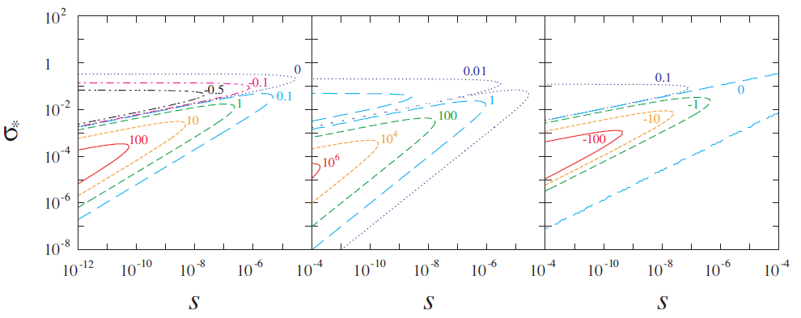
Non-linearity parameters for

Slide 26
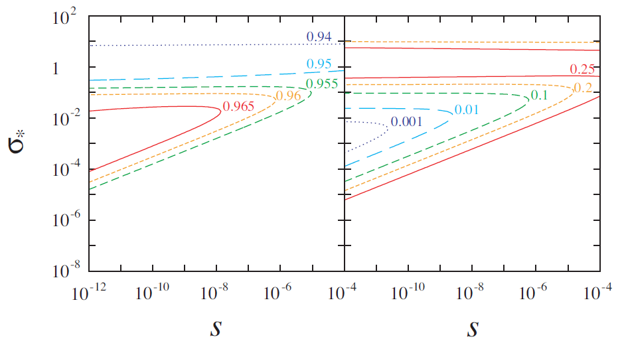
Spectral index and tensor-to-scalar ratio for
approaches 1.
Existence of the curvaton.
becomes close to 0.
There are allowed regions.

Slide 27
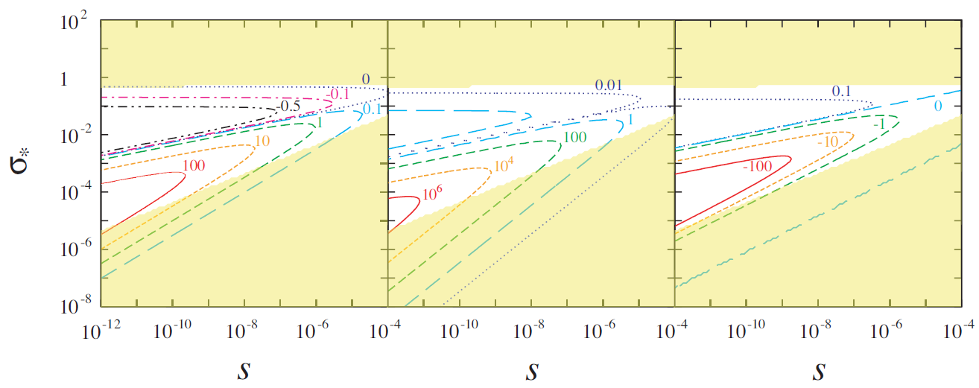
Non-linearity parameters for

Slide 28
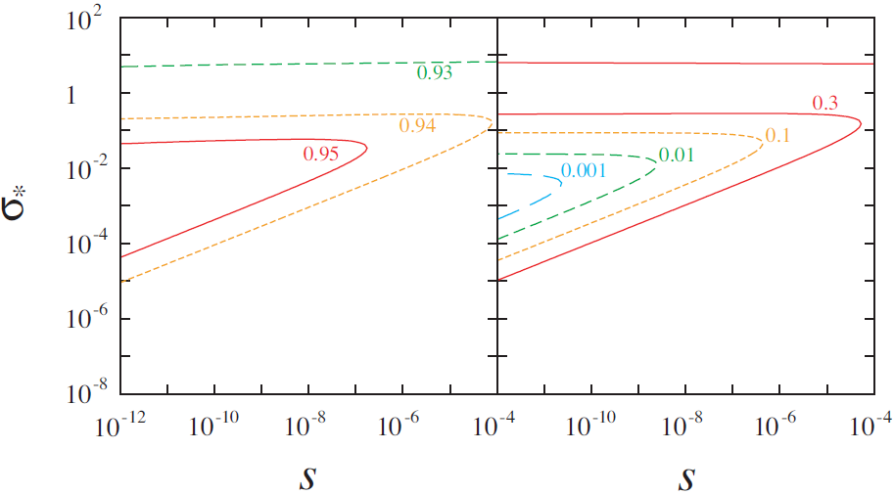
Spectral index and tensor-to-scalar ratio for

Slide 29
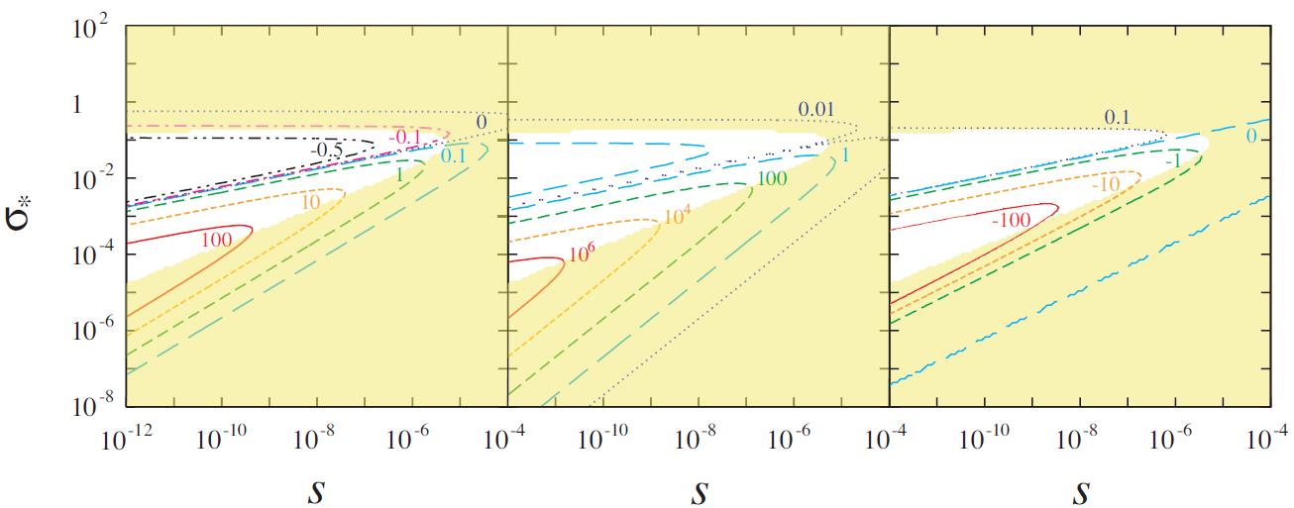
Non-linearity parameters for

Slide 30
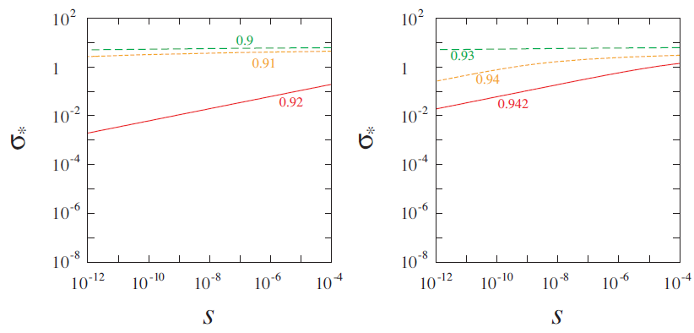
2. New inflation
Spectral index

Slide 31
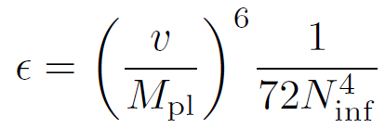
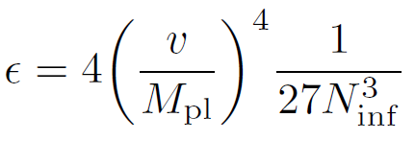
In new inflation, slow-roll parameter is
for
Very small number
for
Effects of the curvaton fluctuations always appears in the combination of
e.g.)
Effects of the curvaton fluctuations are small in this kind of models.

Slide 32
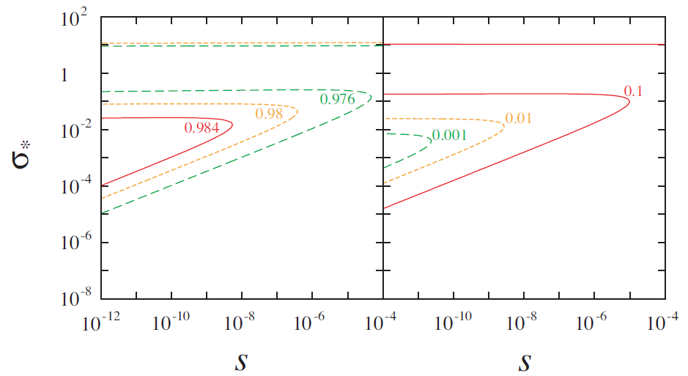
3. Hybrid inflation
We take

Slide 33
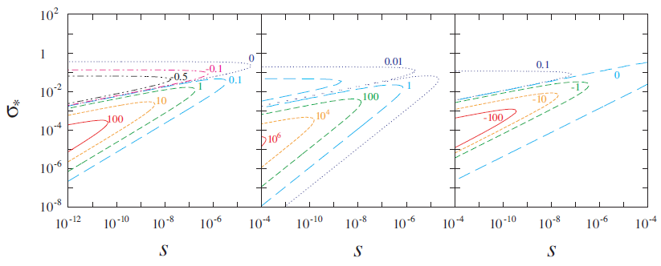
Non-linearity parameters

Slide 34
Summary
We studied primordial fluctuations in models where both the inflaton and the curvaton contribute to the cosmic density fluctuations.
Spectral index, tensor-to-scalar ratio and non-Gaussianity
Very non-Gaussianity can be generated even if the curvaton contribution to the total one is comparable to or smaller than that of the inflaton.
If the curvaton contribution is minor, is enhanced by
compared to .
When , we have the following consistency relations.

Slide 35
Some inflation models already excluded by the data can be liberated due to the curvaton. But in this case, large non-Gaussianity can be generated, which is consistent with the current data.
The effects of the curvaton appears in the combination of .
Hence inflation models with very small such as new inflation are scarcely affected by the curvaton.

