Slide 1
Type II Seesaw Portal and PAMELA/Fermi LAT Signals
Toshifumi Yamada
Sokendai, KEK
In collaboration with Ilia Gogoladze, Qaisar Shafi (Univ. of Delaware) and Nobuchika Okada (Univ. of Alabama)
12/11/2009, HEAP2009@KEK
Paper in preparation, arXiv: 0911.XXXX [hep-ph]

Slide 2
Table of Contents
Introduction
Our Model : Type II Seesaw Portal
Numerical Analysis : Calculation of Cosmic-rays
Conclusions

Slide 3
Introduction

Slide 4
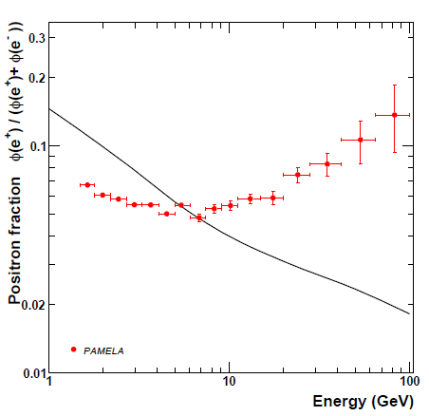
Positron Fraction from PAMELA
Anomalous excess above 10 GeV.

Slide 5
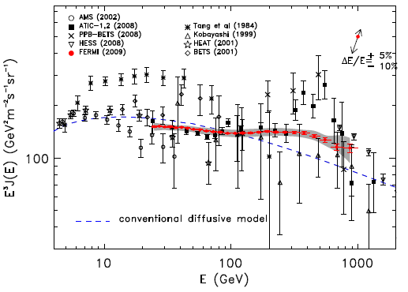
Flux from Fermi
Mild excess in
1000 GeV > E > 10 GeV.

Slide 6
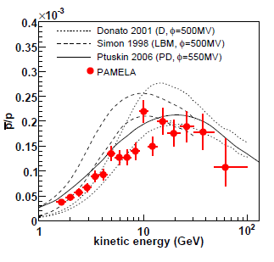
“Leptophilic Dark Matter”
Anti-proton ratio from PAMELA.
No significant excess.
DM decay or ann. into leptons is favored.
“Leptophilic DM”

Slide 7
Our Model : Type II Seesaw Portal
In SM, neutrino mass and dark matter particle are missing.
For a minimal UV completion, we assume
(1) type II seesaw mechanism
(2) a gauge singlet scalar DM

Slide 8
Our Model and PAMELA anomaly
In our model, PAMELA anomaly and its leptophilic nature are naturally explained by DM pair annihilation. (with unknown “boost factor”)
We calculated cosmic-ray positron fraction and flux and compared them with PAMELA/Fermi LAT data.

Slide 9
Our Model

Slide 10
Particle Contents
DM particle = SM singlet scalar :
SU(2) triplet scalar :
SM SU(2) doublet leptons :
SM Higgs :
We assign odd -parity to the DM.

Slide 11
Lagrangian and Potential
Scalar potential
SU(2) doublet lepton + triplet scalar term

Slide 12
Type II Seesaw Mechanism
SU(2) triplet scalar gets vev .
Neutrino mass matrix is .
Precision measurement of -parameter implies
.

Slide 13
DM pair annihilations and decay
We assume so that the left is dominant.
We assume so that the left is dominant.

Slide 14
Dominant mode of DM annihilation
genuinely leptophilic
Cross section is .
DM relic abundance implies .
To explain the PAMELA excess, .
We introduce “boost factor” that enhances the pair annihilation at present.

Slide 15
Boost Factor
Astrophysical origin :
large inhomogeneity of DM distribution
2. Particle Physics origin :
We consider Breit-Wigner enhancement of the process by introducing a -even singlet scalar .
Scalar potential is
.

Slide 16
Boost Factor II
Relevant process is
The cross section for is
If and ,
is enhanced,
while for (at early universe) remains unenhanced.

Slide 17
DM Direct Detection Bound
DM particles do elastic scattering off nuclei.
Current bound is for .
For our model, the relevant process is below.
If and , our model is safely below the bound.

Slide 18
Neutrino Mass Hierarchy
decides the branching ratio of decaying
into , , .
Since
,
neutrino oscillation data indicate
for the normal hierarchy of neutrino masses
,
for the inverted hierarchy
.

Slide 19
Mass of
When mass is near the DM mass, a s produced by DM pair annihilations are almost at rest.
When is much lighter than the DM particle,
the s are Lorentz boosted by .
In the following analysis, we assume two extreme cases :

Slide 20
Spectrum of Primary Leptons from a
For , is almost at rest and the energy spectrum of primary leptons from decay is :
For , is Lorentz boosted by aaa and the energy spectrum of primary leptons from decay is :

Slide 21
Numerical Analysis

Slide 22
Cosmic-ray Flux from DM annihilation
We calculated cosmic-ray flux from DM pair annihilation for various DM particle mass .
With “boost factor” and the normalization of background being free parameters, we fitted PAMELA and Fermi LAT data simultaneously.

Slide 23
Four Cases
We assumed four cases for our calculations.
Neutrino mass hierarchy
Normal hierarchy
Inverted hierarchy
Mass of
s are almost at rest.
s are Lorentz boosted.
(we fixed for our analysis.)

Slide 24
Cosmic-ray Fluxes
propagation in the Galaxy is determined by the static diffusion equation:
background fluxes are

Slide 25
Best Fits
We obtained best fit to PAMELA positron ratio and Fermi LAT flux data for three cases.
i) , normal hierarchy
,
ii) , normal hierarchy
,
iii) , inverted hierarchy
No good fit
iv) , inverted hierarchy
,

Slide 26
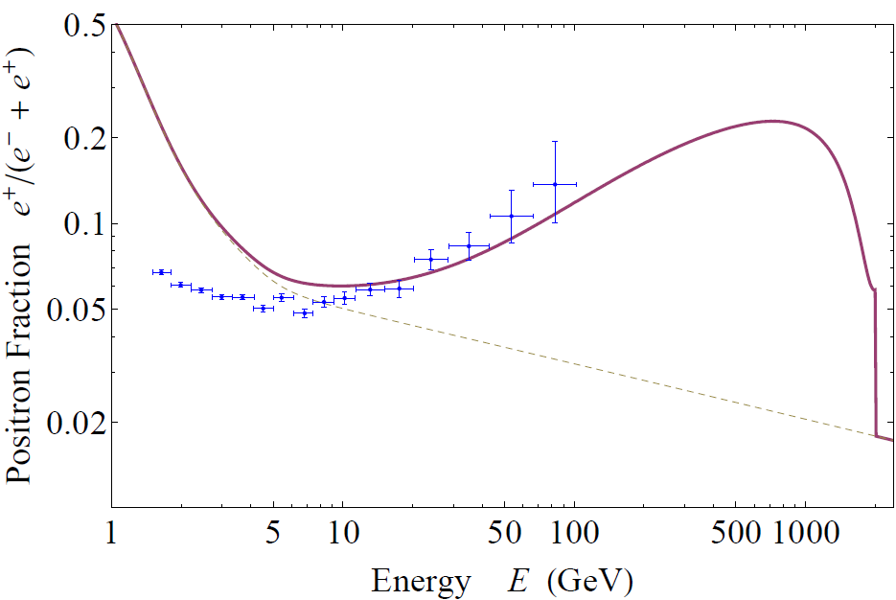
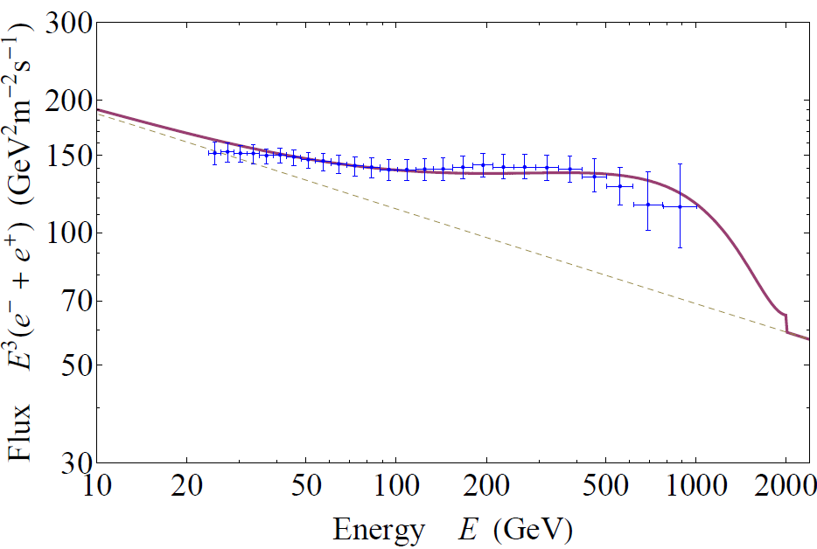
Graphs of Best Fit i)
, , normal hierarchy

Slide 27
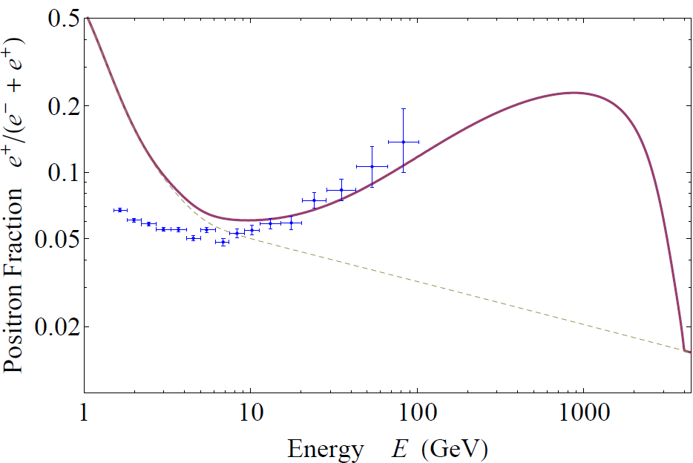
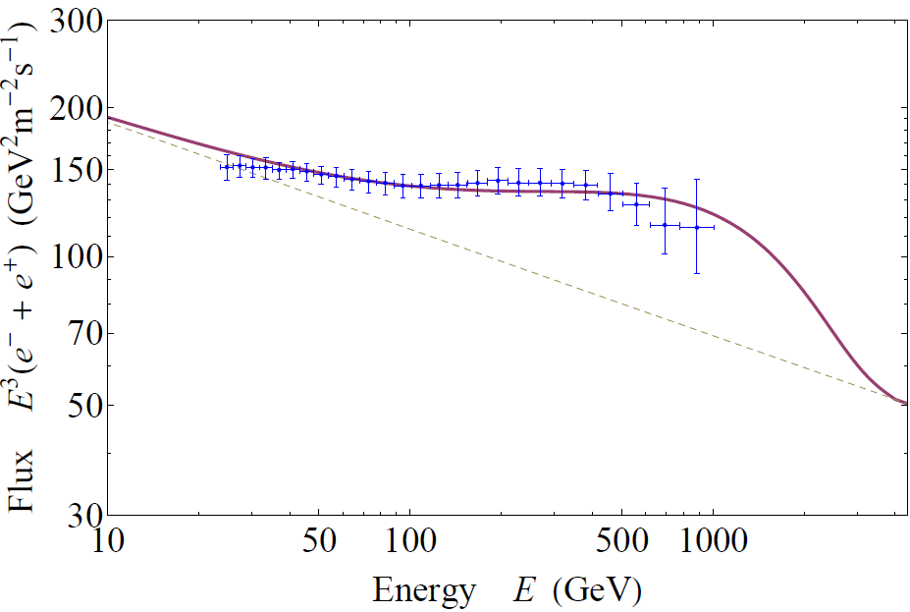
Graphs of Best Fit ii)
, , normal hierarchy

Slide 28
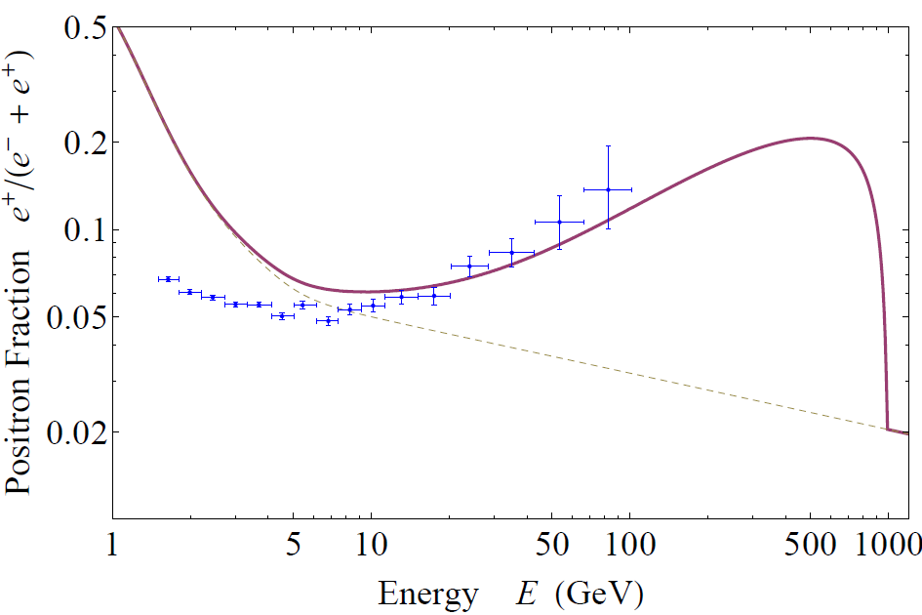
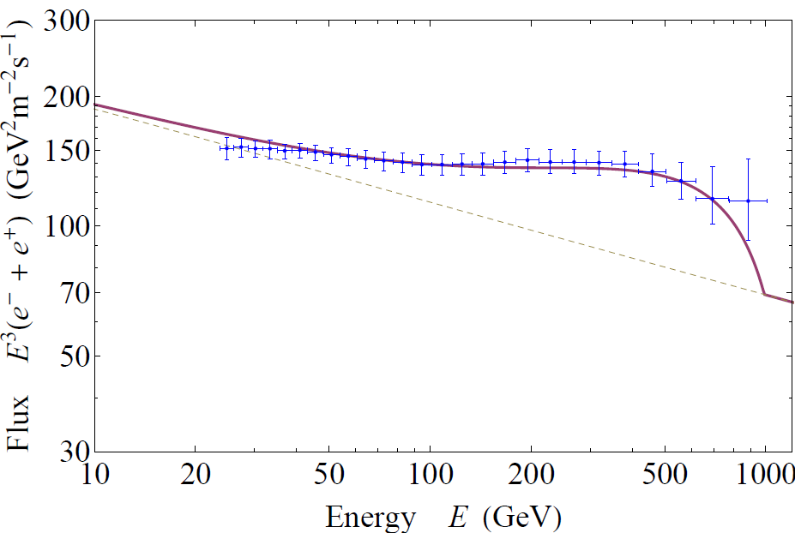
Graphs of Best Fit iii)
, , inverted hierarchy

Slide 29
Bounds on Neutrino Flux at SK
DM pair annihilation produces neutrino, directly or via or decay.
SK measured the flux of upward-going muons induced by cosmic-ray neutrino.
Regions of 3 degree to 30 degree from Galactic Center are observed.
SK data work as an upper bound.

Slide 30
Neutrino Flux of Our Model
In our model, DM pair annihilation produces lepton doublets, i.e. direct neutrinos are produced with the same amount as charged leptons.
Large neutrino flux
The neutrino flux from the Galactic Center depends heavily on DM density profile.
We investigated two cases :
NFW profile
cored isothermal profile with 4kpc core.

Slide 31
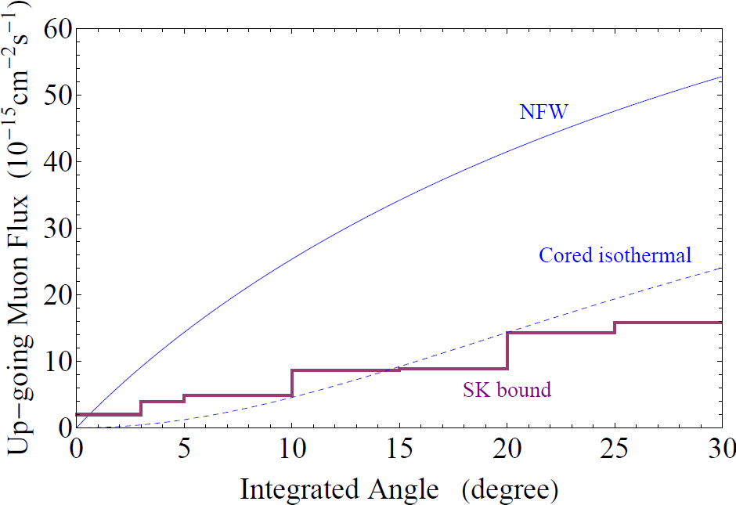
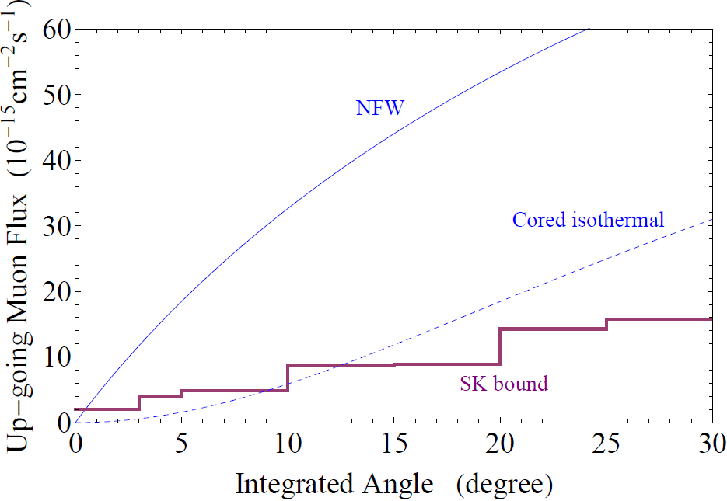
Neutrino Flux vs. SK bound
Case i) , Case ii) ,
, ,
Normal hierarchy Normal hierarchy
The bound is severe in these cases.

Slide 32
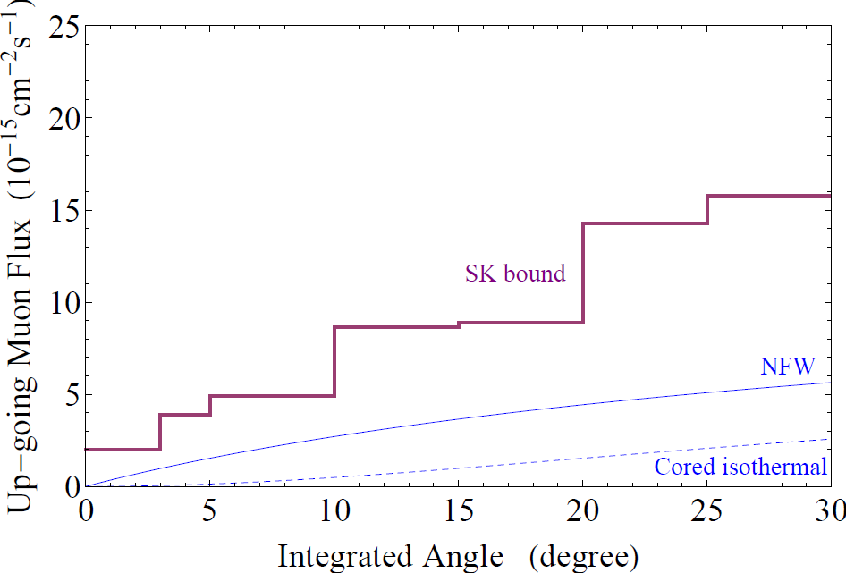
Neutrino Flux vs. SK bound II
Case iii) ,
,
inverted hierarchy
The flux is safely below the SK bound because DM mass is comparatively light, and the best fit value of “boost factor” is also small.
inverted hierarchy case is favored

Slide 33
Cosmic Gamma-ray of Our Model
Our model produces large gamma-ray flux through inverse compton scattering of with interstellar radiation field, that with extra-galactic CMB and hadronic decay.
Of these, contribution from hadronic decay is dominant for .
Gamma-ray flux of hadronic decay a from regions other than GC is almost free from astrophysical uncertainties. a (ISRF distribution, DM density profile, …)

Slide 34
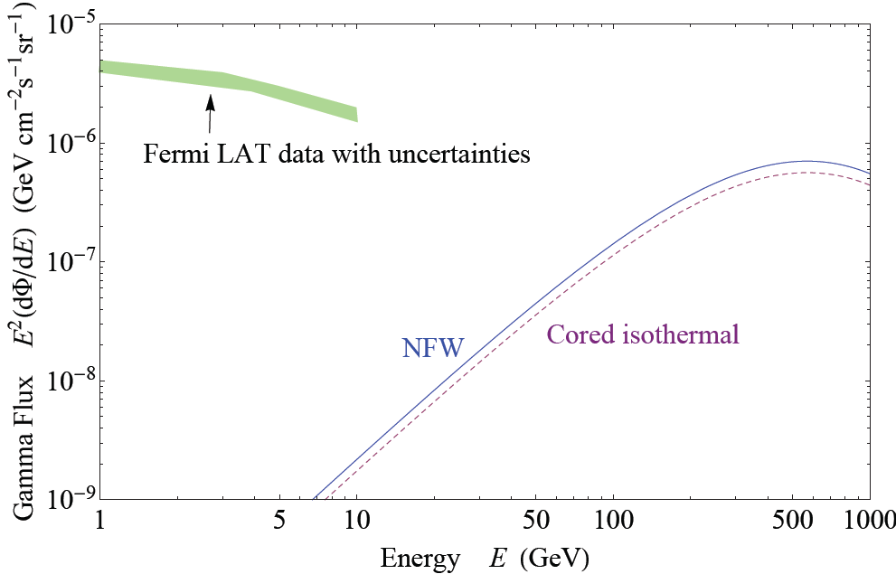
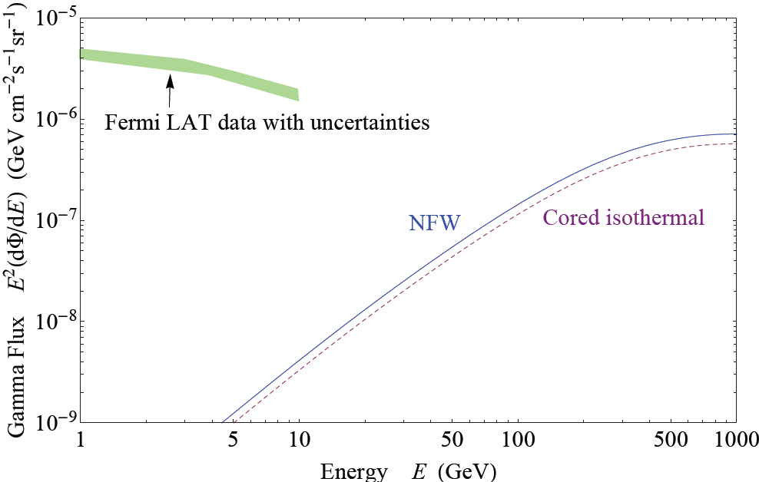
Gamma-ray Flux vs. Fermi LAT
Fermi LAT measured gamma-ray from the region a , (avoiding GC) . We compare gamma-ray from hadronic decay of our model with current Fermi LAT data.
Case i) Case ii)

Slide 35
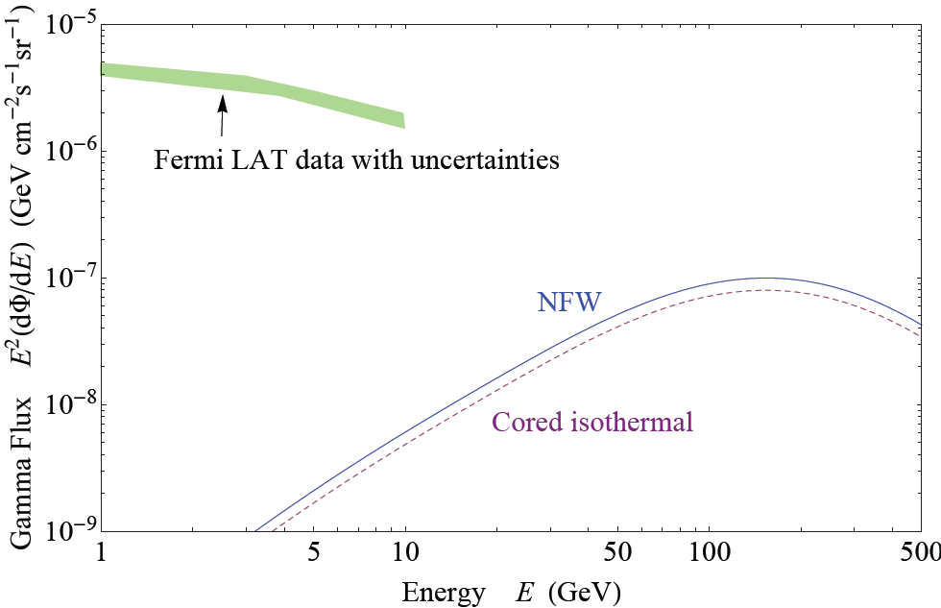
Gamma-ray Flux vs. Fermi LAT II
Case iii)
Future measurement of gamma-ray flux may discover the peak of hadronic decay.

Slide 36
Conclusions

Slide 37
We built a minimal UV completion of SM by adding type II seesaw mechanism and gauge singlet scalar DM.
This model naturally induces leptophilic DM.
PAMELA anomaly and Fermi LAT data can be explained by DM pair annihilation with “boost factor” and subsequent decay into leptons.
Because of type II seesaw mechanism, flavor structure of primary lepton flux is related to neutrino mass pattern.

Slide 38
We calculated cosmic-ray flux with the assumptions that or and normal or inverted hierarchy for neutrino masses.
We found that inverted neutrino mass hierarchy and light can give a good fit to PAMELA and Fermi LAT data without tension with SK neutrino flux bound.
inverted hierarchy is favored.

