Slide 1
(Concluding) Remarks
KEK Workshop on Hadron Physics with high-momentum beams at J-PARC
2013.1.15-18
Ken Imai (JAEA/J-PARC)

Slide 2
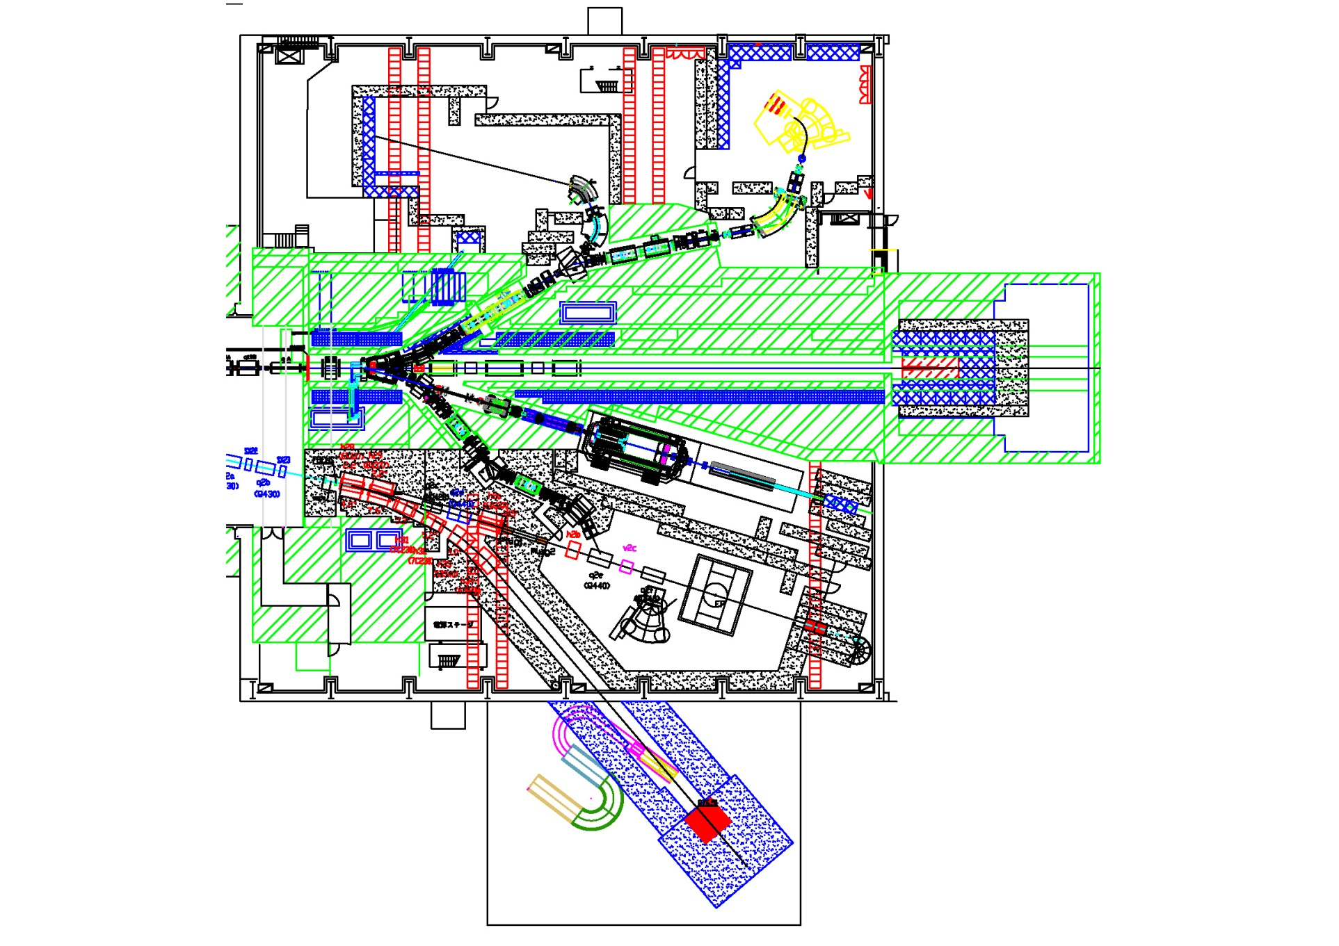
Hadron Hall at J-PARC

Slide 3
High-momentum beams at J-PARC
High momentum-beam line was an important part of the project when the J-PARC (JHF) was proposed in late 90s. Int. workshop on hadron physics in 1966.
The construction of the beam line was postponed because of budget shortage. ( not many hadron physics proposals )
Now it is a time to start the construction of the high-momentum beam line.
Congratulations for the budget approval !!
We need good physics programs.

Slide 4
Proposals to J-PARC at PAC
P04: Measurement of High-Mass Dimuon Production at the 50-GeV Proton Synchrotron Spokespersons: J.C. Peng (U. Illinois, USA), S. Sawada (KEK, Japan)
E16: Electron pair spectrometer at the J-PARC 50-GeV PS to explore the chiral symmetry in QCD Spokesperson: S. Yokkaichi (RIKEN, Japan)
P50: Charmed baryon spectroscopy via the (p, D*) reaction
spokesperson: H.Noumi (Osaka)

Slide 5
Possible physics at the high-momentum beam line discussed in this workshop
Nucleon structure physics
Drell-Yan, GPD, spin asymmetry
Hadron spectroscopy
charm (baryons)
Hadrons and hadron interactions in nuclear medium
chiral / color properties

Slide 6
Hyperon spectroscopy
Λ(1405) ½- exotic baryon, kaonic nuclei
Is there Λ(1405) analogue of Ξ* and Ω* ?
PDG statement on Ξ*
“Nothing of significance on Ξ resonances has been added since our 1988 edition.”
Same for Ω resonances !
No ½- states identified. No spin parity identified Ω*
-> high momentum K beam

Slide 7
Λ(1405) analogue for Ω*
Ω* ½- Is it below or above ΞK (1815MeV) ?
If it is below ΞK, it should have very narrow width. Ω*->Ωπ is forbidden by isospin.
It can be ΞK bound state and
Main decay mode is Ω*-> Ωγ (unique !)

Slide 8
High-momentum beam line at J-PARC will be an important resource for international hadron physics community
J-PARC PAC encourages to have international workshops to enhance physics programs with high-momentum beams.
This workshop is the important step.
It is important to have “interactions” with 12GeV Jlab, FAIR, COMPASS,,, to produce complimentary and competitive physics.

Slide 9
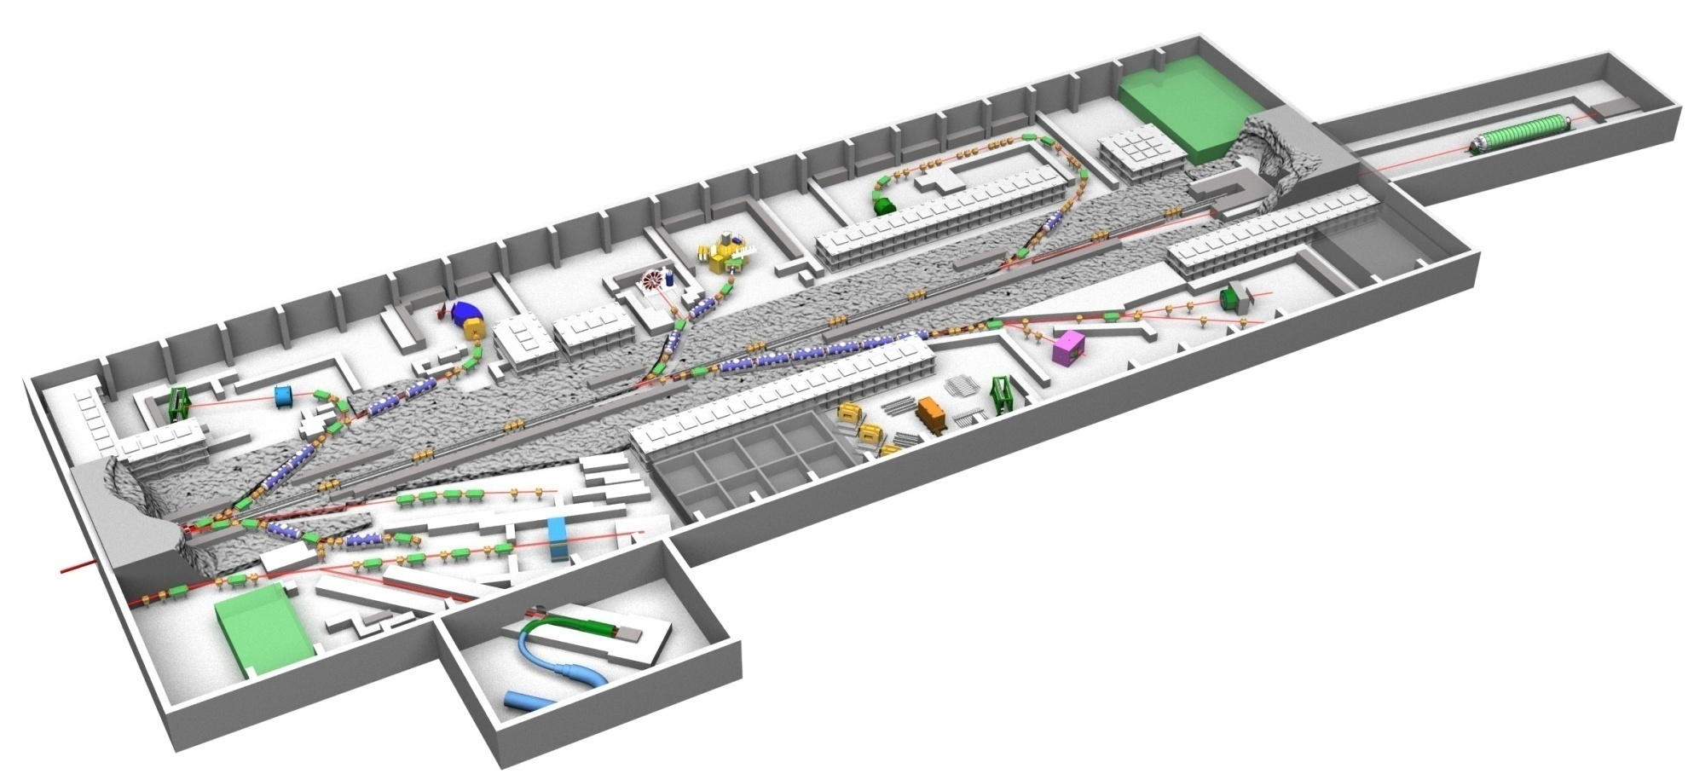
Extension of Hadron Hall
(Original Plan)

Slide 10
Phase 1 and Phase 2
(as of 2001)
1) Budget and Schedule
  Phase 1 + Phase 2 = 1,890 Oku Yen (= $1.89 billion if $1 = 100 Yen).
  Phase 1 = 1,335 Oku Yen for 6 years (= 2/3 of 1,890 Oku Yen).
  JAERI = 865 Oku Yen (≅ 2/3), KEK = 470 Oku Yen (≅ 1/3).

Slide 11
Let us thank the organizers
S. Kumano, O.Morimatsu, S.Sawada
Let us thank Ms. Reiko Kusama for her help

Slide 12
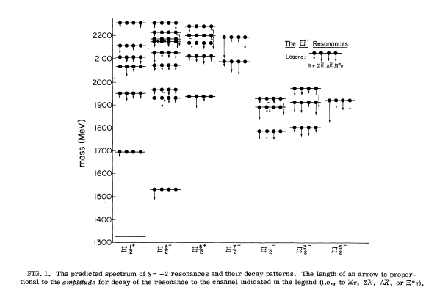
Ξ* quark model: Chao, Isgur, Karl PRD 23 (1981)
Ξ(1690)J^{P}?
Ξ(1530)3/2+
Ξ(1820)3/2-
Λ(1520)3/2-
Λ(1405)1/2-

Slide 13

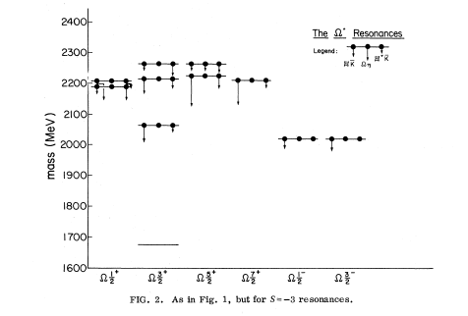
Observed states
Ω(2250) Jp?
Ω(2380) Jp?
Ω(2470) Jp?
No Ω* near 2000 MeV ?

