Slide 1
High-Energy Hadron Physics with Dilepton Production
Jen-Chieh Peng
University of Illinois at Urbana-Champaign
KEK Theory Center Workshop on “Hadron Physics with High-Momentum Hadron Beams at J-PARC” KEK, January 15-18, 2013

Slide 2
Challenge and opportunities of dilepton experiments at J-PARC
Challenge
  Beam energies are relatively low (30-50 GeV ptoton, and secondary pion, kaon, antiproton at lower energies)
Opportunities
  Very few existing data at this energy region
  Some novel hadron physics topics could be well studied at relatively low energies
  Polarized beam/target offers new possibilities

Slide 3
Dilepton production in hadron-hadron collision
p + p(d) → μ⁺μ⁻ x at 800 GeV/c
Two components in the dilepton mass spectrum
(a) Continuum: Drell-Yan process
FNAL E866
(b) Vector mesons: J/ψ, Υ

Slide 4
Complimentality between DIS and Drell-Yan
DIS
Drell-Yan
Ann.Rev.Nucl. Part. Sci. 49 (1999) 217
Both DIS and Drell-Yan process are tools to probe the quark and antiquark structure in hadrons (factorization, universality)
4

Slide 5
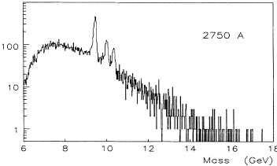
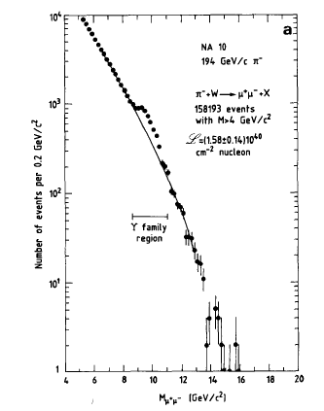
Lepton-pair production provides unique information on parton distributions
Probe antiquark distribution in nucleon
Probe antiquark distribution in pion
Probe antiquark distributions in antiproton
Unique features of D-Y: antiquarks, unstable hadrons…

Slide 6
Fermilab E866

Slide 7
Meson Cloud Models
Chiral-Quark Soliton Model
Instantons
nucleon = chiral soliton
expand in 1/Nc
Quark degrees of freedom in a pion mean-field
(For reviews, see Speth and Thomas (1997), Kumano Phys Report (hep-ph/9702367)
These models also have implications on
asymmetry between and
flavor structure of the polarized sea
Meson cloud has significant contributions to sea-quark distributions
7

Slide 8
Implications on the “intrinsic” quark sea
In 1980, Brodsky, Hoyer, Peterson, Sakai (BHPS) suggested the existence of “intrinsic” charm
“extrinsic”
“intrinsic”

Slide 9
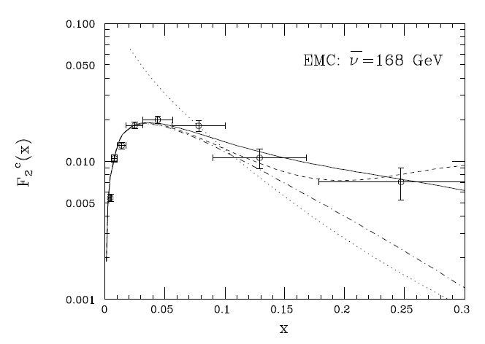
Evidence for the “intrinsic” charm (IC)
DIS data
Λ_{c} production
With IC
With IC
No IC
No IC
Gunion and Vogt (hep-ph/9706252)
(Evidence is subjected to the uncertainties of charmed-quark parametrization in the PDF)
9

Slide 10
A global fit by CTEQ to extract intrinsic-charm
Blue band corresponds to CTEQ6 best fit, including uncertainty
Red curves include intrinsic charm of 1% and 3% (χ² changes only slightly)
No conclusive evidence for intrinsic-charm
10

Slide 11
Search for the lighter “intrinsic” quark sea
No conclusive experimental evidence for intrinsic-charm so far
The 5-quark states for lighter quarks have larger probabilities!
11

Slide 12
How to separate the “intrinsic sea” from the “extrinsic sea”?
Select experimental observables which have no contributions from the “extrinsic sea”
“Intrinsic sea” and “extrinsic sea” are expected to have different x-distributions
  Intrinsic sea is “valence-like” and is more abundant at larger x
  Extrinsic sea is more abundant at smaller x

Slide 13
How to separate the “intrinsic sea” from the “extrinsic sea”?
Select experimental observables which have no contributions from the “extrinsic sea”
=

Slide 14
The data are in good agreement with the 5-q model after evolution from the initial scale μ to Q²=54 GeV²
The difference in the two 5-quark components can also be determined
(W. Chang and JCP , PRL 106, 252002 (2011))

Slide 15
How to separate the “intrinsic sea” from the “extrinsic sea”?
“Intrinsic sea” and “extrinsic sea” are expected to have different x-distributions
  Intrinsic sea is “valence-like” and is more abundant at larger x
  Extrinsic sea is more abundant at smaller x

Slide 16

HERMES collaboration, Phys. Lett. B666, 446 (2008)

Slide 17
This allows the extraction of the intrinsic sea for strange quarks
(W. Chang and JCP, PL B704, 197(2011))
17

Slide 18
How to separate the “intrinsic sea” from the “extrinsic sea”?
Select experimental observables which have no contributions from the “extrinsic sea”

Slide 19
(W. Chang and JCP, PL B704, 197(2011))

Slide 20
Extraction of the various five-quark components for light quarks

Slide 21
Future Prospect (Experimental)
dbar-ubar for large x region at the Fermilab E906 andd J-PARC Drell-Yan experiments.
Kaon production in SIDIS at COMPASS and 12 GeV Jlab/EIC for more information on s and s-bar?
Kaon-induced Drell-Yan at J-PARC for probing s and s-bar?
Open-charm production at forward rapidity at RHIC and LHC.
J/ψ production at forward x_{F} in p-A collision at J-PARC?

Slide 22
DY cross section is ~ 16 time larger at 50 GeV than at 800 GeV
J-PARC P-04 (Peng and Sawada)

Slide 23
Revisit the NMC measurement of the Gottfried Sum rule
The Gottfried Sum Rule
New Muon Collaboration (NMC) obtains
S_{G} = 0.235 ± 0.026
( Significantly lower than 1/3 ! )

Slide 24
E866
NMC
(W.C. Chen, K.F. Liu, JCP)

Slide 25
Modification of Parton Distributions in Nuclei
EMC effect observed in DIS
(Ann. Rev. Nucl. Part. Phys., Geesaman, Sato and Thomas)
F₂ contains contributions from quarks and antiquarks
How are the antiquark distributions modified in nuclei?

Slide 26
Drell-Yan on nuclear targets
The x-dependence of can be directly measured

Slide 27
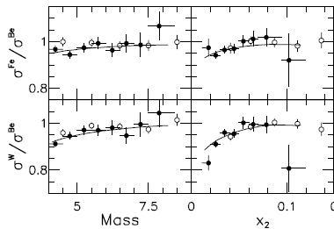
Drell-Yan on nuclear targets
PRL 64 (1990) 2479
PRL 83 (1999) 2304
The Drell-Yan data place strong constraints on EMC models

Slide 28
Modification of Antiquark Distributions in Nuclei
Nuclear dependence of Drell-Yan at larger x at J-PARC?
J-PARC P-04 (Peng and Sawada)

Slide 29
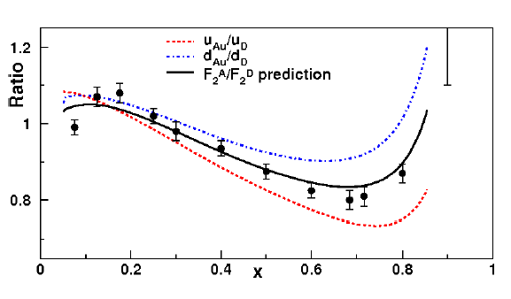
Flavor dependence of the EMC effects ?
Isovector mean-field generated in Z≠N nuclei can modify nucleon’s u and d PDFs in nuclei
Cloet, Bentz, and Thomas, arXiv:0901.355 (see also Kumano et al.)
SIDIS (Semi-inlusive DIS) and PVDIS (Parity-violating DIS)
Pion-induced Drell-Yan
29

Slide 30
Pion-induced Drell-Yan and the flavor-dependent EMC effect
160 GeV pion beam
(D. Dutta, JCP, Cloet, Gaskell)
Drell-Yan data from COMPASS and J-PARC with pion beams could provide important new information

Slide 31
Decay Angular Distribution of “naïve” Drell-Yan:
Drell-Yan angular distribution
Data from Fermilab E772

Slide 32
Forward-backward asymmetry in decay angular distribution of Drell-Yan:
Parity violation in Drell-Yan?
Parity violation in D-Y can probe Weinberg angles at low Q²

Slide 33
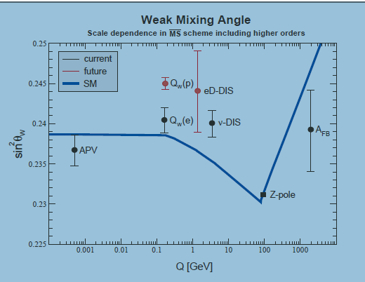
Forward-backward asymmetry in decay angular distribution of Drell-Yan:
Parity violation in Drell-Yan?
Parity violation in D-Y can probe Weinberg angles at low Q² (Never been studied yet)

Slide 34
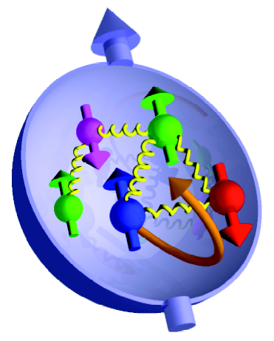
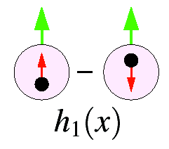
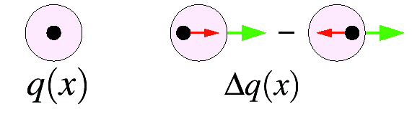
Polarized Drell-Yan with polarized proton beam?
Polarized Drell-Yan experiments have never been done before
Provide unique information on the quark (antiquark) spin
Quark helicity distribution
Quark transversity distribution

Slide 35
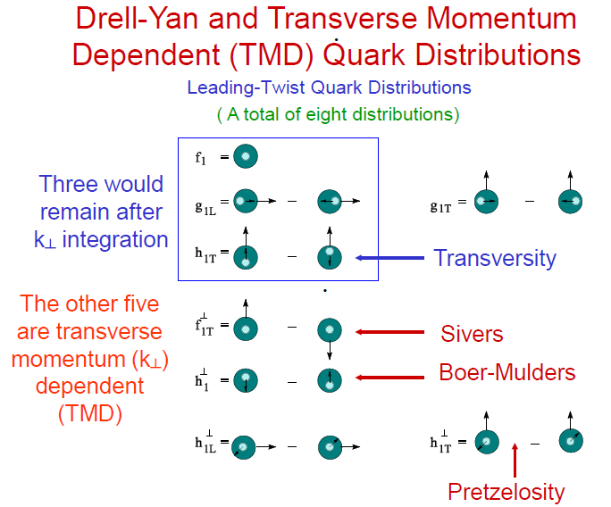

Slide 36
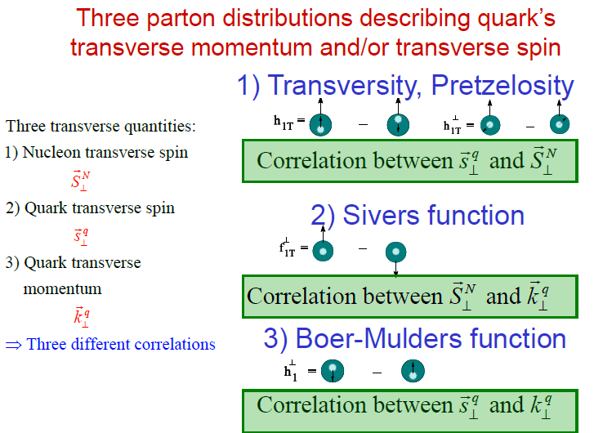

Slide 37
Transversity and Transverse Momentum Dependent PDFs are also probed in Drell-Yan
37

Slide 38
Azimuthal cos2Φ Distribution in $π$+W and p+d Drell-Yan
E866 Collab., Lingyan Zhu et al., PRL 99 (2007) 082301; PRL 102 (2009) 182001
Boer-Mulders function from unpolarized DY
Largeνis observed for pion DY,but small ν for proton DY
Sea-quark BM functions are much smaller than valence quarks
Can be further explored at J-PARC
38

Slide 39
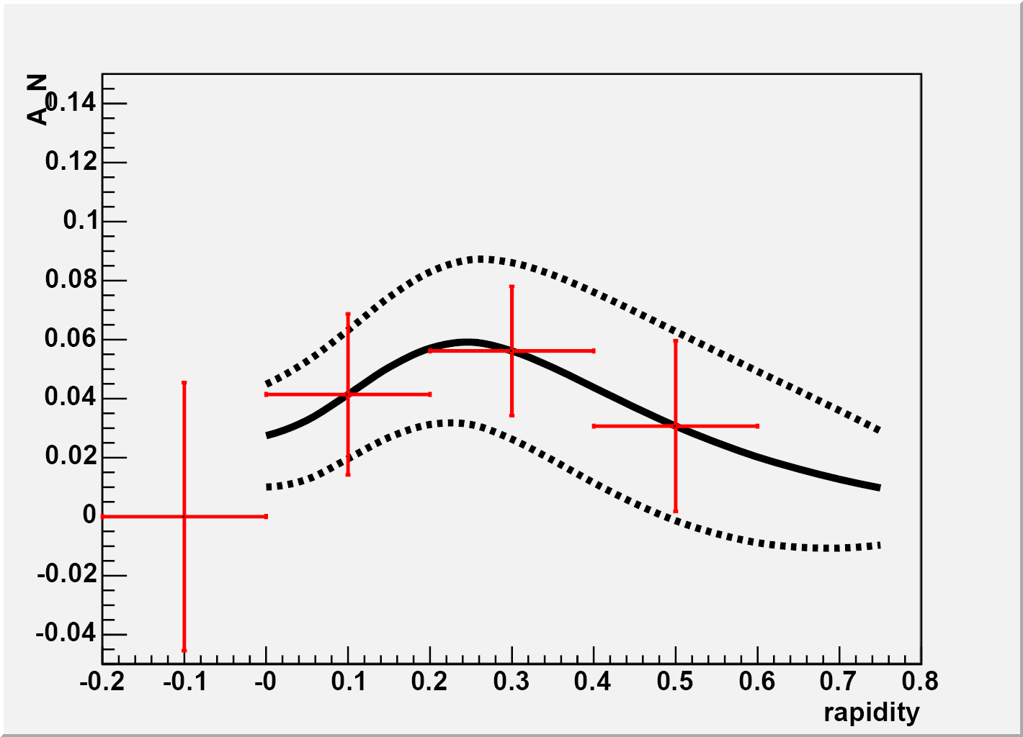
Spin physics with dimuons at J-PARC
(See Y. Goto’s talk)
Single-spin asymmetry (A_{N}) measurements for orbital angular momentum
  Drell-Yan, J/Ψ
D-Y A_{LL} at 50 GeV
G-S
GRSV
Other measurements
  Drell-Yan A_{LL} for sea-quark polarization
  Drell-Yan A_{TT} for transversity
  Unpolarized Drell-Yan for Boer-Mulders function
  A_{LL} for J/Ψ for gluon polarization
Drell-Yan A_{N} (Ji et al.)
sensitive to Sivers effect at low q_{T} << Q
sensitive to higher-twist effect at high q_{T} ~ Q
Sivers function in Drell-Yan is expected to have a sign opposite to that in DIS.

Slide 40
Outstanding questions to be addressed by future Drell-Yan experiments
Does Sivers function change sign between DIS and Drell-Yan?
Does Boer-Mulders function change sign between DIS and Drell-Yan?
Are all Boer-Mulders functions alike (proton versus pion Boer-Mulders functions)
Flavor dependence of TMD functions
Independent measurement of transversity with Drell-Yan
Can be studied at COMPASS, RHIC, FAIR, JPARC, JINR, etc

Slide 41
J/Ψ Production at 30 GeV
At 800 GeV, J/Ψ production is dominated by gluon-gluon fusion
At 30 GeV J/Ψ production is dominated by quark-antiquark annihilation
J/Ψ production at 30 GeV is sensitive to quark and antiquark distributions

Slide 42
Summary
The Drell-Yan process is a powerful experimental tool complimentary to the DIS for exploring quark structures in nucleons and nuclei.
A rich physics program in Drell-Yan and J/Ψ production can be pursued at J-PARC.
Unique information on flavor structures of quarks and quark sea, and on the novel transverse-momentum dependent parton distributions can be obtained with Drell-Yan experiments.

