Slide 1
Modeling SNS Availability Using BlockSim
Geoffrey Milanovich
Spallation Neutron Source

Slide 2
Contributors
G. Dodson for providing initial reliability study and discussion
Vivian Chang (summer student from Carnegie Mellon) for building much of the accelerator reliability block diagram

Slide 3
Outline
SNS Availability Numbers
Modeling an Entire Accelerator in BlockSim
Modeling Klystron End of Life Behavior

Slide 4
Availability for Last 2 Runs
FY12 Availability – 93.6%
Notes:
FY average – 93.6%, run average 93.1%, commitment 90%

Slide 5
FY 12 Downtime by Group

Slide 6
Neutron Production Hrs, MWhrs, & Downtime by Year

Slide 7
Downtime by Fiscal Year (07-12) Comparison
Presentation_name

Slide 8
Reliability Estimates, in the Beginning
“the spreadsheet” – numbers from industry, design specs, LANL, JLab, experts, and guesses
Exponential distributions only (constant failure rate)
For 160 hours mission time, availability:
Source – 87%
Linac – 80%
Modulators – 99%
Overall - ??
Notes:
160 hrs is 6.67 days, 20 shifts, 1 week

Slide 9
RBD/BlockSim Advantages
Reliability Block Diagram (RBD) – “graphical representation of the components of the system and how they are reliability-wise related”
Many failure distributions allowed
Standby, load share, failure of switching to standby
Analytical solution of very complex diagrams (but not an accelerator)
Monte Carlo simulation – maintenance phases, spares, crews
Notes:
Weibull, Gumbel, Gamma, Exponential, Normal, Logistic, Arrhenius-Weibull
Fast! 1000 simulations of 4 weeks on 4 yr old Macbook Pro running Vista in Parallels < 4 minutes

Slide 10
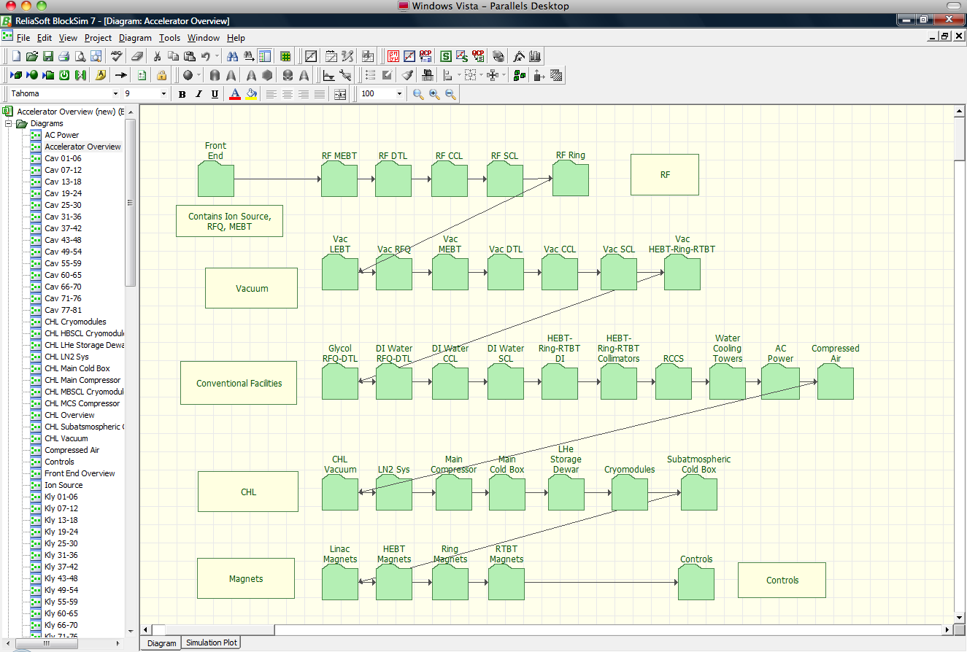
BlockSim 7/8 Model

Slide 11
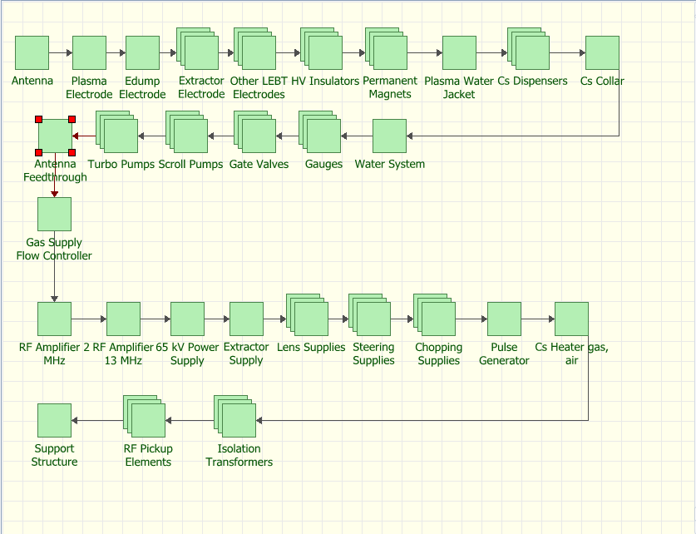
Ion Source

Slide 12
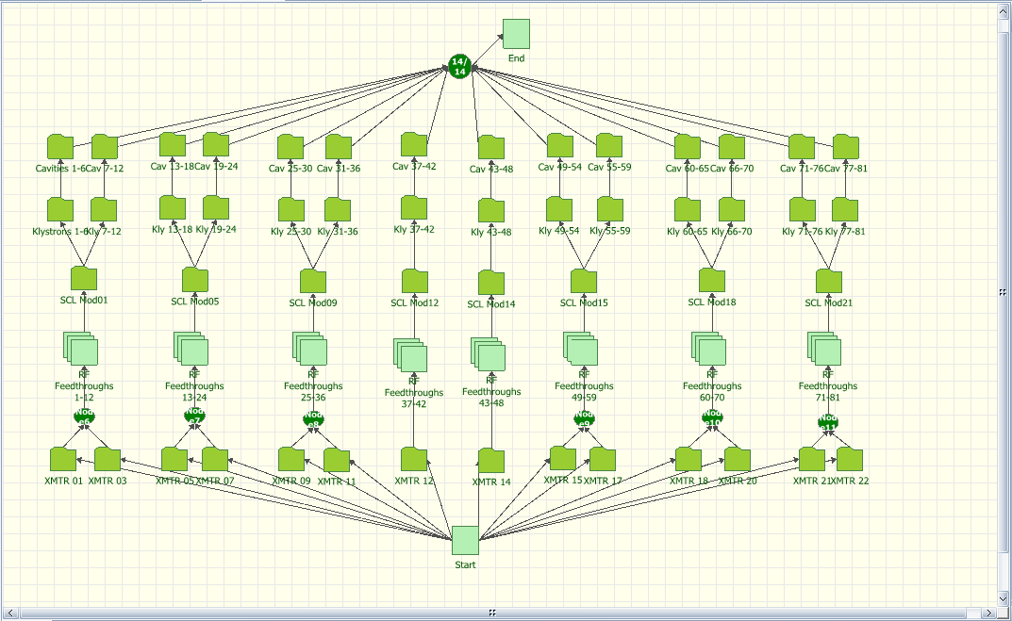
RF Systems

Slide 13
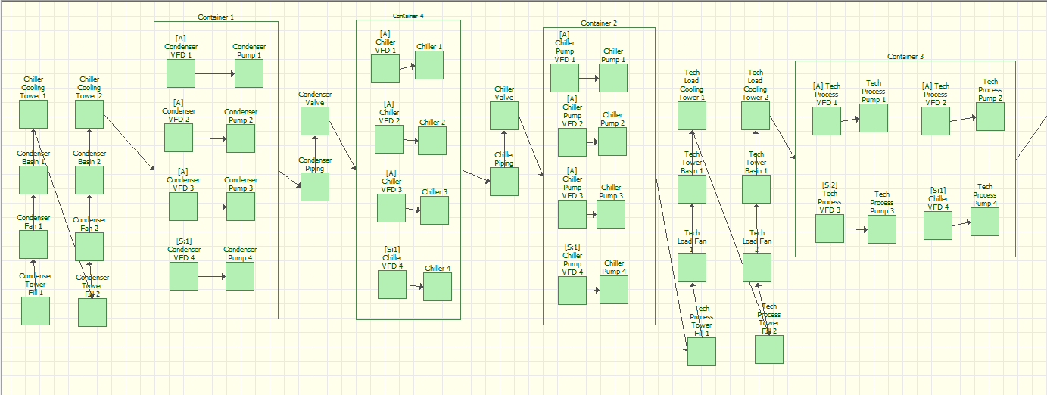
Standby Containers

Slide 14
Full Accelerator Simulation Results
Used exponential distributions (random failures)
86% - corrector power supplies, circulators, PPS modules, water valves, JT valves, etc.
Change values for PS controllers and circulators from 50k to 100k
89% - RF feedthroughs, JT valves, etc.
Change RF feedthrough from 100k to 4m (1 every 7 years), JT valves from 87k to 400k (1 every 5 years), etc
92% - Finally! But only for 1 seed

Slide 15
Klystron Spares Study
805 MHz, 550 (700) kW peak, 50 kW average power, 1.5 ms pulse length, 9% duty cycle
M type cathode, 0.6-0.7 A/cm² density, manufacturer predicted lifetime > 100,000 hours
81 in service, 70 with ~40000 hours on filament
How many spares to order and how quickly?
Notes:
2.8 million hours total. 6200 hrs operation per year. Efficiency 67%, gain 51 dB. SLAC klystrons – 2856 MHz, 65 MW peak, 41 kW average, 3.5 us gain 50 dB, efficiency 45%, density 8 A/cm^2

Slide 17
Weibull Distribution Parameters
Beta – “Shape” Parameter
Eta – “Scale” Parameter

Slide 18
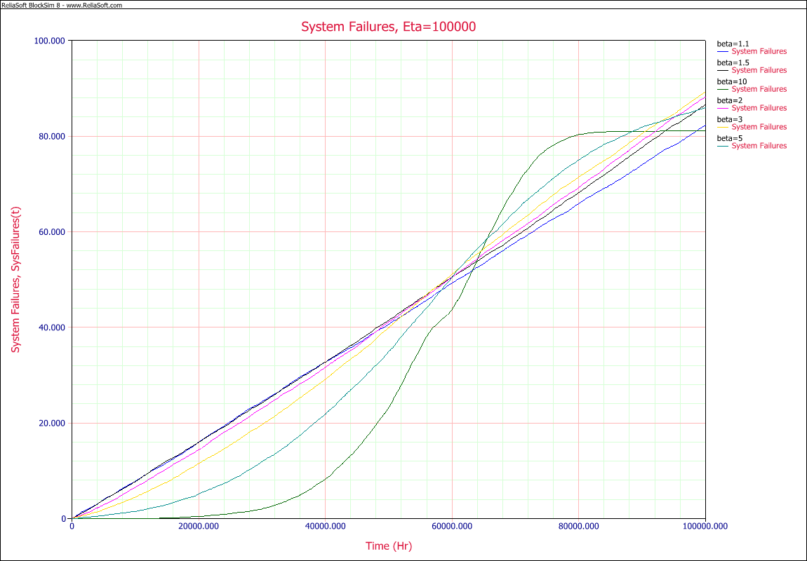
Klystron failures, different values of β
Notes:
Assuming we are at 40k hours already

Slide 19
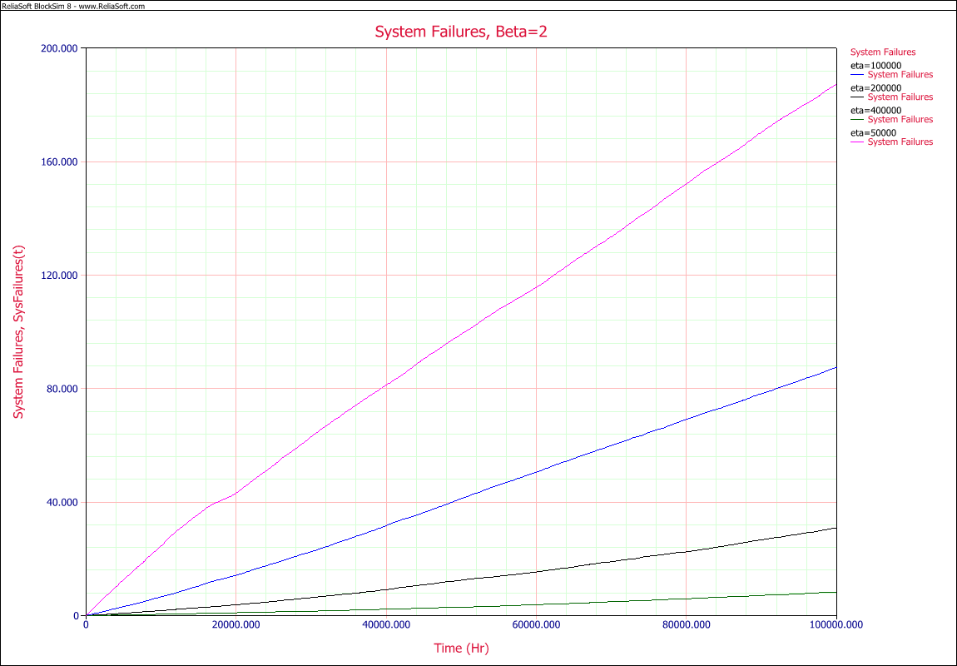
Klystron failures, different values of η
Notes:
Assuming we are at 40k hours already

Slide 20
Cathode Life Time
M,CD (Alloy)
MM, SCANDATE
B,S
Dispenser Cathodes: The Current State of the Technology
L. R. Falce, Hughs Aircraft Company, Electron Dynamics Division, IEDM 83

Slide 21
Conclusions
SNS is middle aged - how long will it last?
We still can not predict the wear-out curve – until it begins! But we can model maintenance plans
Cathode lifetime may not be a major concern
Klystron spares can be ordered at a steady rate

