Slide 1
Moving a cyclotron control room from old to new location with no lost time

Slide 2
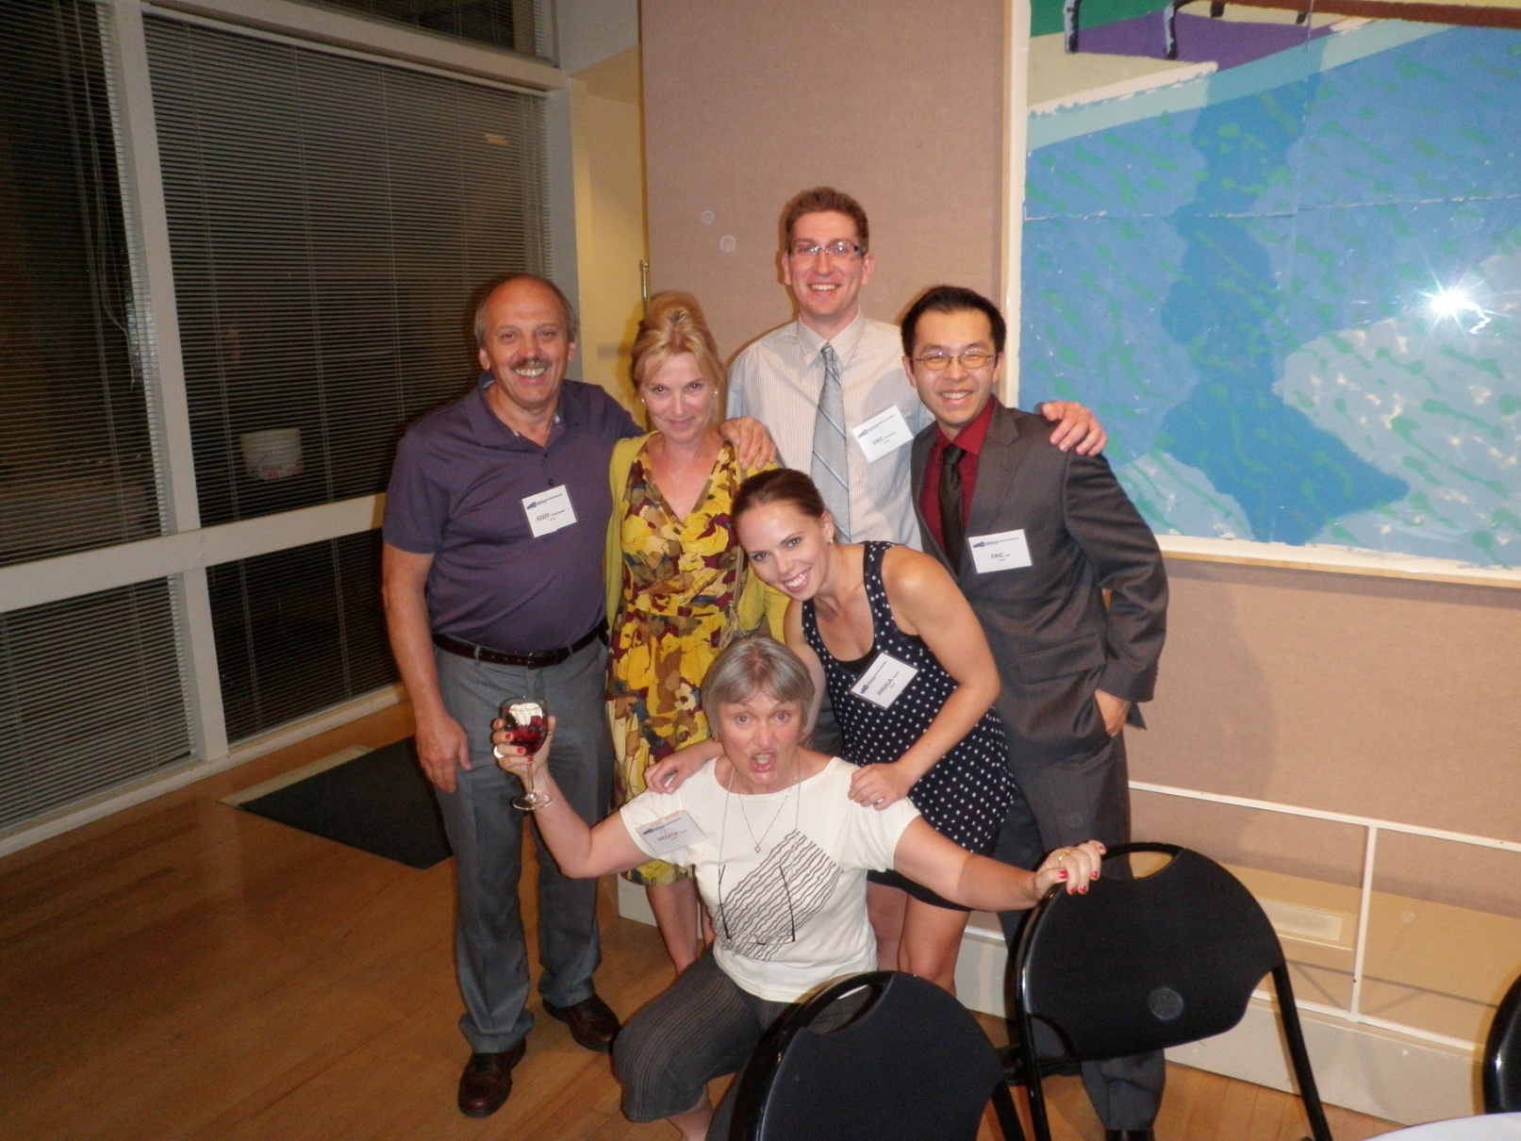
Introduction

Slide 3
Applied Technology Group
Introduction – who we are, what we do?
Why do we needed a new control room?
Cyclotron control room move preparation
Cyclotron control room move
Verification, validation
Conclusion

Slide 4
Introduction

Slide 5
Applied Technology Group
ATG is a TRIUMF’s group operating three cyclotrons
ATG provides irradiation services for commercial company NORDION
Beam is used for production of the several isotopes for medical application

Slide 6
Applied Technology Group
We operate three cyclotrons:
CP42, 42 MeV up to 200 µAmp – 1981
TR30-1, 30 MeV up to 1 mAmp – 1991
TR30-2, 30 MeV up to 1 mAmp – 2003
Small group – 30 people, we operates, maintain/repair all our system as well as we design and build equipment

Slide 7
Three distinctive stages:
1980 – first cyclotron - CP42
1991 – second cyclotron – TR30-1
2003 – third cyclotron – TR30-2

Slide 8
Why do we needed a new control room?

Slide 9
The simple answer is:
the old one is too small

Slide 10
The old control room problems:
Too small
Hallway
Located in the evacuation zone

Slide 11
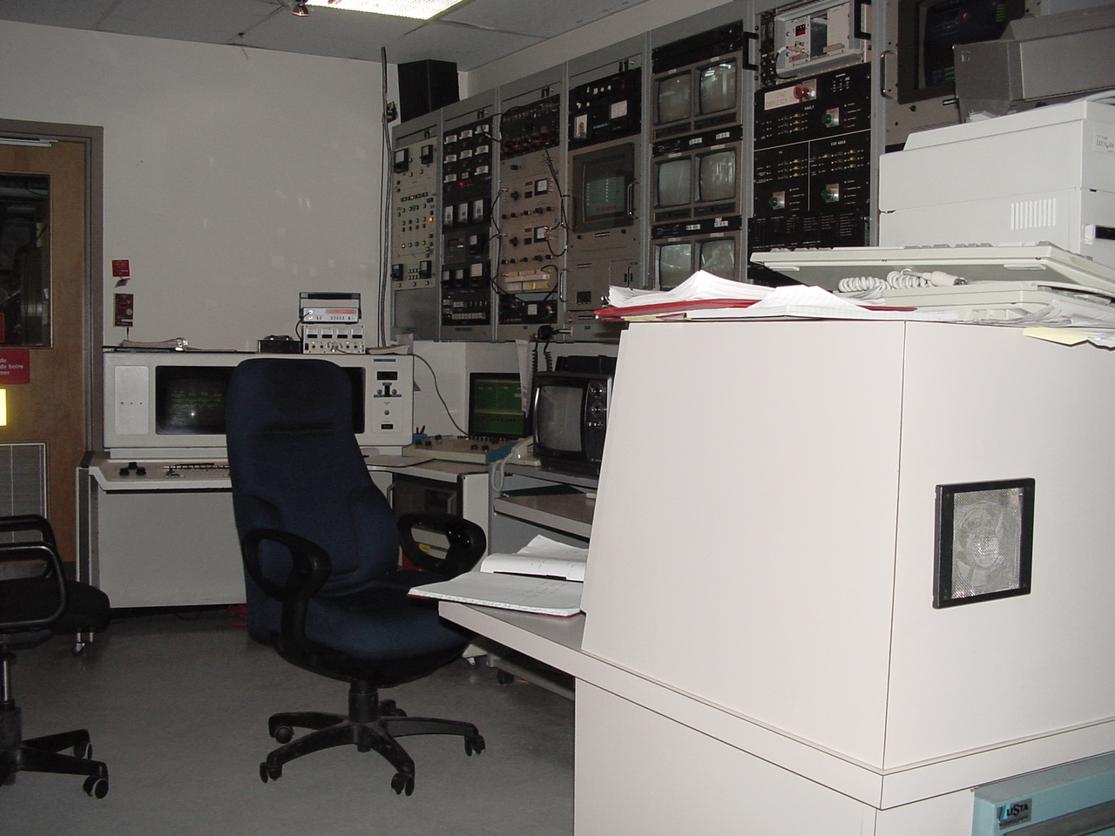
Old control room

Slide 12
Cyclotron control room move preparation

Slide 13
There was only one requirement:
Move it fast

Slide 14
Preparation:
Inventory of the modifications
Planning the modifications
using the cyclotrons maintenance days
Identifying needed equipment
Implementing the modifications
Regulatory requirements

Slide 15
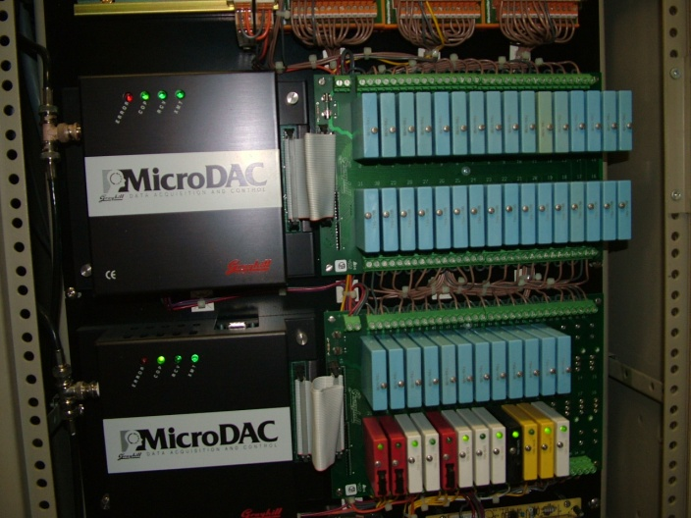
Grey Hill PLC

Slide 16
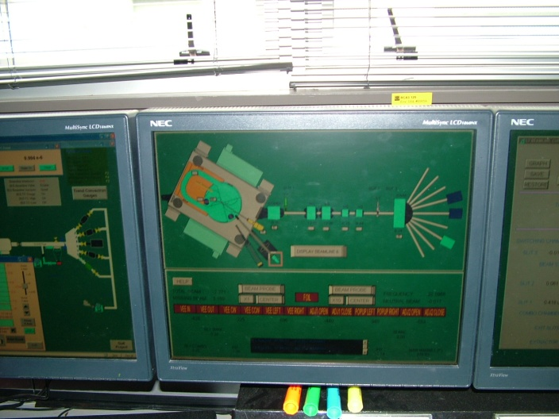
Iconic Genesis for Windows HMI

Slide 17
Regulatory requirements:
Human Factors Engineering Report
Verification and validation

Slide 18
Human Factors Engineering Report
Human Machine Interface Systems
Job Design
Operating Experience Review
Physical Working Environment
Human Reliability
Shift Work Systems and Staffing
Validation
Verification

Slide 19
Move into new control room
Fast
Painless

Slide 20
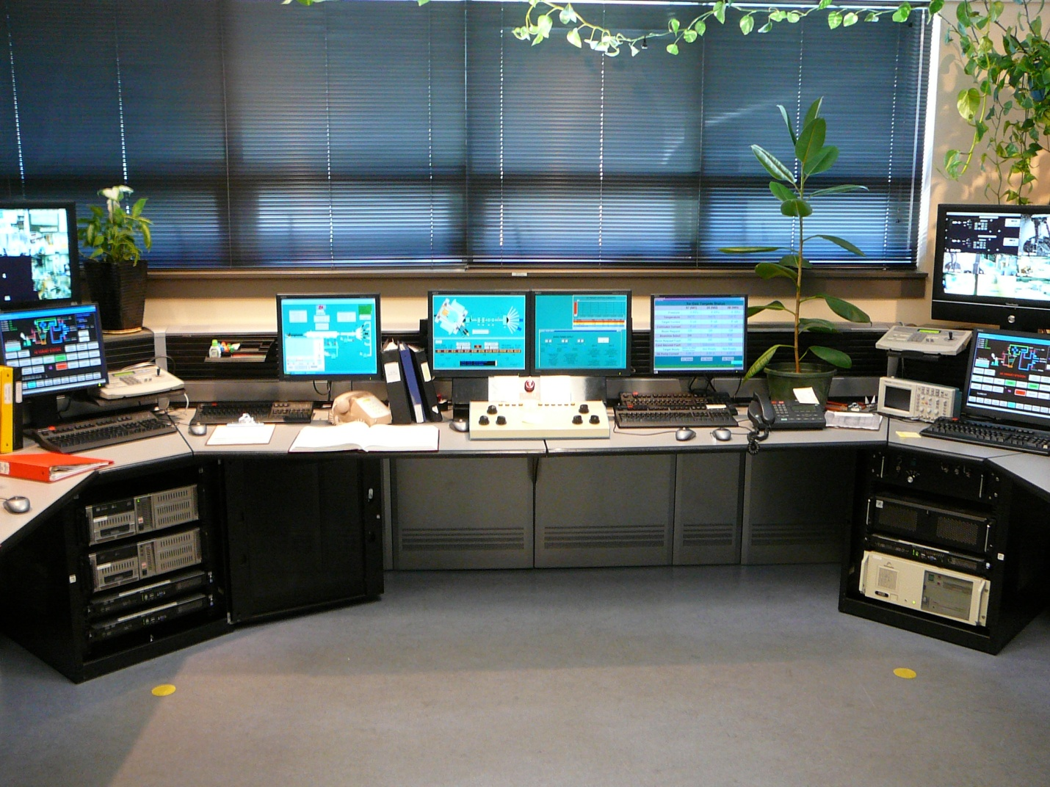
The new cyclotron control room

Slide 21
Verification, Validation

Slide 22
Operators feedback was used to verify and validate that we met all the requirements

Slide 23
Some small issues identified and corrected
Alarm panel size identified as a problem

Slide 24
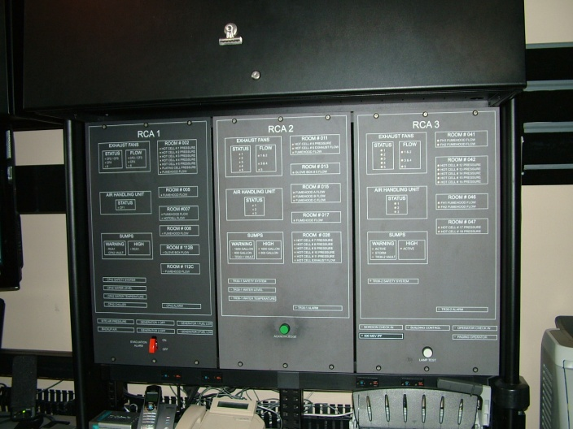
New alarm panel

Slide 25
Move went well, but after ten years in the new (now old)control we discover (surprise) that is small again

Slide 26
Conclusion
Think big

Slide 27
Acknowledgement
R. Van den Elzen- TRIUMF
J. Lofvendahl – TRIUMF
R. Bloemhard – LBNL

Slide 28
Thank you!

