Slide 1
Automation of Operations at Fermilab
Check lists to mouse clicks
The Fermi National Accelerator Laboratory is a U.S. Department of Energy (DOE) research laboratory, operated under DOE contract by Fermi Research Alliance (LLC), a joint partnership of the University of Chicago and the Universities Research Association (URA).

Slide 2
Abstract
Implementing system automation to increase productivity, improve efficiency, ensure repeatability, and reduce errors has become essential for complex accelerator operations. This presentation will address some of the positive and negative effects of automation on operations and operators using experiences and examples from the Fermilab Operations Department.

Slide 3
Overview
Intro
Machines
Operational Modes
Automation Examples
Accelerator Coordination
Collider
Anti-Proton
Neutrino Production
Operations
Affects
Pros
Cons
Maybes
Summary

Slide 4
Machine Intro
Proton Source
Provides 8 GeV protons
Booster Neutrino Beamline (MiniBoone)
8 GeV protons for neutrino production
Main Injector
120 GeV proton for fixed target
120 GeV protons for anti-proton production
120 GeV protons for neutrino production
150 GeV protons and anti-protons for collider
8 GeV anti-protons
Switchyard (Fixed Target)
120 GeV protons for Test Facility
Anti-Proton Source
120 GeV protons to target
8 GeV anti-protons (pbars)
NuMI beamline
120 GeV protons for neutrino production
Tevatron
Anti-proton on proton collider
Recycler Ring
8 GeV anti-proton storage ring
Notes:
Proton Source delivers 8 GeV protons to BNB for neutrino production
It also sends 8 GeV protons to the Main Injector.
The Main Injector is the multi-tasker, sending 120 GeV protons to fixed target, anti-proton production (where 8 GeV anti-protons are accumulated), NuMI neutrino production, and 150 GeV protons for the collider. It also tranfers 8 GeV pbar from the Anti-proton source to the Recycler.
The Recycler serves as a large pbar storage before sending them through MI to the Tevatron

Slide 5
Operational Modes
Collider Store
~16 hours
Fixed Target
Approx. once per minute
Neutrino Production
NuMI (MINOS, MINERνA)
350 kW ~0.5 Hz
BNB (MiniBooNE)
2.5-5 Hz
Anti-Proton Production (Stacking)
~0.5 Hz rate
30 mA ~ 1hr
Anti-Proton Transfer to Recycler (Stashing)
10 minutes
Tevatron Shot Set Up
~ 1 hour
Repeat !
BNB
NuMI
Store
Pbars in Recycler
Stack to 30 mA
Notes:
I will present examples of system automation that has evolved at Fermi lab over the past 12 years of operation. In that time we provided proton beam fixed target facility, for neutrino production at two separate neutrino experiments and for anti-proton production (stacking). After 40 min of anti-proton production, the anti-proton source delivered anti-protons to the anti-proton storage ring (stashing). Finally protons are loaded into the tevatron and anti-protons are transferred from the recycler to the tevatron to establish colliding beams.

Slide 6
Accelerator Coordination
Maximize store hours, minimize shot set up time, don’t waste time transitioning between operational modes, and still deliver beam for neutrinos. The first step was better coordination through automation.
Notes:
The numbers that I showed were where we ended up. But to get there required reducing time spent in shot set up, and minimizing the effects of anti-proton transfers on both pbar and neutrino production. As well as changing modes quickly and efficiently. Maximize useful store hours, and keep the other users satisfied (relatively). The first step was better accelerator coordination.

Slide 7
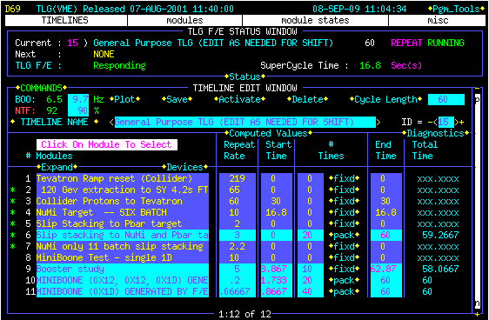
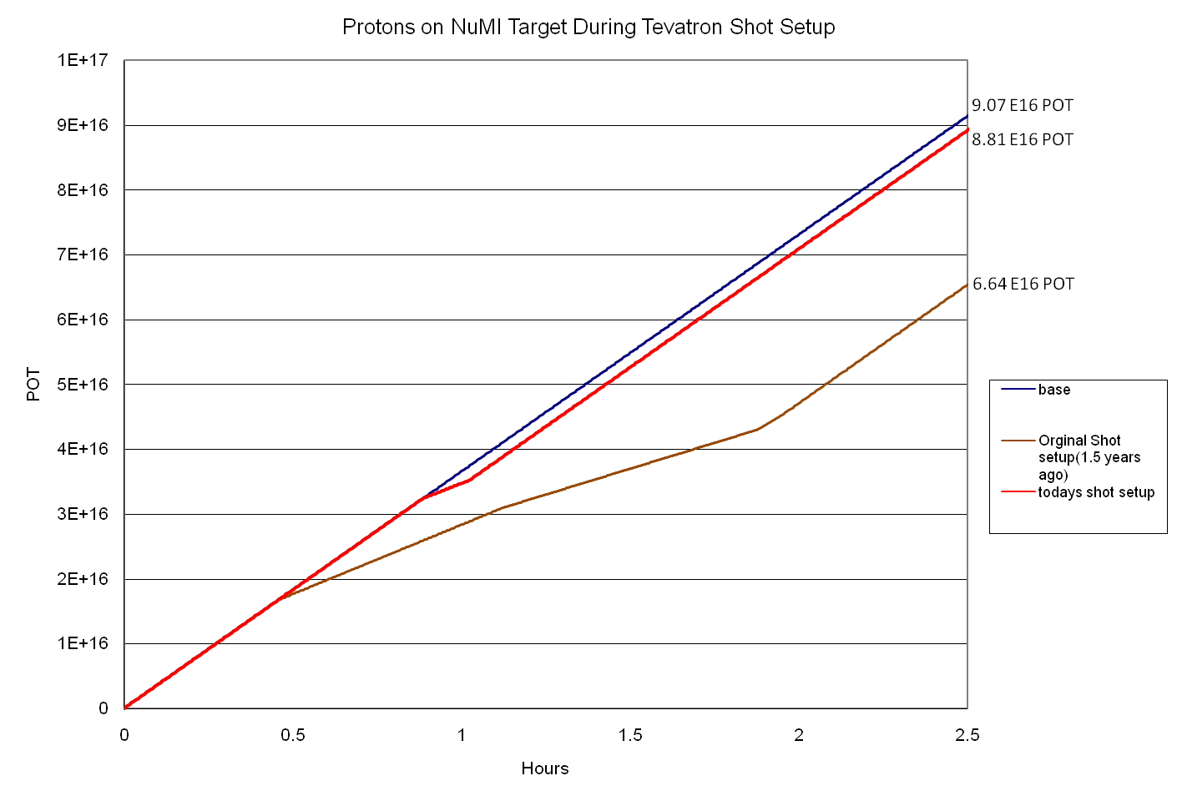
Accelerator Coordination
Timeline Generator (TLG)
Sets overall Accelerator Complex timing clock events (TCLK) to orchestrate beam delivery from machine to machine.
Timelines built with modules
Allows quick reconfiguration of operational modes
One-Shot function
Minimized impact of Shot Set Up and Pbar Transfers on beam delivered for NuMI and Pbar Production
Sequencer Loading
Increased efficiency of timeline transition during Shot Set Up and Pbar Transfers
Replaced Operators building individual timelines for mode changes
Increased efficiency and reduced errors
10
Protons on NuMI target during Tevatron shot setup
9
9.07x10¹⁶ POT
8
8.81x10¹⁶ POT
7
6.64x10¹⁶ POT
6
Protons on target (10¹⁶ )
5
4
3
2
Impact thanks to sequencer and timeline changes
1
0
0 0.5 1 1.5 2 2.5
hours
Notes:
The TLG gets an overhall.

Slide 8
Accelerator Coordination
State Devices
Provide persistent conditions, triggers and informational messages through Accelerator Control Network (ACNET) parameters
When a state device is set, it is reflected to the rest of the control system
Multicast
Registered listeners (Sequencers)
Sequencer can set state devices
Tevatron States
Recycler States
Notes:
State Devices to coordinate

Slide 9
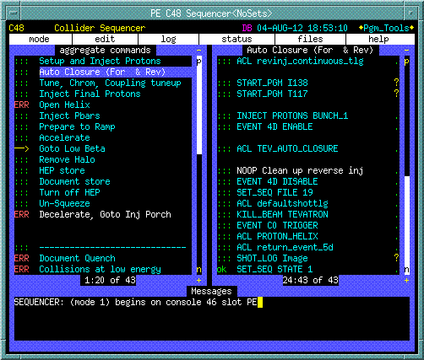
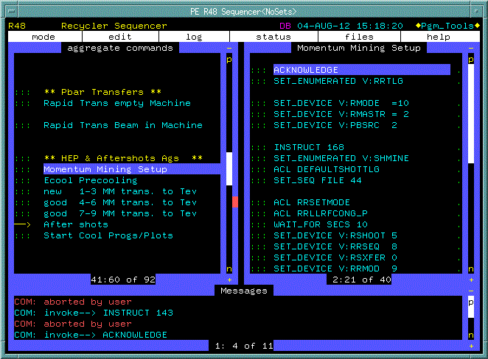
Accelerator Coordination
“Smarter” Sequencer
Separate sequencer instances for TeV, MI, Pbar, Recycler
Sequencer issues high level control commands
Changes Timeline
Launch programs and scripts for complex operations (Tev_Auto_Closure)
Listens too and sets State Devices to provide synchronization
(V:RRTLG)
Implemented to improve efficiency of Shot Set Up and Pbar Transfers to Recycler

Slide 10
Collider Automation
Focus on reducing the shot set up time, and build some tools to be proactive and increase productivity.
Notes:
Shot set up

Slide 11
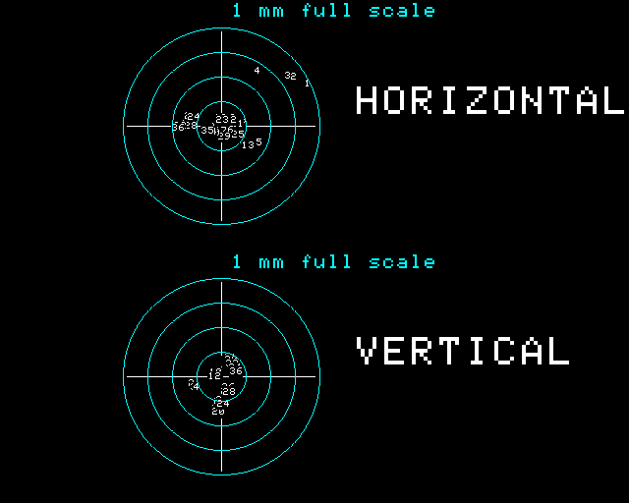
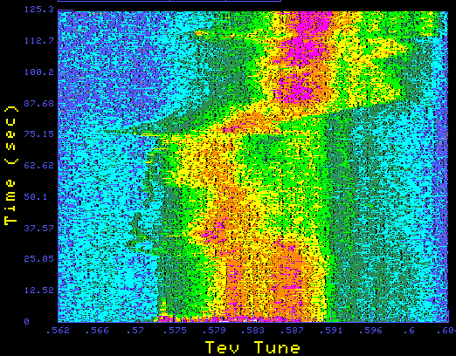
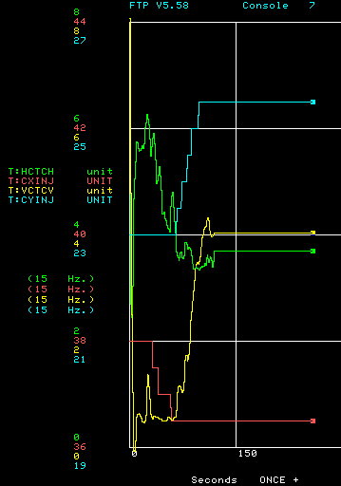
Collider Automation
Automated Injection Closure program
Forward and Reverse injection
Tune Tracker (PPLL)
Provided continuous measurement of Tev tunes during tune up, ramp and squeeze
Monitor tune drift during the store
Alarmed when out of tolerance
Manual Correction
Improved response time to maintain stable tunes throughout the store
Chromaticity Tracker
Auto Chromaticity Measurement Program
Set the chromaticities, and coupling for Tevatron Shot setup

Slide 12
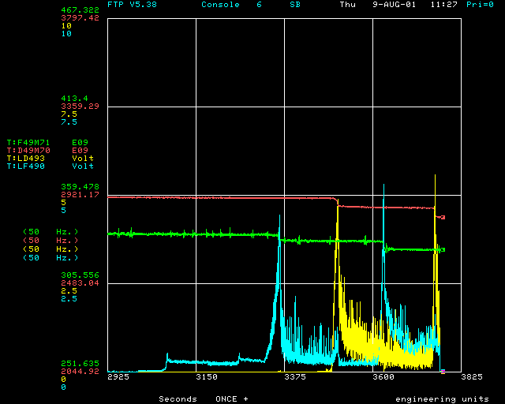
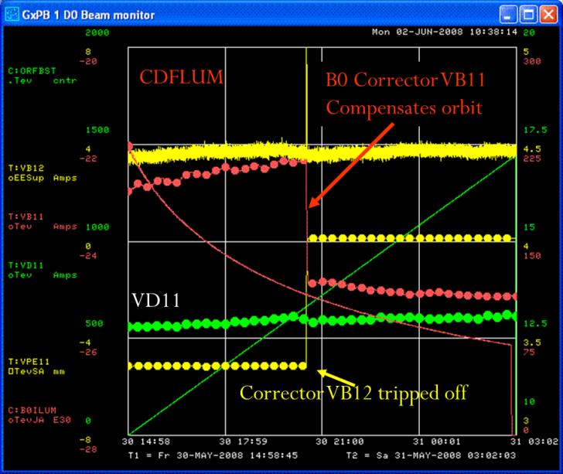
Collider Automation
Automated Collimators to remove halo at IP
Beam intensity and loss monitor feedback
Reduced time from 30 to 10 min.
Orbit Stabilization Program
Orbit smoothed to a reference orbit file one time at lowbeta, at Int collisions and at the end of a store.
During a store, corrects the orbit every 30 sec.
Implemented to correct orbit drift due to environmental factors and corrector failures.
Proton bunched beam intensity
D49 local BLM
Pbar bunched beam intensity
F49 local BLM

Slide 13
Anti-Proton Automation
Increase the repeatability and consistency of the beam conditions for the anti-protons. Normalize the results with automation.
Notes:
Stacking was more of an art before implementing auto tune beam lines and cooling regulation. Unfortunately art is sometimes in the eye of the beholder.

Slide 14
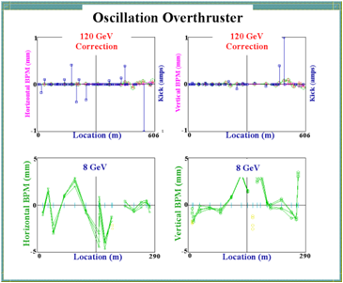
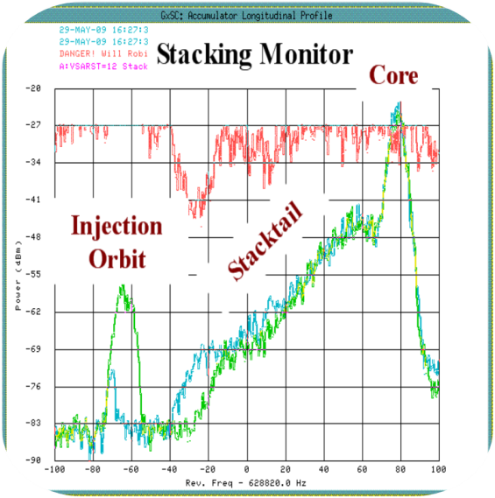
Anti-Proton Automation
Beam Line Tuner
120 GeV proton trajectory in 3 beamlines prior to the Pbar target and 8 GeV secondary beam after the target.
Replaced Operators target tuning.
Stacktail Monitor
Regulates stacktail momentum cooling power
Core Babysitter
Core momentum cooling power regulation

Slide 15
Results
Pbar Transfer
Tevatron Shot Set Up
Notes:
Not all due to automation, but it was a contributing factor

Slide 16
Neutrino Production
With all this collider and pbar production who has time to make neutrinos?
Notes:
Collider and pbar did consume sometime

Slide 17
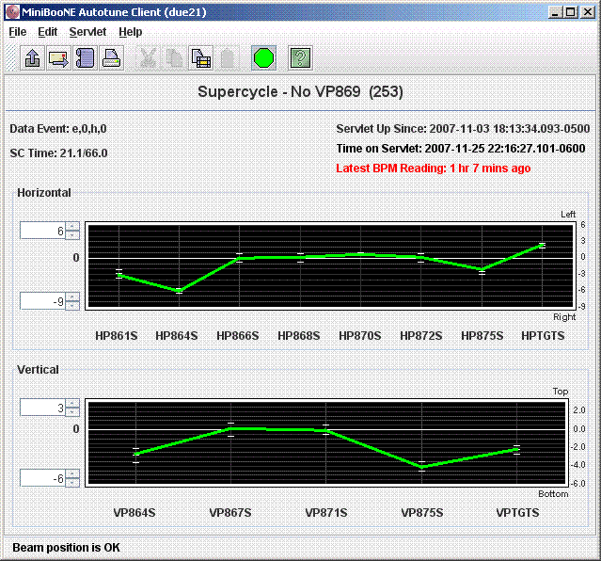
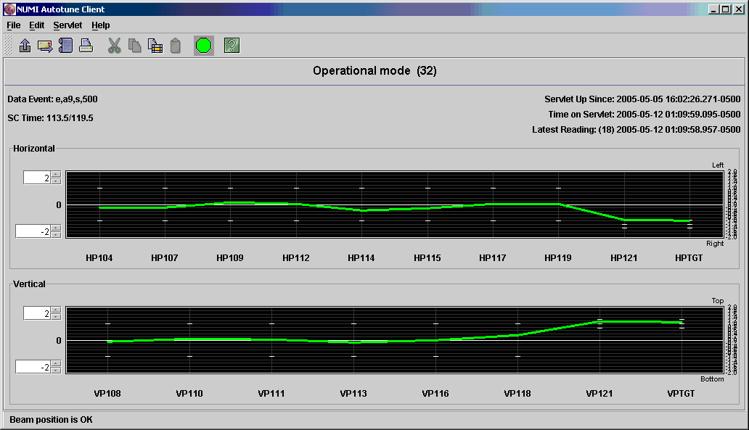
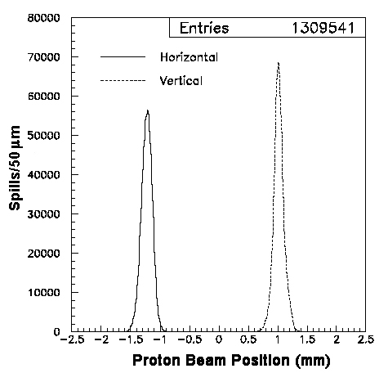
Neutrino Production
Booster Neutrino Beamline Tuner (MiniBoone)
Target position stability
2-5 Hz rate
NuMI Beamline Tuner
Target position
100µm rms
350 kW beam power on target MINOS, MINERνA
700 kW NOνA (future)

Slide 18
Affects on Operators/Operations
What does this button do?
Notes:
Collider and pbar did consume sometime

Slide 19
Affects on Operators/Operations
Process/System knowledge suffers.
Slows learning.
A good operator will learn it.
Operations becomes more expert dependent.
First response is to call someone.
Difficult to operate in a non-standard configuration.
Large pbar stack sizes.
Requires more attention in training
Don’t just know that it works, know how it works.
Notes:
When you sit down to write a talk about how automation has affected the accelerator operations you can for the most part make a quantitative analysis, but considering it’s affect on the operators knowledge is not even qualitative it’s more of a gut feeling. You can point to general examples that have been observed, but we aren’t in the habit of keep track how long something would take under different circumstances that don’t exist in your system. You perceive a reduction in process knowledge, and you believe that will negatively impact creativity and problem solving skills, but it’s not something that can be determined until it’s tested.
The machine knowledge does declines. It’s hard to learn how to compensate for a bad corrector or identify a quad steering problem if you haven’t spent time tuning.
It stunts the development of trouble shooting skills.

Slide 20
Affects on Operators/Operations
Increase productivity.
Focus on areas that have no automation.
Expands our responsibility.
Different skills are being developed
More computer savvy, operators that write their own automation programs.
Is this just the evolution of an operator at work?

Slide 21
Summary
Automation when it’s done correctly improves reliability, reduces human error, increases productivity, and is a necessity for complex operations. Generally the benefits outweigh the drawbacks, and with effort, attention and training Operations can nearly eliminate them.
Notes:
Automation when it’s done correctly improves reliability, reduces human error, increases productivity, and is a necessity for complex operations. Generally the benefits outweigh the drawbacks, and with effort, attention and training Operations can nearly eliminate them.

Slide 22
Summary
Automation
Improves reliability
Reduces human error
Increases accelerator productivity
Is a necessity for complex operations
Operations/Operators
Will adjust and evolve

Slide 23
AUTOMATION
1: the technique of making an apparatus, a process, or a system operate automatically
2: the state of being operated automatically
3: automatically controlled operation of an apparatus, process, or system by mechanical or electronic devices that take the place of human labor

Slide 24
Thank You.

