Slide 1
Operator vs. Automation
Lawrence Berkeley National Lab
88” Cyclotron Operations
August 7, 2012
Navid Radnia

Slide 2
Glossary
History of the 88” Cyclotron
History of Automation
Why our facility has stayed analog?
Current Automation Proposal
Finding a Balance
Possible Solution
What do you propose?

Slide 3
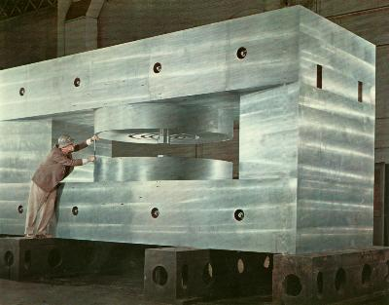
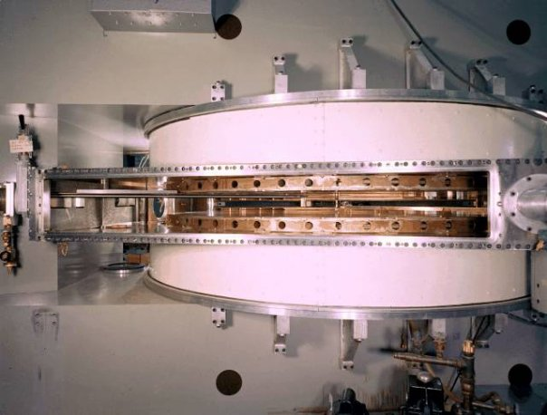
88” Cyclotron
K=140 sector-focused cyclotron
Light- and heavy-ion capabilities
Maximum energies: 55Mev(p), 65Mev(d), 170MeV(3He).
Most heavy ions through uranium can be accelerated to maximum energies which vary with the mass and charge state.

Slide 4
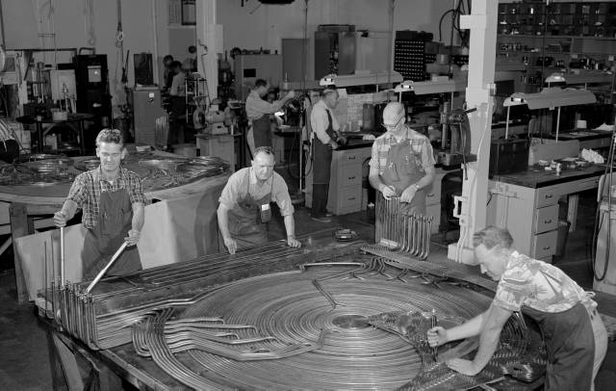
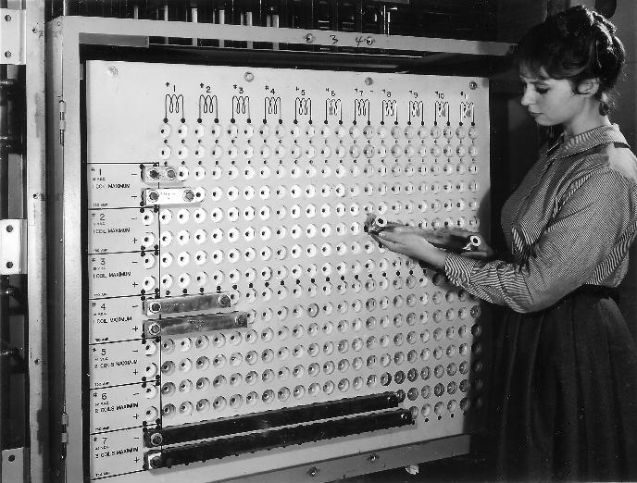
88” Cyclotron
1500 man-hours of work were necessary to assemble the trim coils which help regulate the strength and shape of the accelerator's magnetic field. (LEFT)
Power supplies are patched in with bus bars on a patch panel. Setup is still used today. (RIGHT)

Slide 5
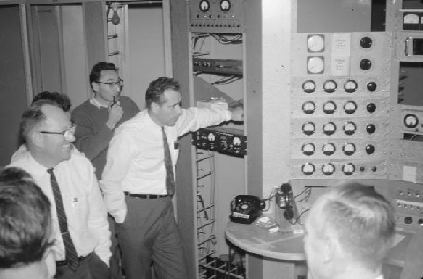
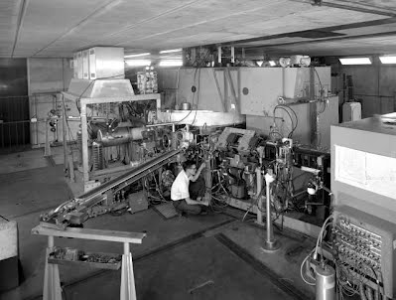
88” Cyclotron
First internal beam on December 12, 1961. (LEFT)
First external beam in May 1962. (RIGHT)

Slide 6
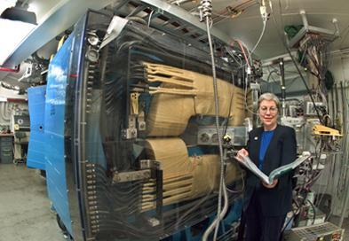
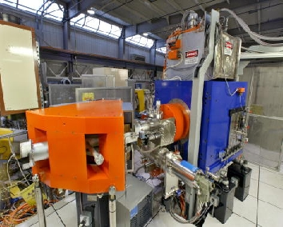
88” Cyclotron
BGS
VENUS
Major instrumentation at the 88-Inch Cyclotron includes the Berkeley Gas-filled Separator (BGS) and Versatile ECR ion source for Nuclear Science (VENUS), a third-generation superconducting ECR ion source and prototype for the Rare Isotope Accelerator (RIA).

Slide 7
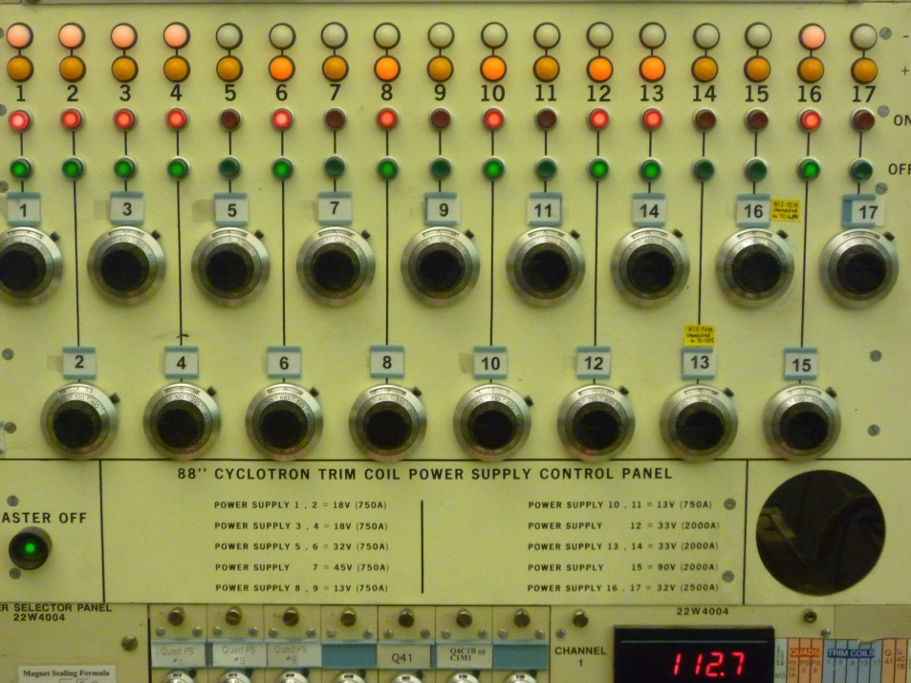
History of Automation
Attempts over the years to integrate automated Trim Coil control.
First attempt in 1960’s
IBM Punch Cards
1980’s to Present
Tech Boom

Slide 8
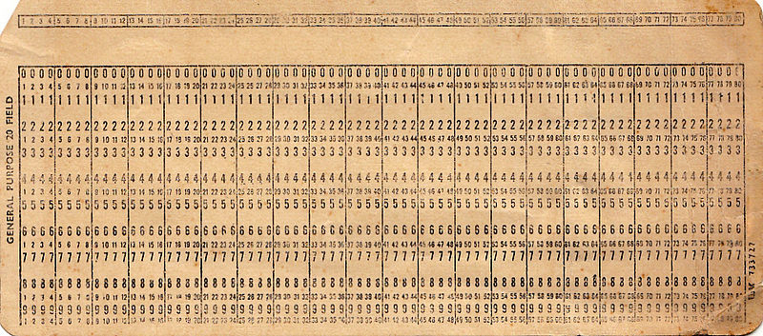
1960’s
Goal of Proposal
Monitor Set points.
Decrease tune time to
20-25 minutes per shift.
Annual Savings of about $75,000
Failures
Feedback Errors
IBM Punch Card Errors
More Time Consuming

Slide 9
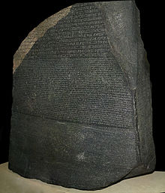
1980’s to Present
Software & Equipment Lost to Tech Boom
FORTRAN
Cyclotron Development (CYDE)
Program used to calculate
Trim Coil Solution.
Outdated Equipment
Power Supplies
Variable Controllers

Slide 10
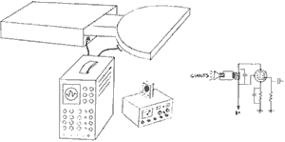
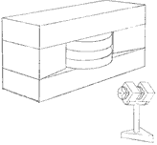
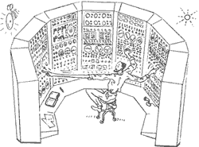
The Cyclotron, as seen by….
…the Electrical Engineer
…the Mechanical Engineer
…the Operator
…the Experimental Physicist

Slide 11
88” Cyclotron
Why our facility has stayed analog?
Budget
Operational Issues

Slide 12
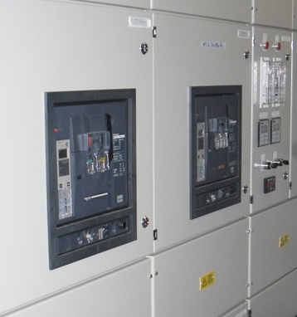
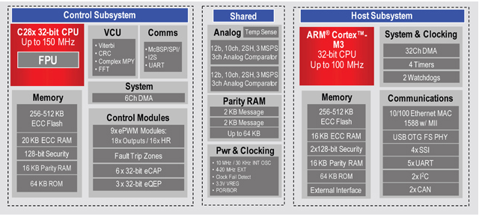
88” Cyclotron
Why our facility has stayed analog?
Budget
Software Engineer
Power Supplies
Variable Controllers
And many more

Slide 13
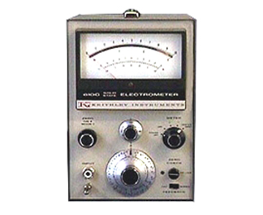
88” Cyclotron
Why our facility has stayed analog?
Operations
Automation Failures
Optimizing beam intensity
Not as simple as it looks.

Slide 14
Current Proposal
Trim Coil Upgrade
Design
Digitally Controlled & Automated
Stored preset values for a particular product.
Algorithm that will optimize beam intensity.

Slide 15
Current Proposal
Not Considered
Chassis configured with only one pot for all 17 trim coils.
Proposed configuration drastic upon failure.
Two pots necessary for optimization upon failure of automated system.
What about weekly meetings and work planning?

Slide 16
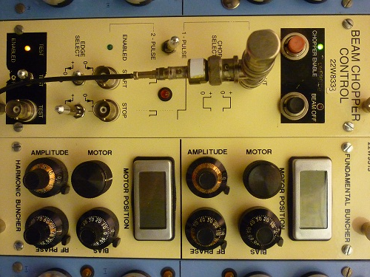
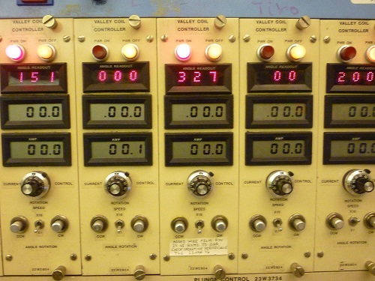
88” Cyclotron
Existing Design Flaws in Control Room
Bunchers
Valley Coils

Slide 17
Finding a Balance
Key factors in determining a balance.
Machine Efficiency
Operator Knowledge
Problem Solving

Slide 18
Finding a Balance
Machine Efficiency
Operator
Involve operator in design
Parameters available to Operator.
Must be an appendage.
Automation
Software would have to evolve.

Slide 19
Finding a Balance
Operator Knowledge & Problem Solving
Operator
Mechanical, Electrical & Infrastructure
Software knowledge
Checklists

Slide 20
Possible Solution
+
=
Get the right people more involved
Engineer
Control Room
Tuning Methods and Styles
Help bring more reality to theory

Slide 21
Questions?

