Slide 1
FLASH Operation at DESY
From a Test Accelerator to a User Facility
Michael Bieler
FLASH Operation at DESY
WAO2012, SLAC, Aug. 8, 2012

Slide 2
Vocabulary
DESY: Deutsches Elektronen-Synchrotron, Hamburg, Germany
TTF: TESLA Test Facility
TESLA: TeV Energy Superconducting Linear Accelerator
FLASH: Free Electron Laser in Hamburg

Slide 3
Content
The History of FLASH
TTF as a linear collider testbed
TTF operation
TTF becomes FLASH
FLASH user operation
Difficulties for Operators
Conclusion

Slide 4
The History of FLASH
1994: The TESLA project requires superconducting rf cavities for a TeV-scale linear collider.
TESLA Test Facility: A 500 MeV testbed for TESLA.
1997: TTF reaches 16.7 MeV/m with superconducting cavities
1998: TTF tunnel extended, first undulators in the tunnel
2000: First lasing @110 nm
2003: Extension from 100 m to 260 m, TTF becomes FLASH
2005: FLASH becomes a user facility, lasing at 25 nm
A test facility becomes a user facility.

Slide 5
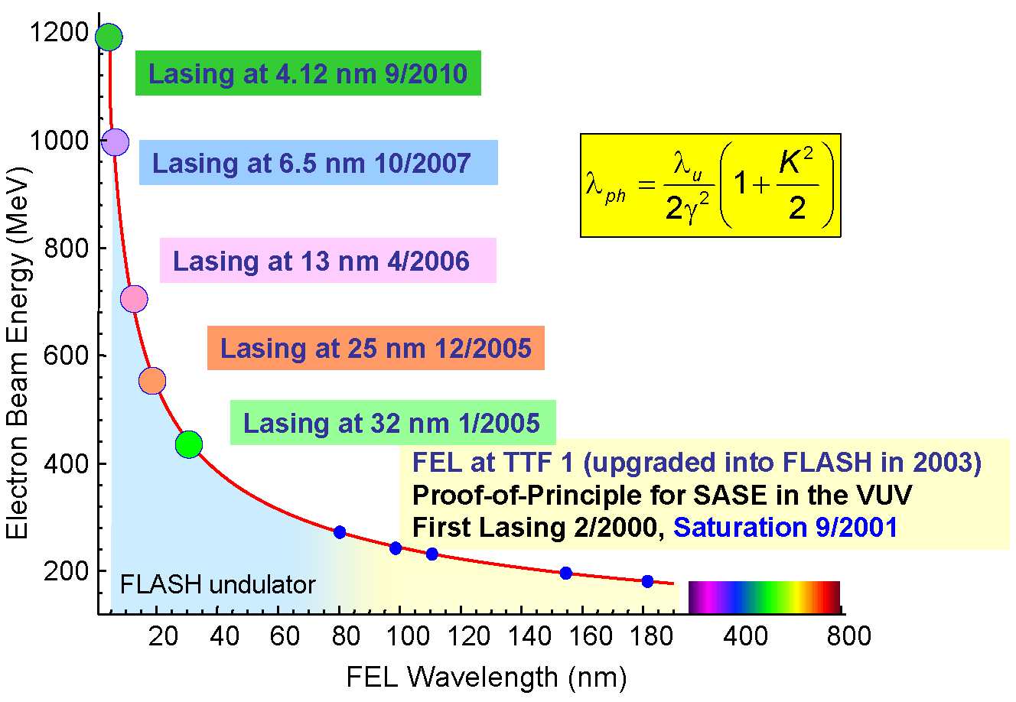
The History of FLASH

Slide 6
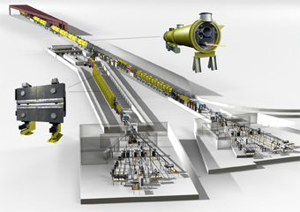
The Future of FLASH
2012: FLASH running as
- a user facility, 4.1 – 50 nm
- a testbed for XFEL (component tests, diagnostics,
control system, etc.)
- as a testbed for machine studies (Seeding, …)
2013: FLASH will be upgraded
to FLASH II

Slide 7
TTF as a linear collider testbed
TESLA Test Facility was a test facility:
- Components running at their limits
- Components from different vendors or collaborators
- Different kinds of the same component
(BPMs, current monitors, klystrons, modulators,…)
- Only the backbone of a control system
Different integration of components into the control system
Different levels of application software
- Different levels of documentation

Slide 8
TTF operation
Goals of TTF operation:
High accelerating gradients
Component tests for a linear collider
Mode of TTF operation:
Separate control room
Separate control system
Separate operators (scientists and students)

Slide 9
TTF becomes FLASH
TTF was an ideal testbed for the SASE mechanism
200 MeV beam energy
high current, pulsed, laser driven gun
1998: Conversion into a SASE FEL
Chicanes for bunch compression (no 3rd harmonic cavity)
More beam energy
Better diagnostics
Undulators
Lots of Research and Development
The TTF VUV SASE FEL was born
(But it took years to get it running)
2000: First lasing @110 nm

Slide 10
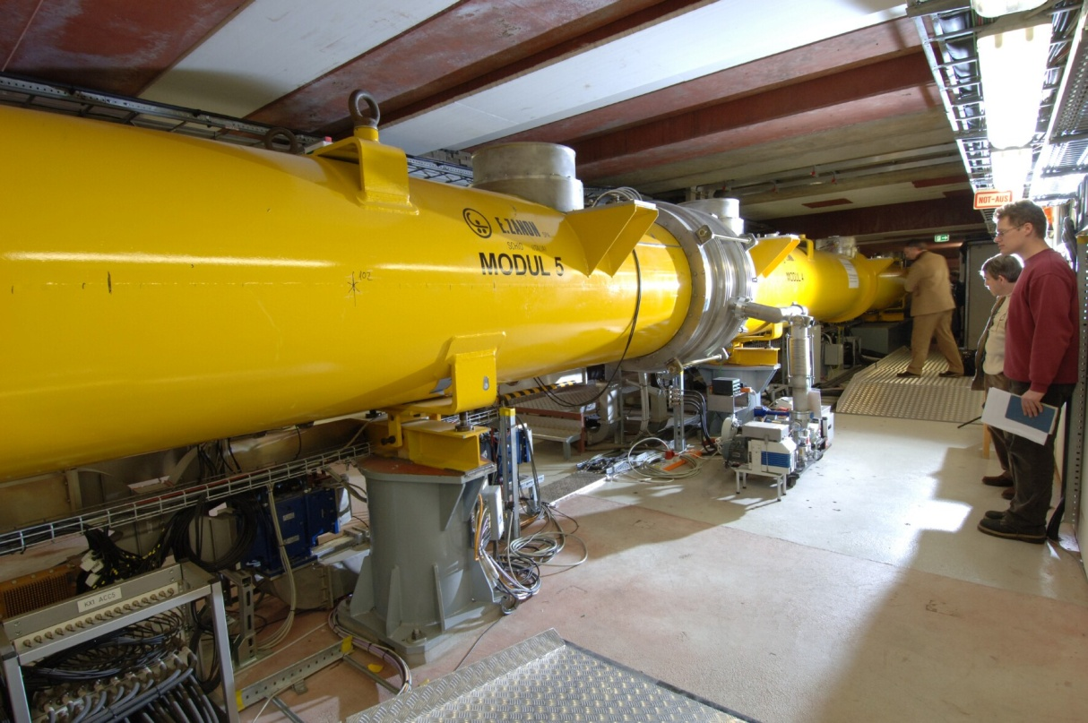
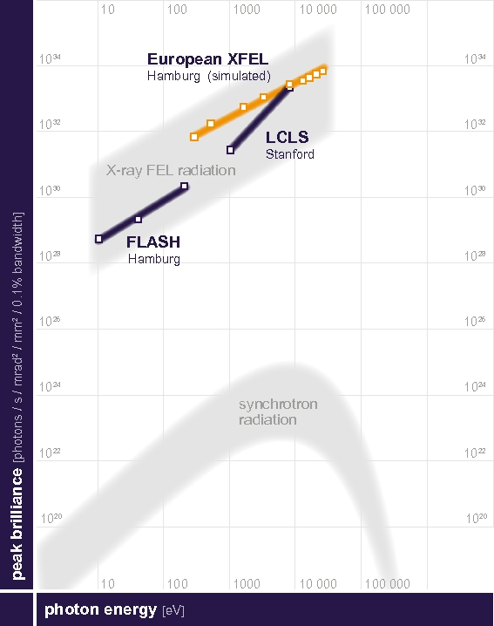
TTF becomes FLASH
2003: Extension from 100 m to 260 m, TTF becomes FLASH
longer tunnel, space for more accelerating modules
energy upgrade over the years, 3rd harmonic cavity
1200 MeV reached in 2010

Slide 11
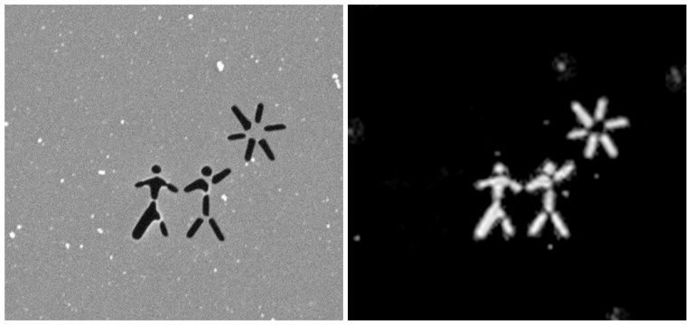
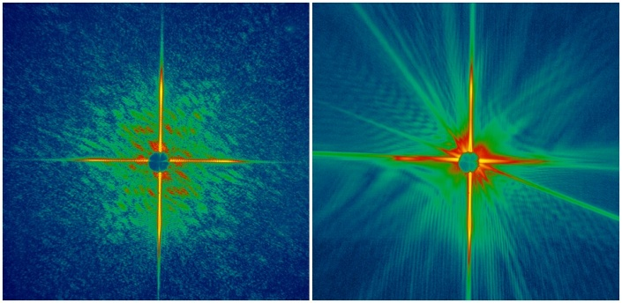
FLASH user operation
2010: 4.12 nm wavelength (well within the ‘water window’)
FLASH is used for fundamental research
Reconstruction
from the diffraction
pattern of one shot
3 μm
Original Foil
Diffraction pattern
of the first shot
Diffraction pattern
of the second shot

Slide 12
FLASH user operation
FLASH schedule:
User runs (3 – 5 weeks)
interleaved with
Accelerator studies
and FEL studies
(2 – 7 weeks)

Slide 13
FLASH user operation
FLASH accelerator studies and FEL studies:
Performed by experts with a little help from some
experienced operators.
FLASH user runs:
Performed by operators with a little help from some experts.

Slide 14
Difficulties for Operators
Questions of a storage ring operator
on his first day at an FEL:
First turn steering all day long?
Closed orbit? Closed bumps?
Betatron Tunes?
Where are the resonances?
Beam Energy, RF-Phases?
Not constant? Not known everywhere?
Dark Current?
What’s that?
Bunch length?
Who cares?

Slide 15
Difficulties for Operators
Problems of a storage ring operator at an FEL:
Every slight change at the injector spoils the beam in the undulator section.
Every change in the energy distribution changes the beam optics.
Every change of RF-phases spoils the bunch length.
Dark current from the gun must not reach the undulator section.
Feedbacks, feedbacks, feedbacks….
Orbit, energy, peak current

Slide 16
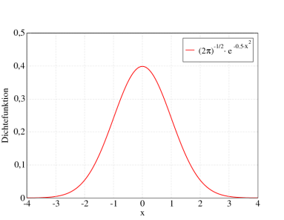
Difficulties for Operators
Problems of a storage ring operator at an FEL:
Which tuning strategy works today?
Many tuning parameters (like luminosity tuning),
but some can totally destroy SASE.
The SASE effect is less robust than luminosity.
Most lumi parameters have
a Gaussian distribution,
many SASE parameters
are steep peaks.

Slide 17
Conclusion
FLASH had (and in parts still has) a lot of childhood diseases.
Parts of FLASH were never meant to be a user facility.
FLASH was (and in parts still is) a testbed.
The level of automation and feedbacks is not optimal.
Operators were not part of the FLASH crew from the beginning.
(Some) Storage ring operators have a hard time with an FEL.
Operators are performing routine user operation now
(but still need help for e.g. wavelength changes).

Slide 18
Conclusion
“FLASH performance is too much operator dependent”
(from our funding agency)
Operator Training!
Automation of Procedures!
Feedbacks!
(LCLS has 16 feedbacks running)

