Slide 1
ISIS - brief overview
Alan Stevens
Accelerator Operations Group
with
Bob Mannix
Controls Group
Workshop on Accelerator Operations
SLAC, Menlo Park, CA
6th - 10th August 2012

Slide 2
ISIS
ISIS not an acronym – Margaret Thatcher 1985
First spallation neutron source to run 2 targets
Pulsed Neutron & Muon Source
World leading research centre for physical & life sciences – Physics, chemistry, Biology, Engineering, materials science
1984 (Dec) – First Beam to Target Station 1 (18 ports)
2008 (Aug) – First Neutrons from TS2 (18 ports)
52m Diameter Rapid Cycling Synchrotron (RCS)
200µA 300µA with 2nd Harmonic RF
£145M 2nd Target Station

Slide 3
ISIS Main Components
Pre-Injector
Linac
Synchrotron – 10 section 800 MeV Protons
Extracted Proton Beamline 1 & EPB2
2 Target Stations (TS-1 & TS-2)
Intermediate Target – 7 Muon beamlines (4 RIKEN)
H⁻ Ions -35keV RFQ/665keV Linac/70MeV
Foil/Protons Synchrotron/800MeV EPB’s
TS1 (160kW, 40Hz)/TS2 (40kW, 10Hz) Neutrons

Slide 4
FUNDING
HM Government
Dept. Of Business Innovation & Skills
Research Councils UK
Science &Technology Facilities Council
RUTHERFORD APPLETON LABS
ISIS
£30M Resource
<£50M including collaborations
Notes:
BIS = Department for Business, Innovation & Skills
RCUK = Research Councils UK
MRC = Medical Research Council
NERC = Natural Environment Research Council
EPSRC = Engineering & Physical Sciences Research Council
AHSRC = Arts & Humanities Research Council
STFC = Science & Technology Facilities Council
BBSRC = Biotechnology & Biological Research Council
ESRC = Economic & Social Research Council
UK ATC = Astronomical Technology Centre
£10k - £15k per hour lost (depending on type of experiment)
Extra funding from collaborations 10 – 15%
£50M including TS2
Political damage when off

Slide 5
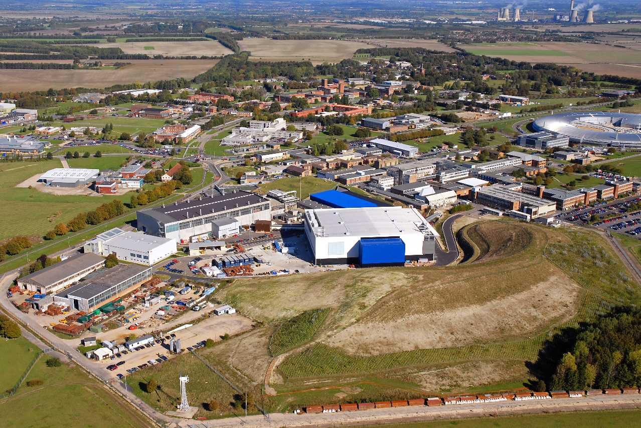
ISIS
Rutherford Appleton Laboratory, looking north-east

Slide 6
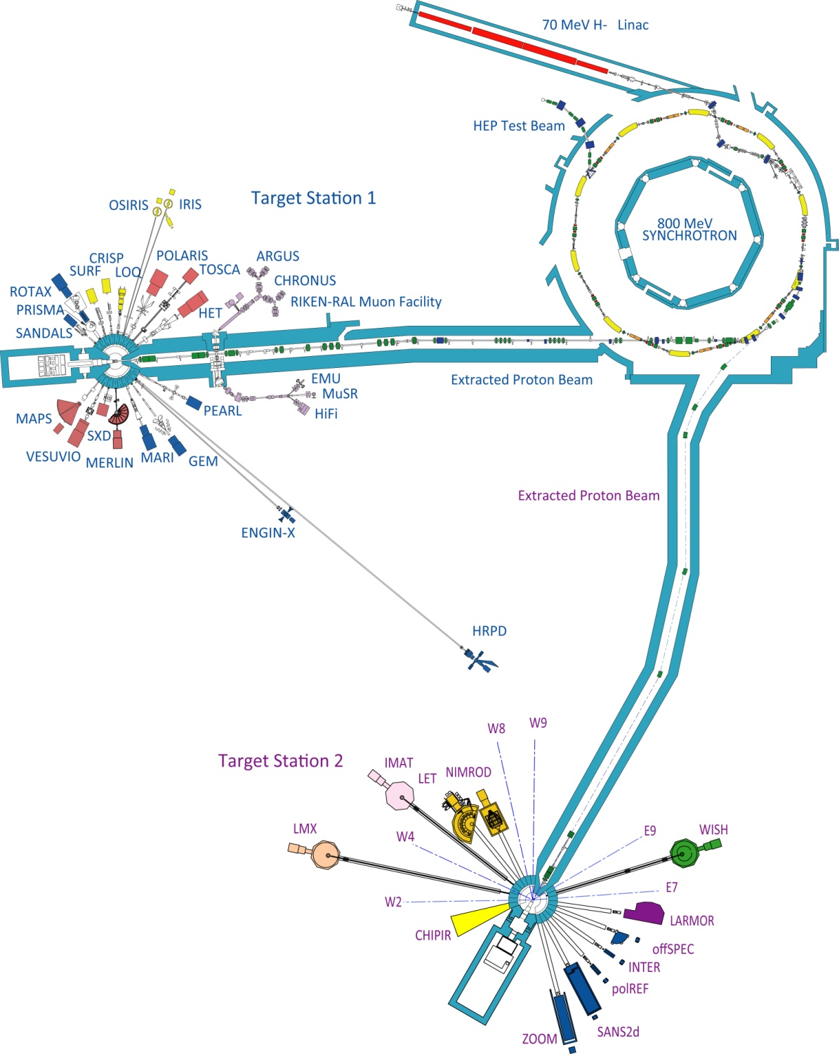
ISIS
70 MeV H– linac
800 MeV proton synchrotron
TS-1
TS-2

Slide 7
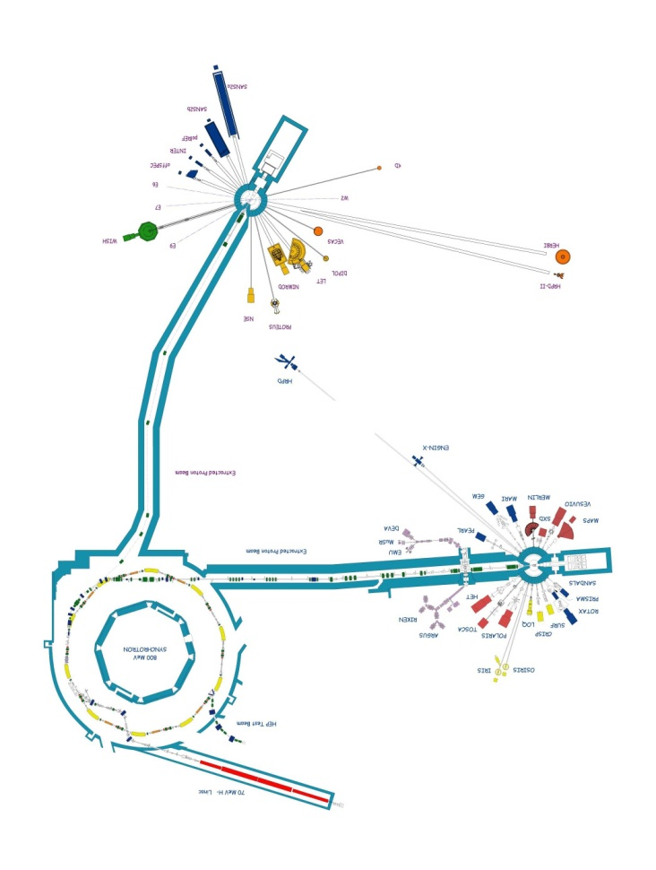

Slide 8
MACHINE OPERATIONS
Funded for 160 days operation per year
24/7 during scheduled cycles
Shutdowns (maintenance) - 1 to 6 weeks
2 Machine Physics periods per cycle
1 day for beam line permits
24 hour mid cycle maintenance period
350 staff, 120 Accelerator technicians and engineers, instrument support, health physics
Shift Staff perform 1st line diagnostics
On Call Expertise

Slide 9
SHIFT DETAILS
5 Teams of 4
24/7 Operation
5 week shift cycles - MAN
8 hour weekday shifts
12 hour weekends
Standby week – partially paid
Rely on goodwill

Slide 10
GENERAL INFORMATION
Supports International community of 3000 scientists
Free for Academic Researchers if results published in public domain
~ 1000 visitors per year
~ 900 Experiments per year
~ 500 Publications per year
9000 publications since 1984
CELLA – hydrogen energy storage http://www.cellaenergy.com/
MICE – Muon Ionising Cooling Experiment – Neutrino Factory

Slide 11
AVAILABILITIES
Defined as:
Beam pulses delivered/Beam pulses scheduled
FY 2007/08 80.1%
FY 2008/09 81.3%
FY 2009/10 77.5%
FY 2010/11 76.1%
FY 2011/12 82.7%

Slide 12
OPERATIONAL ISSUES
Power loss – Substations
Water Plant – Low flows, blockages
Vacuum Plant – O-rings, gate valves
Obsolete equipment – Psu’s, magnets, choke
Single point failures – Tank 4, Vacuum personnel
High ambient temperatures (relatively speaking) -insufficient water coolant capacity, use of fans
On Call personnel – insufficient people to cover
Recruitment & Retention – retention payments made & now recruitment payments to get right people

Slide 13
POSSIBLE ISIS UPGRADES
Phase 3 Target Station 2 instruments
Replacement/partial replacement of Linac (same energy)
180MeV Linac & Ring Injection System (≤ 0.5MW)
3 GeV RCS for beam power of ~1 MW
Further upgrade to accumulate and accelerate beam from a 0.4 – 0.8 GeV linac for 2 – 5 MW beams.

Slide 14
Thank you for listening
Questions?

