Slide 1
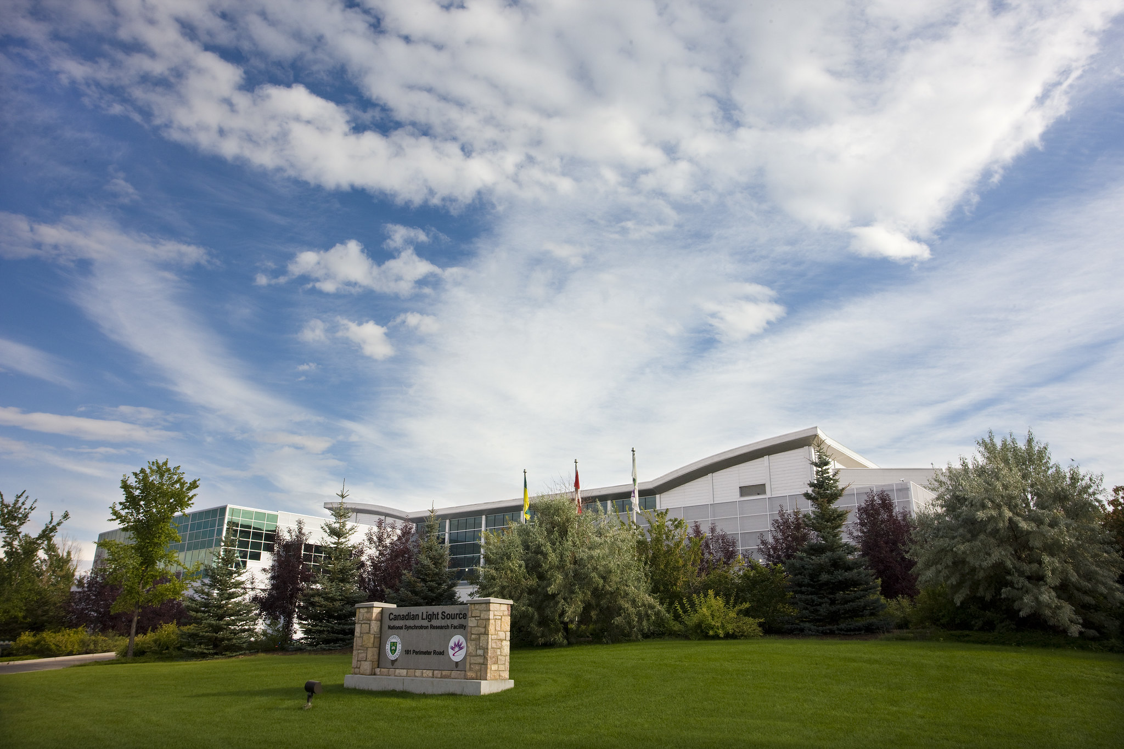
Team Building Opportunities and Operator Retreats at the Canadian Light Source
Presented by Grant Bilbrough, Operator Lead, on behalf of the Operator Group at the Canadian Light Source
The Canadian Light Source sits on Treaty 6 Territory, the traditional homeland of the Metis.

Slide 2
Background…
The Canadian Light Source is a 3rd Generation Synchrotron located in Saskatoon, Canada
  First light in 2004, first users in 2005
The group was created in the summer of 2019
The Operator Group is 10 operators (Union) and 1 supervisor (non-Union)
Operators work 12-hour shifts and average 40 hours a week over a 5 week period
  They might work as many as 48 hours or as little as 28 hours in a week
Operators work in teams of two
  They have staggered start times – one team member starts at 7 o’clock and the other starts at 8 o’clock for their 12-hour shift

Slide 3
Problems to Overcome
How do you build a team out of a group of individuals
How do you get consistency within the team?
How do you make sure everyone knows how to do new tasks?
How do you know everyone is aligned when dealing with issues, projects, etc.?
How do you define a Culture when you don’t have an opportunity to have people share their common Behaviour?

Slide 4
The Solution – Operator Retreats!
Bring the entire team together to share those common experiences
Use it as a time to train so there is common understanding
Meet with people in other departments to foster communications
Make an event out of it so that it is memorable
  Eventually it’ll become a “destination event”
  After a time you will start to hear, “We should do this at our next retreat.”
Operator Retreats are born!!

Slide 5
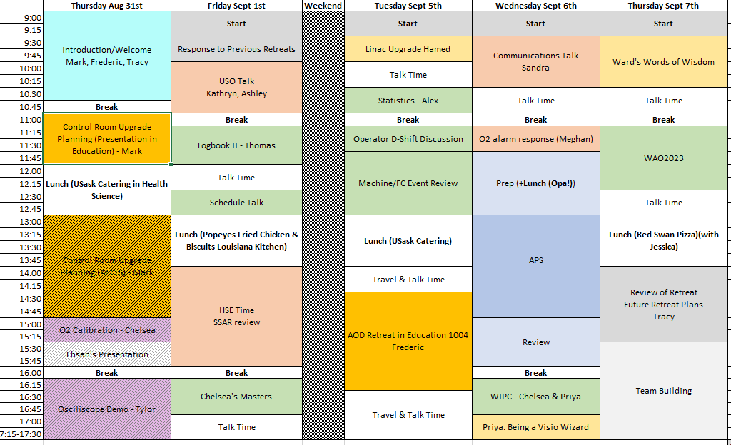
Fall 2023 Retreat Schedule
Latest Retreat – Last week!!
Highlights
Fully planned by operators
Virtual meet up with Argonne’s APS operators
Start time at 9:00 am instead of 8:00 am
Smaller team building event
Lowlights
Schedule forced us to straddle a long weekend (note the days of the week)

Slide 6
Keys to Success
No interruptions to retreat – leave the facility or else someone will get asked to do something by somebody
Make the retreat a space where people can talk about anything they want related to work (and even not related to work within limits) – a so-called Safe Space
  Build time into the schedule to allow for these types of conversations
Bring in an independent third party person to create opportunities to talk and to record information in those discussions then generate a report about it
  make comments anonymous in the report as necessary

Slide 7
More Keys to Success…
As a supervisor, be prepared to leave the room so the group can talk without you being there
  Expect honest feedback afterwards when you do this
Include lunch and coffee – so people don’t have to leave
The retreat is about the group, not about management’s desire to impose directives
The supervisor needs to strike a balance between the posted schedule and the events going on in the moment

Slide 8
