Slide 1
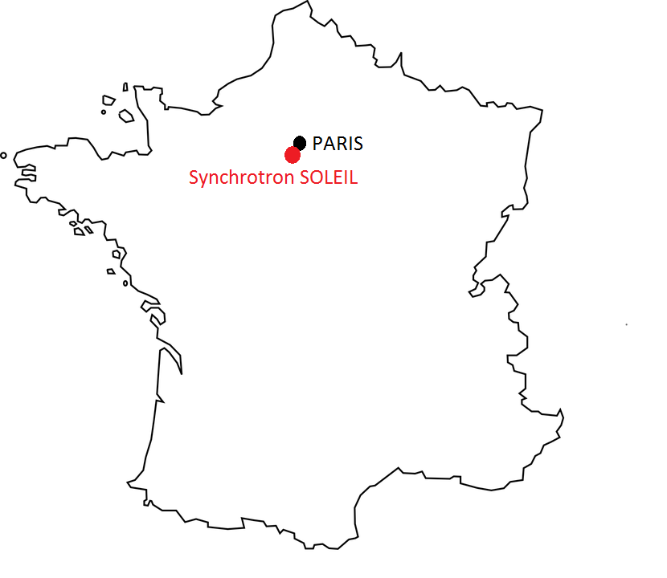
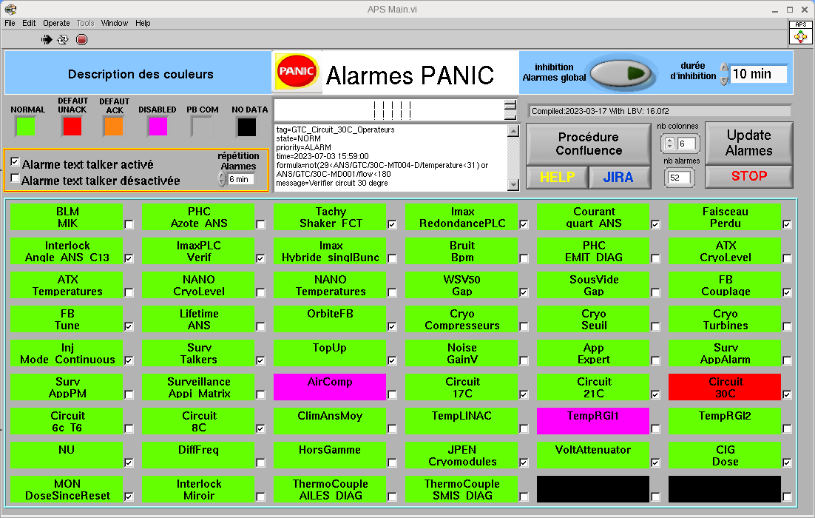
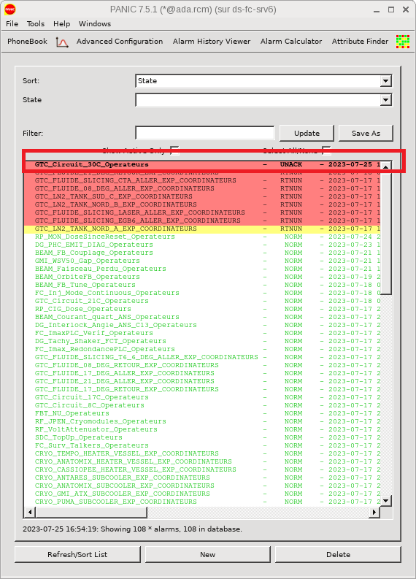
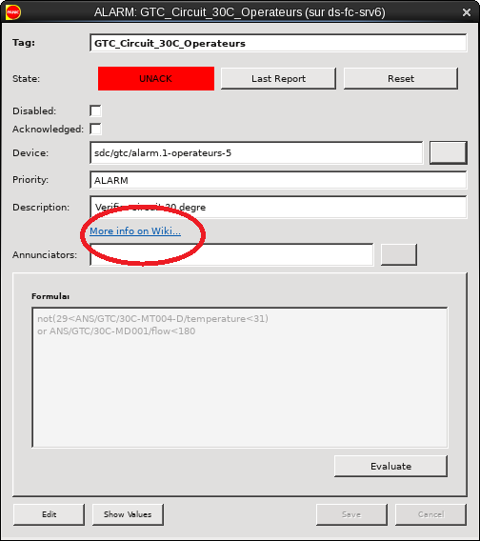
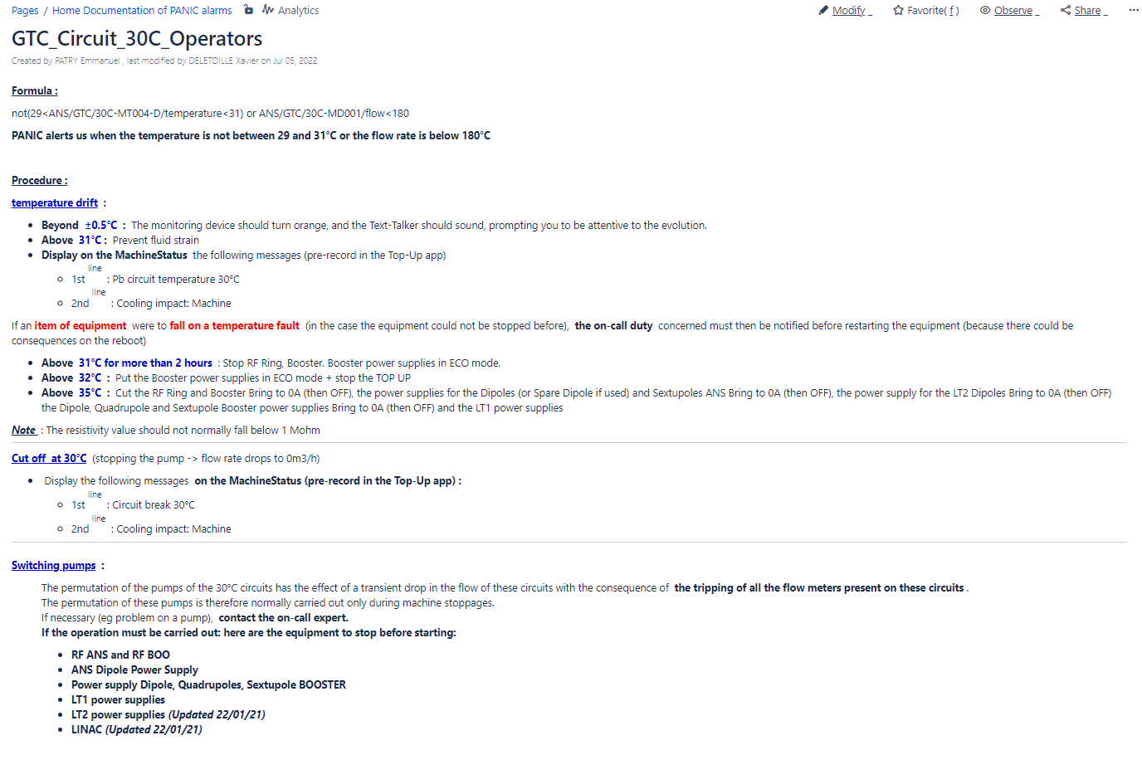
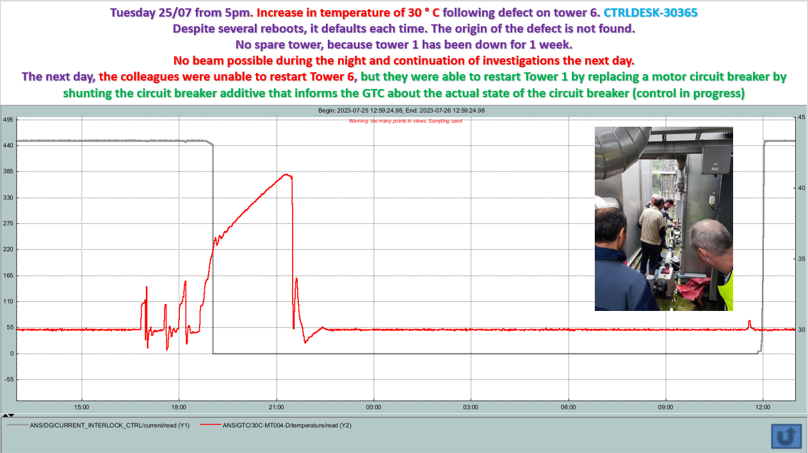
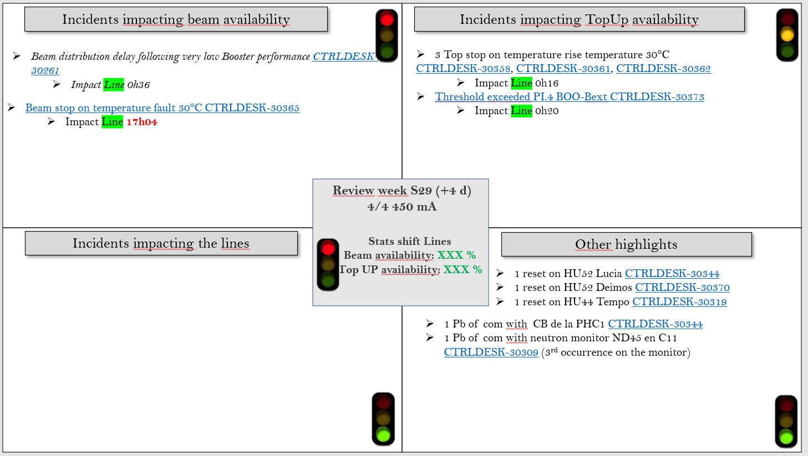
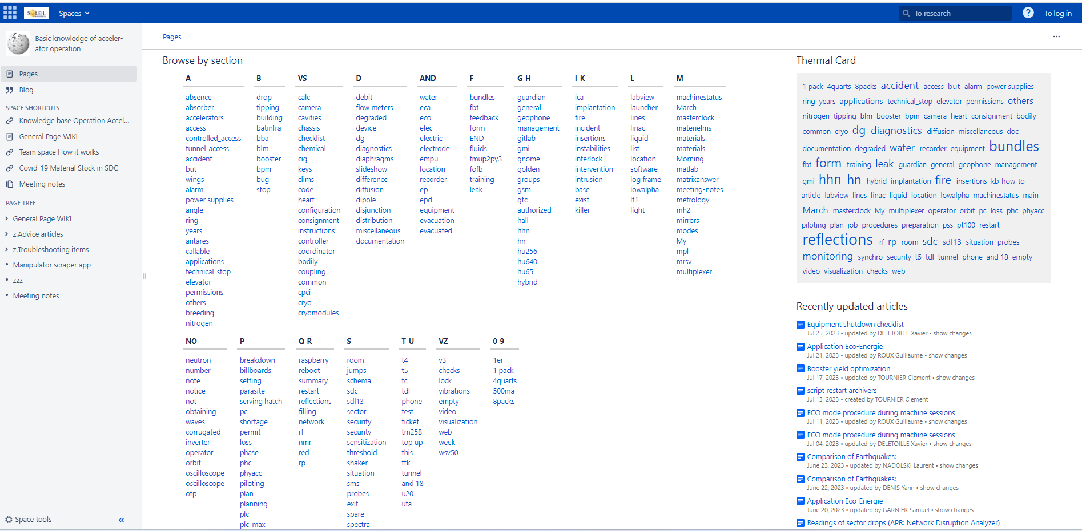
SOLEIL's tools: Successful integration of the PANIC alarm management system into the control room of the synchrotron SOLEIL for continuous improvement
D. TREVARIN, L. S. NADOLSKI, J-F. LAMARRE, X. DELETOILLE, C. BOURG, Y. DENIS, S. GARNIER, T. MARION, E. PATRY, G. ROUX, C. TOURNIER
L'Orme des Merisiers - Départementale 128 - 91190 Saint-Aubin, FRANCE
didier.trevarin@synchrotron-soleil.fr
Introduction :
The SOLEIL synchrotron, commissioned in 2006, currently delivers photon beams to 29 beamlines, with a maximum intensity of 500 mA for 5000 hours per year. To ensure the availability and reliability of electron and photon beams, the Machine Operations Group, with support from the Acquisition and Control Systems Engineering Group, has made significant efforts in recent years to integrate the new PANIC alarm management system into the control room. This system represents a valuable tool for operators with the objectives of achieving beam availability greater than 99%, a mean time between failures (MTBF) of 100 hours and maintaining a mean time to recovery (MTTR) of 1 hour.
01 - Detect and alert with PANIC :
We customize the PANIC system according to our needs by interfacing the application with our various sensors using Python scripts. This customization allows us to obtain a visualization of our monitoring system. In addition, it offers us the possibility of activating or deactivating monitoring for one or more elements with ease. Additionally, we provide quick access to the documentation needed to resolve incidents with just one click.
02 – Secure, analyse and remediate with CONFLUENCE and JIRA:
The operator identifies the incident and resolves it using the procedure made available in Confluence, our collaborative work software based on a wiki system. In addition, the operator has the possibility of entering into a dialogue with the author of the procedure in order to share his comments or suggestions for improvement. In addition, during our weekly meeting, we review the incidents that occurred during the previous week, with particular emphasis on those that had the greatest impact.
03 – Improve and share :
The emphasis on continuous improvement is of paramount importance at the Synchrotron SOLEIL. Our operators are responsible for detecting problems, resolving them in collaboration with support groups, and then disseminating these solutions throughout the company using our knowledge database, accessible to everyone.
Conclusion:
The integration of the PANIC alarm management system in the SOLEIL synchrotron control room improves our efficiency and responsiveness in the event of an emergency. We continually identify actions to exceed our beam availability and recovery time targets. We hope that this work will be useful to improve the performance of other similar installations. You can also consult, on the same subject, our previous presentation “Tools for continuous improvement of the reliability of SOLEIL accelerators (ARW 2022)”.We appreciate any feedback.

