Slide 1
Control tools developed by the ALBA Synchrotron Operators
J.Bañuelos, F.Fernandez, J.C.Giraldo, P.Lengua, J.Rio, M.Rodriguez, O.Serres, M.Sos and D.Yépez
WAO2023

Slide 2

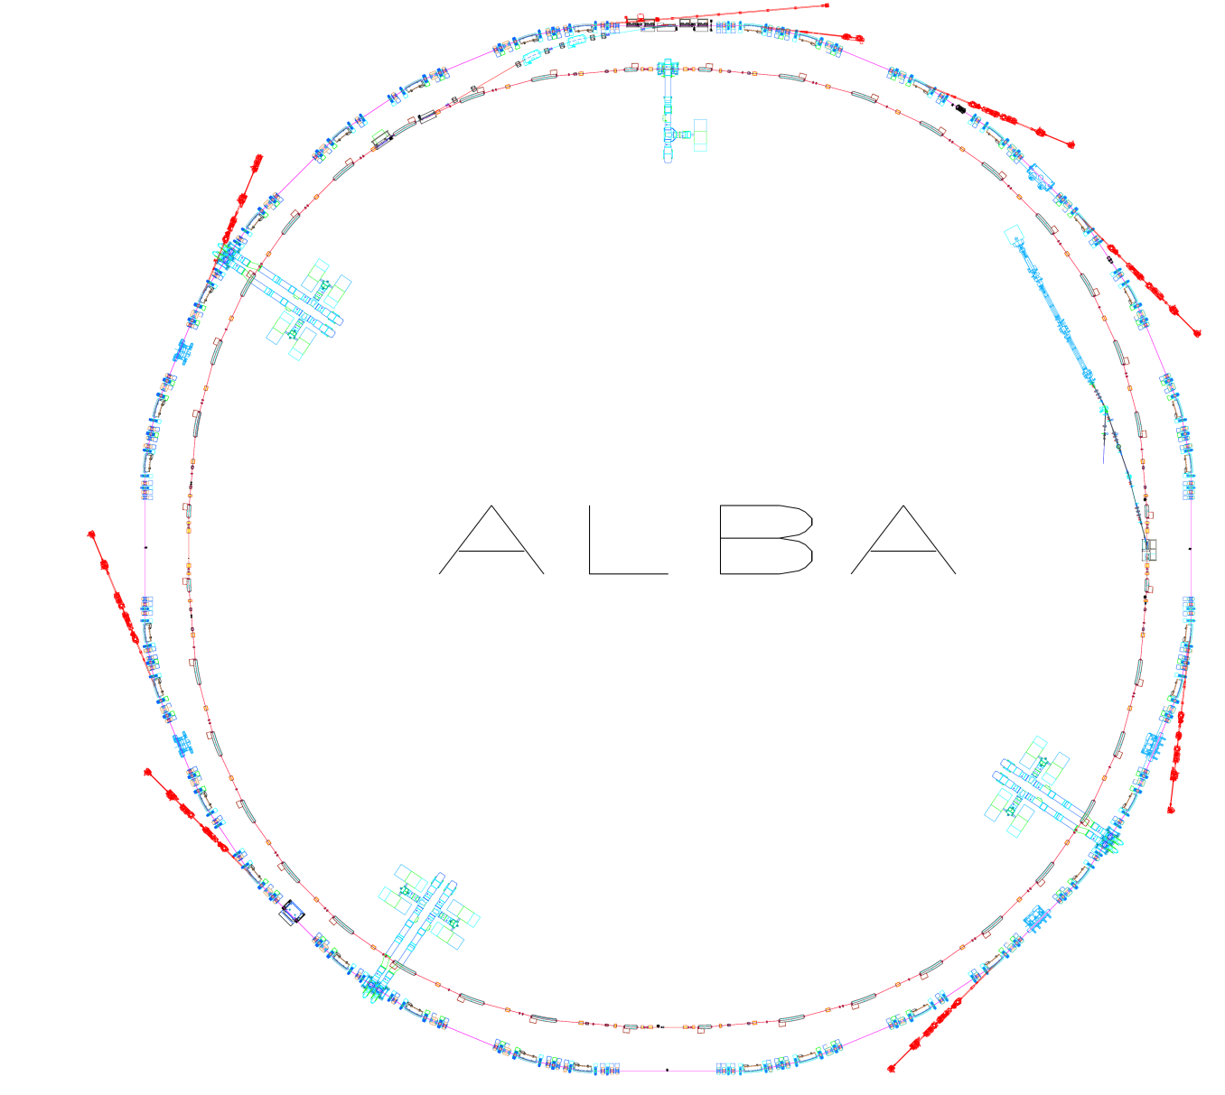
Introduction
Parameter | Value
Energy | 3 GeV
Circumference | 268.8 m
Emittance | 4.5 nm·rad
Current | 250 mA
Rf frequency | 500 MHz
# cavities | 6
Long straights | 4 (8 m)
Medium straights | 12 (4 m)
LINAC
100 MeV
BOOSTER
100 MeV -> 3 GeV
STORAGE RING
3 GeV
2

Slide 3
Introduction
Faxtor
Boreas
31
Xanadu (Acc.)
29
34
Miras
1
Operating for users since 2012
5650h/year
  4500h for users
  1150h for machine
Operating 11 beamlines
Building/commissioning 2 new ones
Minerva
Circe
25
24
New Beamlines
4
MSPD
CLAESS
22
Xaira
6
Lorea
20
20
9
16
11
Mistral
Notos
13
NCD-sweet
Xaloc
3

Slide 4
Introduction
73% 84%
4

Slide 5
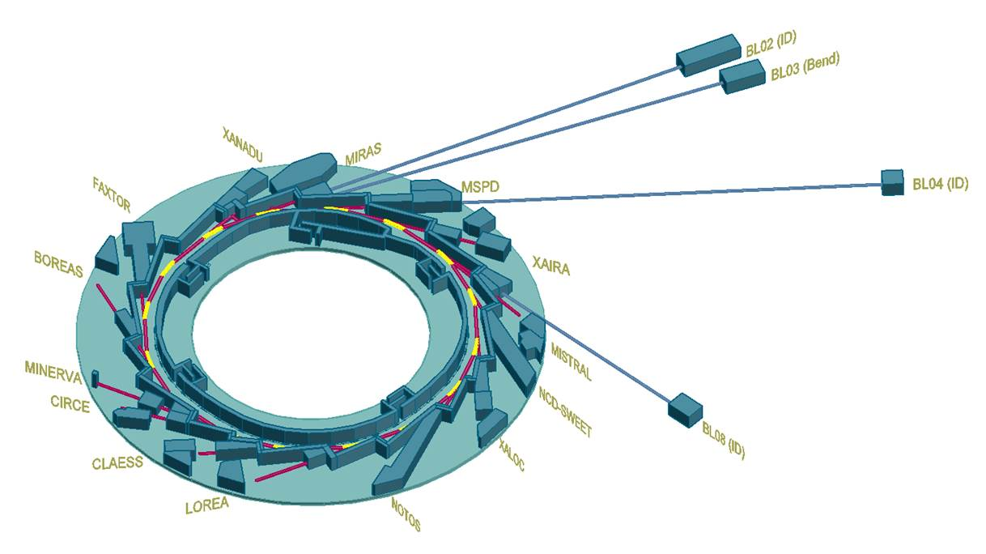
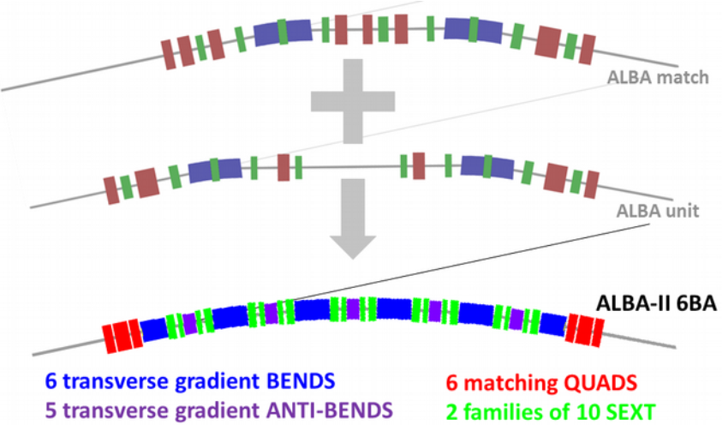

Introduction
ALBA II project: Storage Ring upgrade + Long Beamlines + Data acq. + …
  Same injector and present Beamlines position
Authorities commitment (New land plot + 7.5M€ for prototypes)
Installation 2030 -> Commissioning 2031
Emittance: 4.5 nm·rad -> 205 pm·rad
5

Slide 6
Introduction
The ALBA Accelerator Operators
  8 operators (1 operator/shift)
  50% On Shift // 50% “office”
  20% Machine days // 80% Beamlines days
  Projects related with Operation
Time for other duties
  Each operator is assigned to a subsystem:
  Linac
  Pulsed elements
  Radiofrequency
  Diagnostics
  Controls
  PLCs
  Front Ends, Magnets & Insertion Devices
  Mechanical Designs
6

Slide 7
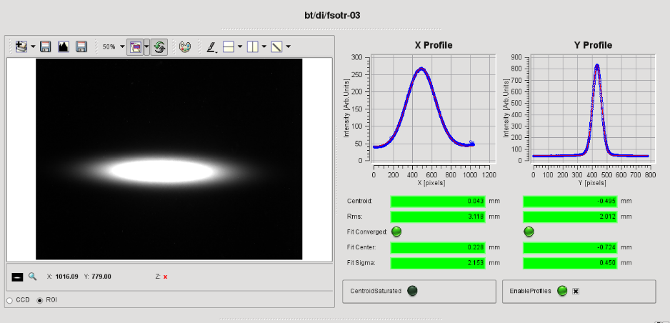
Operators Control Tools
ALBA is operating with users since 2012 (Commissioning in 2011)
Controls group provided Control System (based on Tango) and Guided User Interfaces (GUIs) to operate the different subsystems, as well as the protection systems: Equipment Protection System (EPS) and Personal Safety System (PSS)
Beam Dynamics took care of the Matlab Middle Layer; for commissioning tools and machine setup (LOCO, chromaticity, orbit correction,…)
7

Slide 8

Operators Control Tools
As soon as the operation stabilized, Operators started asking for:
  “Simple” scripts for repetitive tasks/checks
  GUIs designed from our point of view
But:
  Low priority requests
  Controls already at 100% workload
  Operators started to have time for projects
IT’S A
MATCH!
8

Slide 9
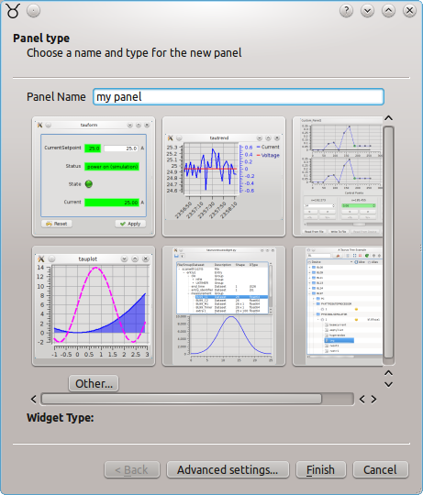
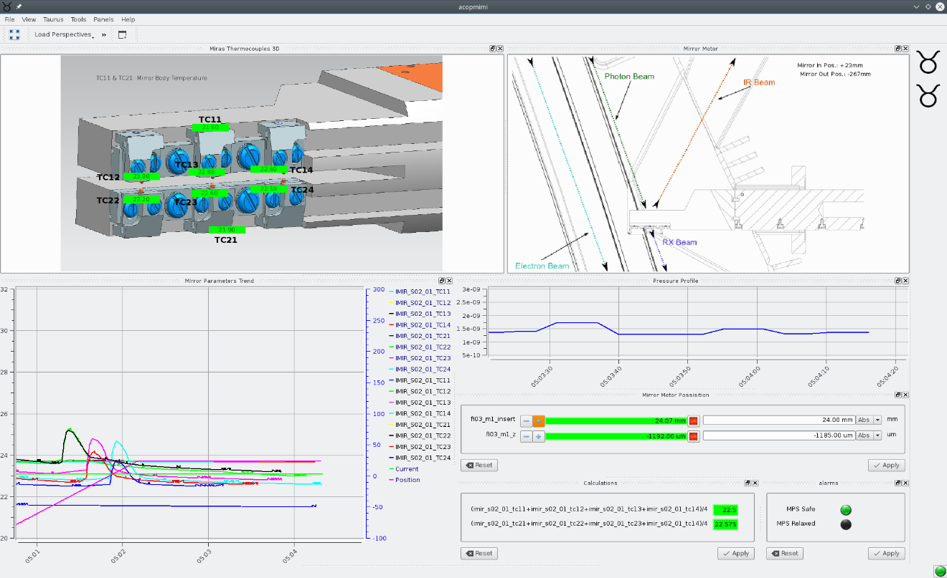
Operators Control Tools
Start writting scritps & creating GUIs with TaurusGui
9

Slide 10
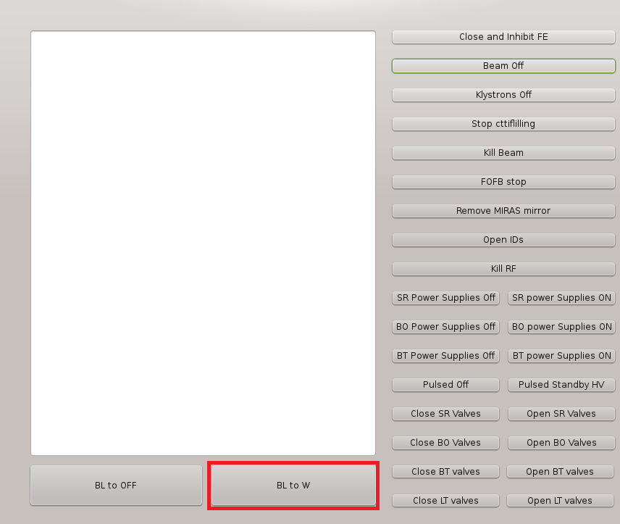
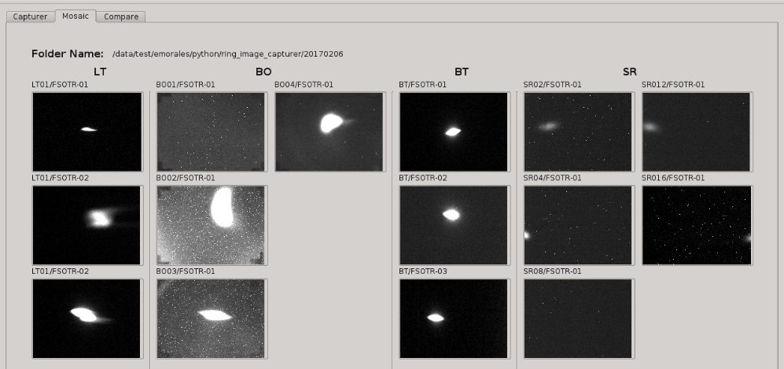
GUIs for Operation
Startup/Shutdown procedures checks & automatization
  CheckFSS.py → Moves IN/OUT all Screens and Scrapers
  RFcheck.py → Checks all LLRF parameters and suggests working pase
  IDopen & IDclose
  RingImageCapturer.py
  Shutdown GUI
It even kills the beam reading the DCCT and action on the scraper
10

Slide 11
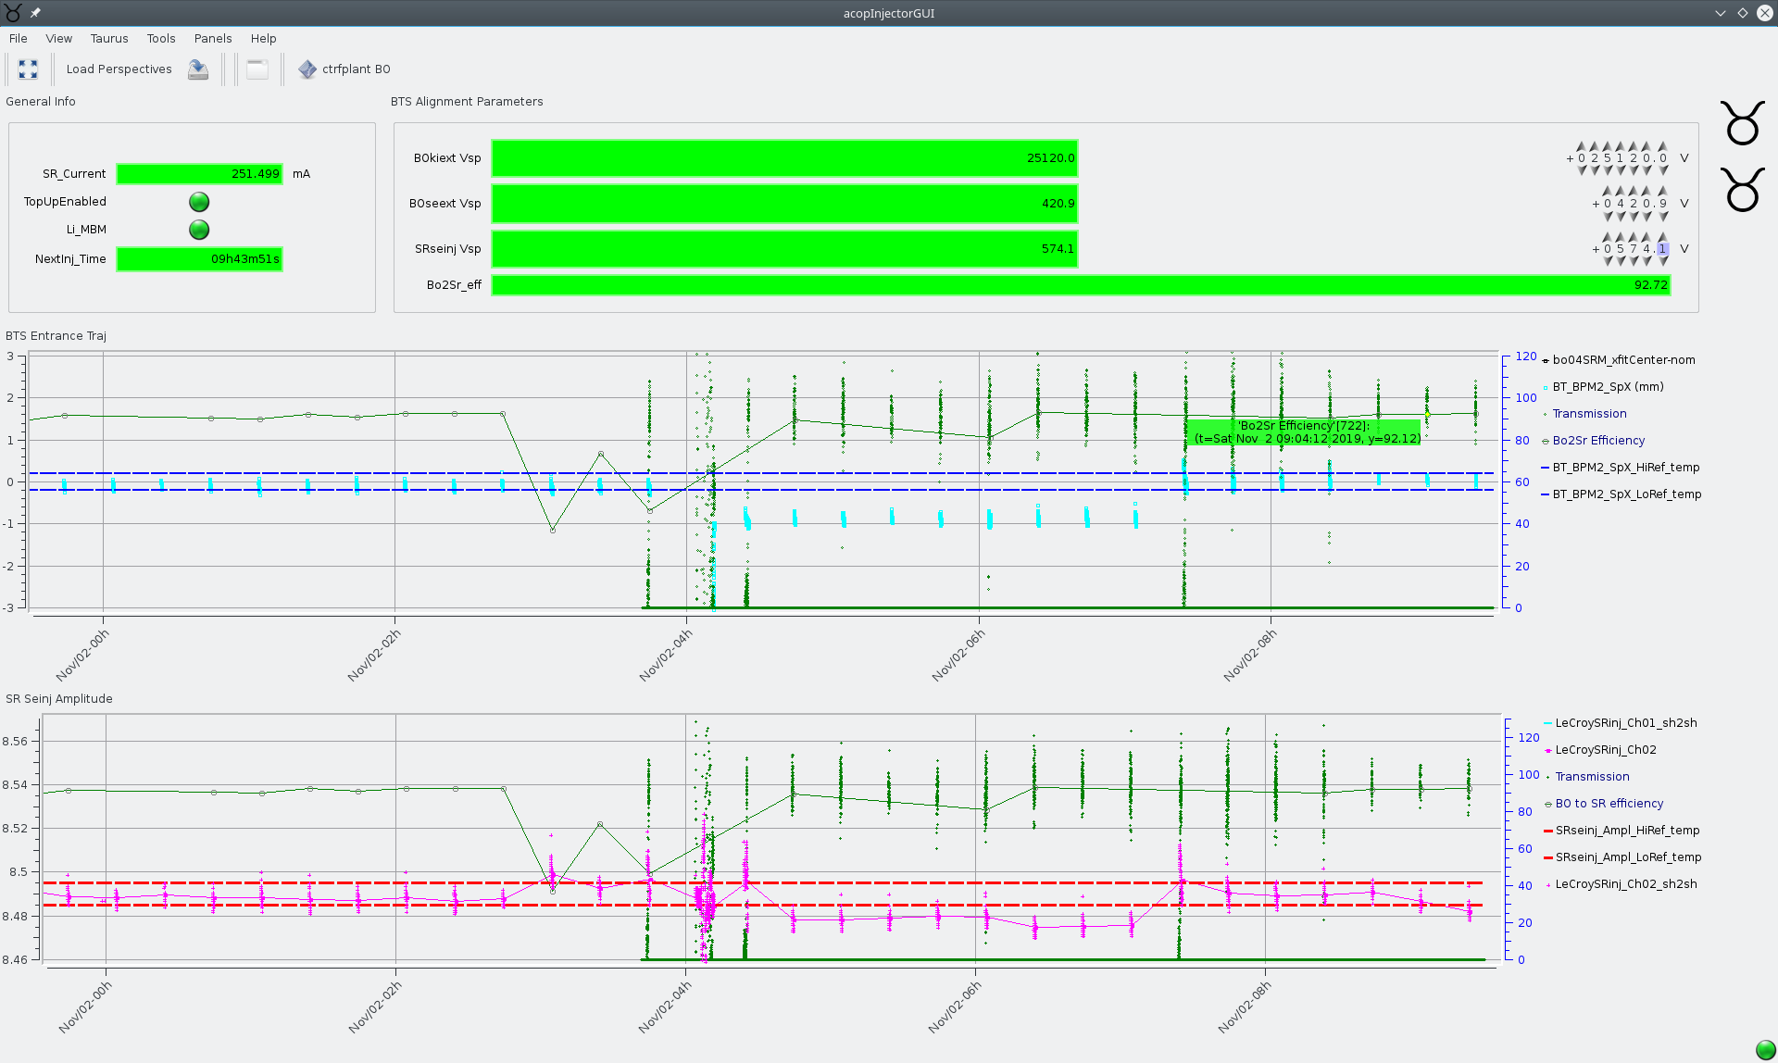
GUIs for Operation
TopUp stability related GUIs
SR BPMs, temperatures, pressure,…
Injection: efficiency, pulsed amplitude meas., transfer line BPMs,
11

Slide 12
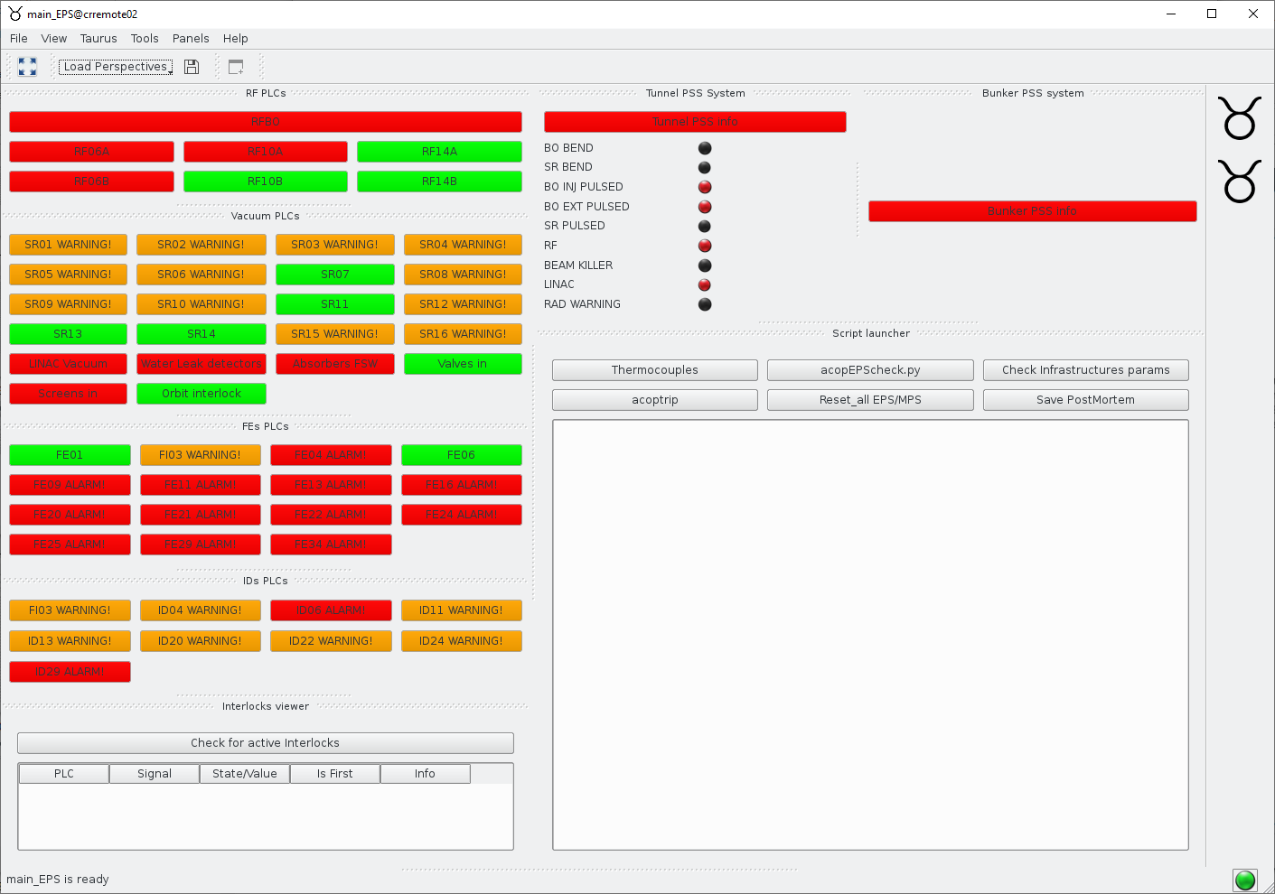
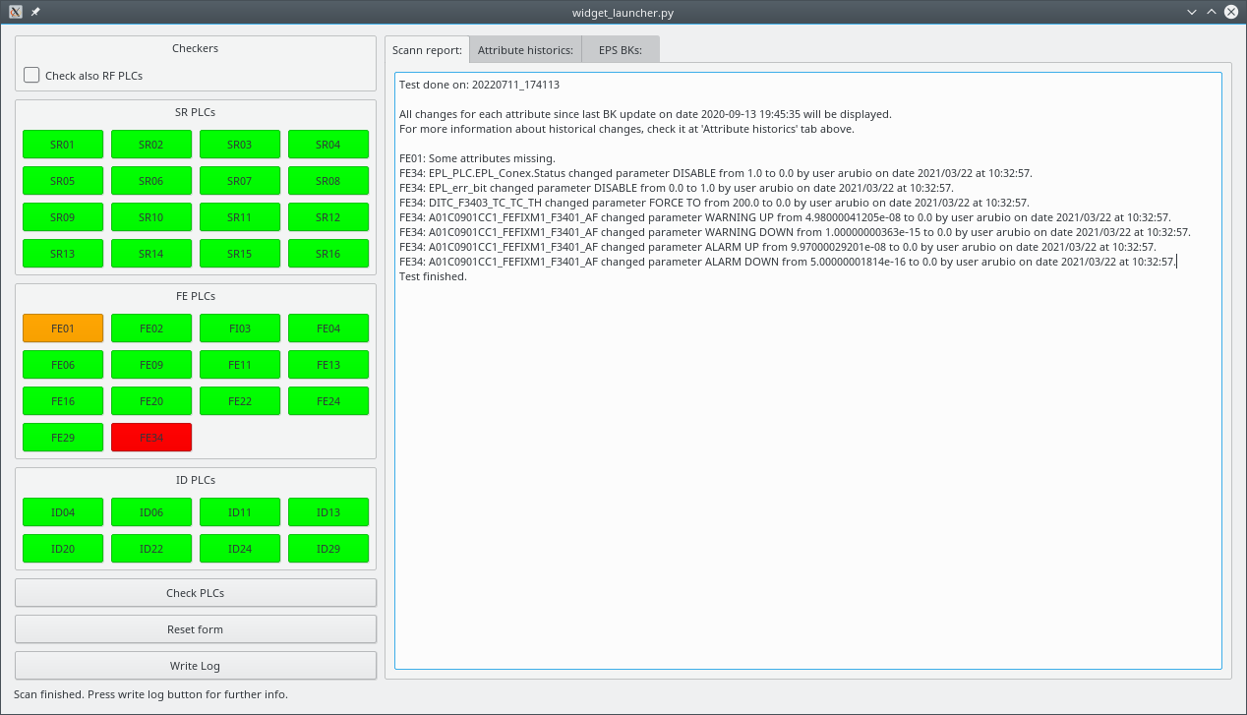
GUIs for Operation - Subsystems
Equipment Protection System (EPS)
EPS user GUI
EPS PLCs configuration check GUI
12

Slide 13
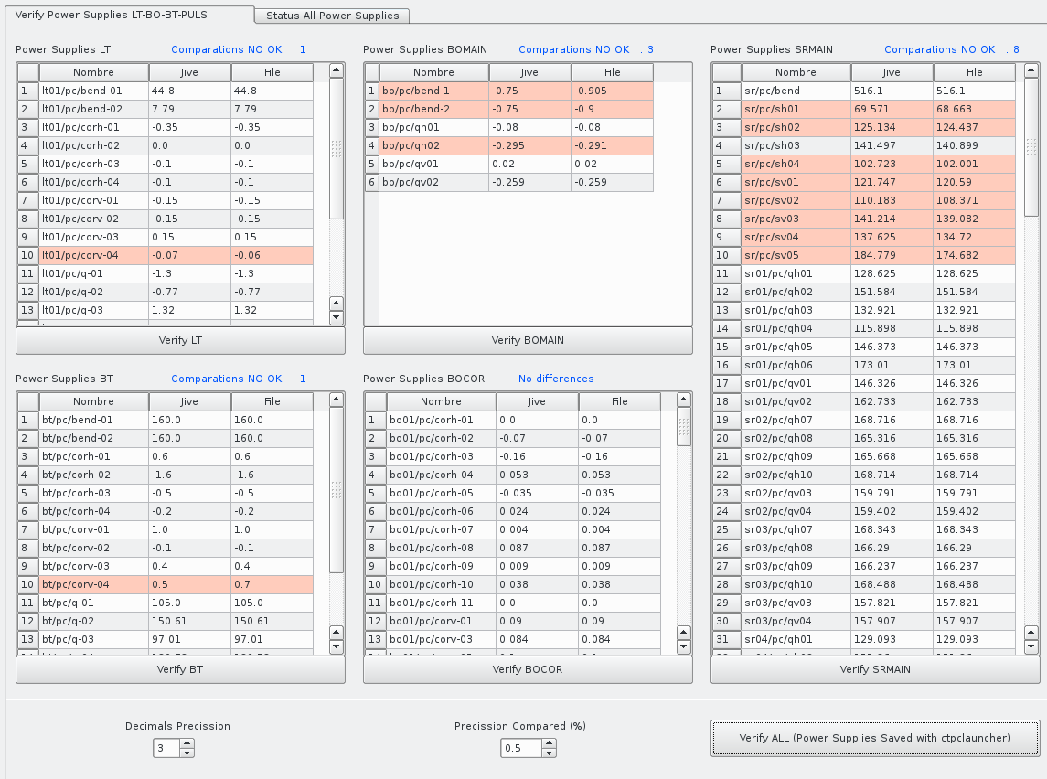
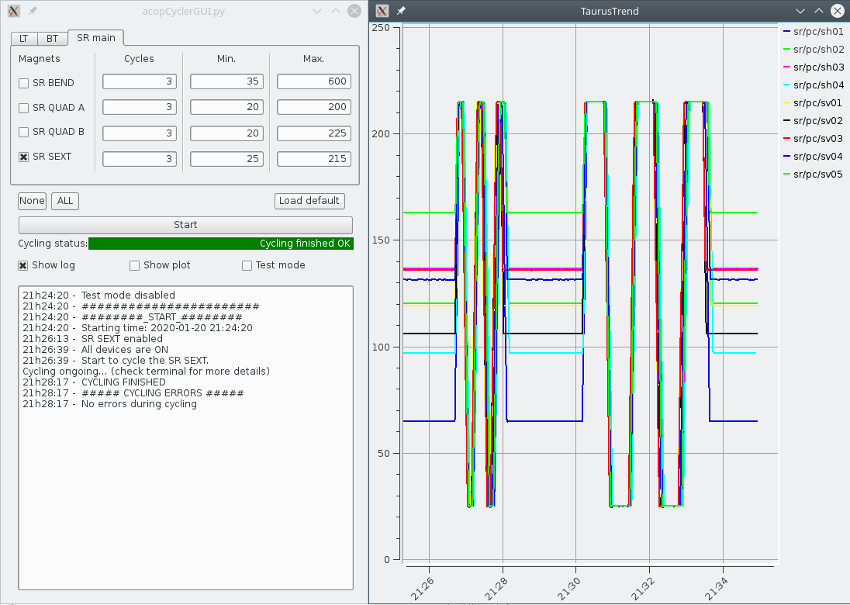
GUIs for Operation - Subsystems
Power Converters
PC checker
PC cycler
13

Slide 14
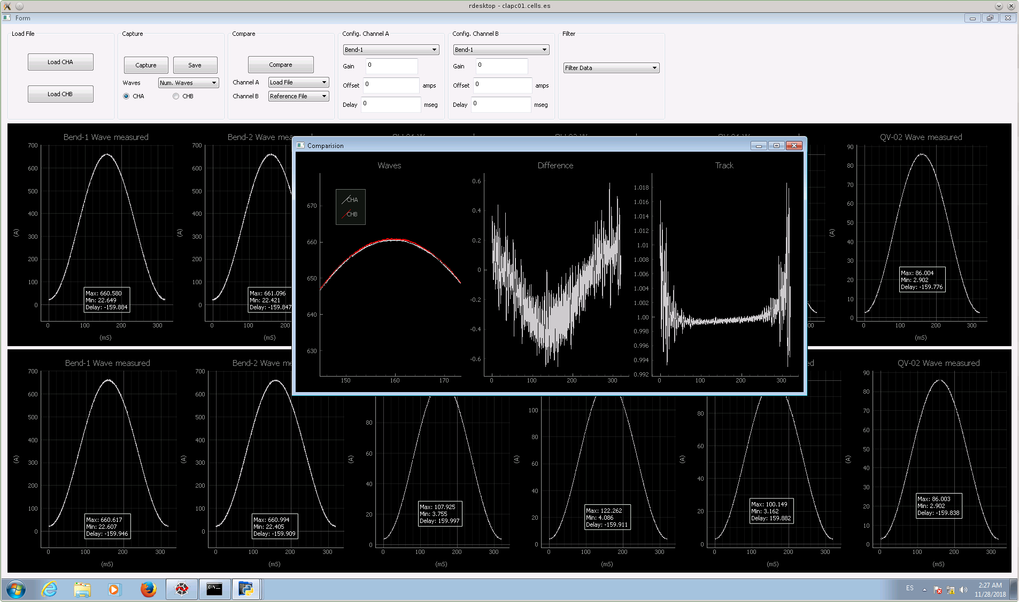
GUIs for Operation - Subsystems
Power Converters – Measure and compare Booster PC
14

Slide 15
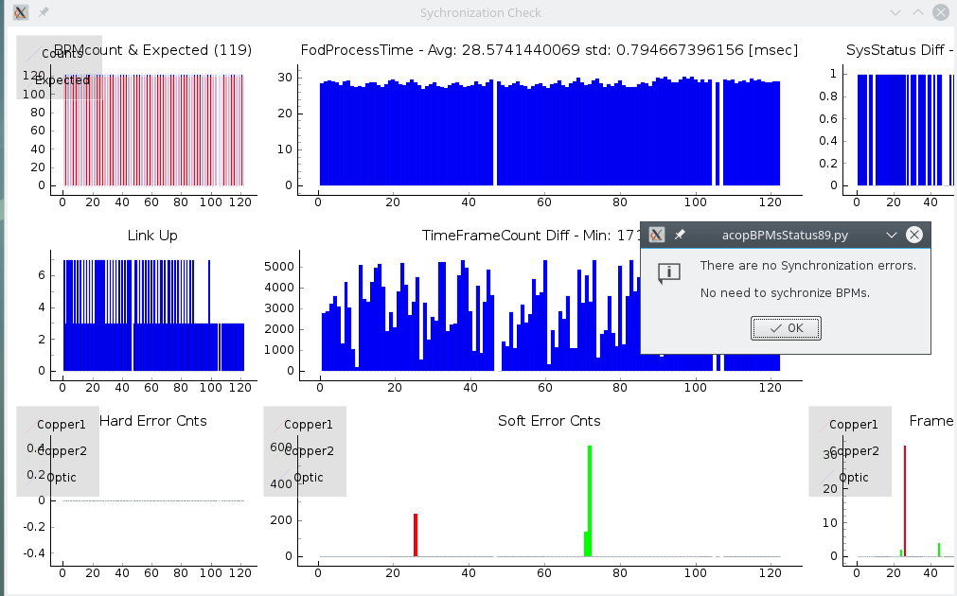
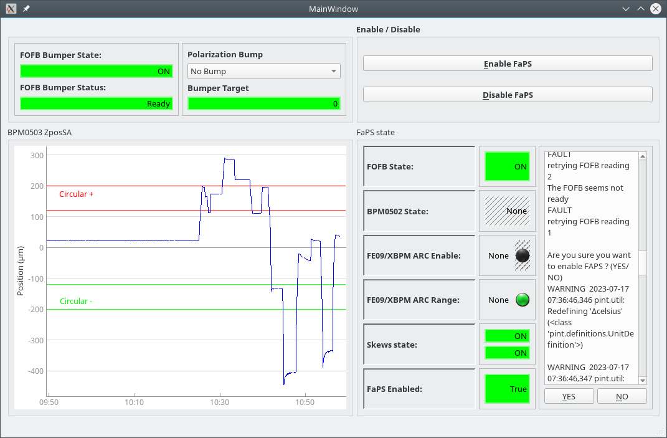
GUIs for Operation - Subsystems
Beam Position Monitors (BPMs)
Check and synchronize BPMs
Fast Polarization Switch (orbit bump)
15

Slide 16
GUIs for Operation
And many other GUIs…
  Check FE → check XBPM positioin at FE + neighboring SR corr. & compares to other dates
  Trip Info → collects data from timing, RF status as first response after beam trip
  Frequency hunter → takes data from BPMs Fast Archiver, FFTs, follow peaks,…
  Save Post Mortem → Connects and downloads all postmortem data from BPMs
  Bump & Tune → Monitors at every injection the beam distortion (bump closure) and tune
  Plot Data → Access to archived data for plotting with advanced featrues like filtering
  Statistics → Chron script that computes statistics from DCCT data
16

Slide 17
Other contributions
We do with limited functioning devices (tango composers and processors)
  Create our own atributes calculated from other attributes
We write communication functions with oscilloscopes
We work with “Sardana macros”; mainly cron scripts that collects data at every injection.
Support to Accelerators scientists regarding data acquisition and devices control
Two operators are giving support to Controls and PLCs groups
  Difficult to get involved due to the shiftwork
17

Slide 18
Coordination with Controls
They teach
  How to create Taurus GUIs
  How to create/edit PANIC alarms
  Python course for beginners
Hotline for doubts on programming or interacting with devices
Programming skilled operator contributing to Control tools
Keep track and report failures of the Control System
The more we know, the less we call them
18

Slide 19
Thanks on behalf of the
Accelerator Operations team
19

