Slide 1
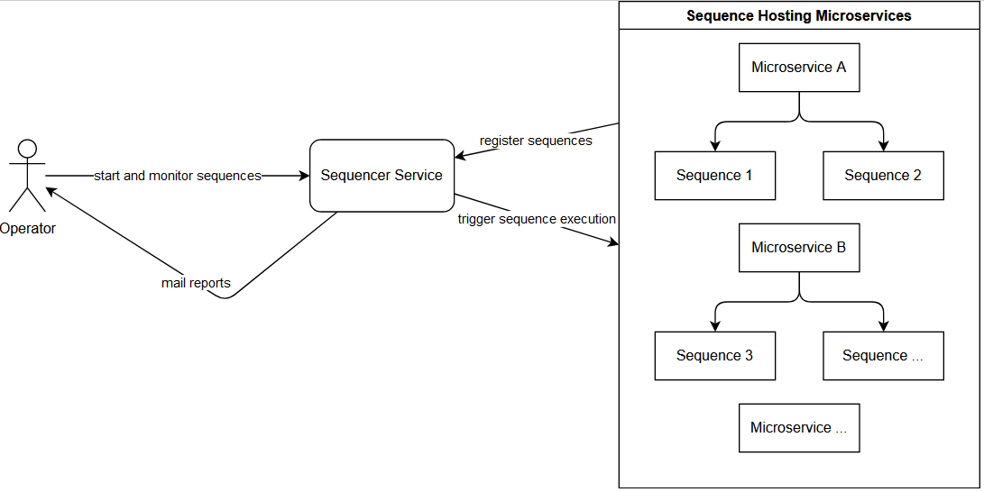
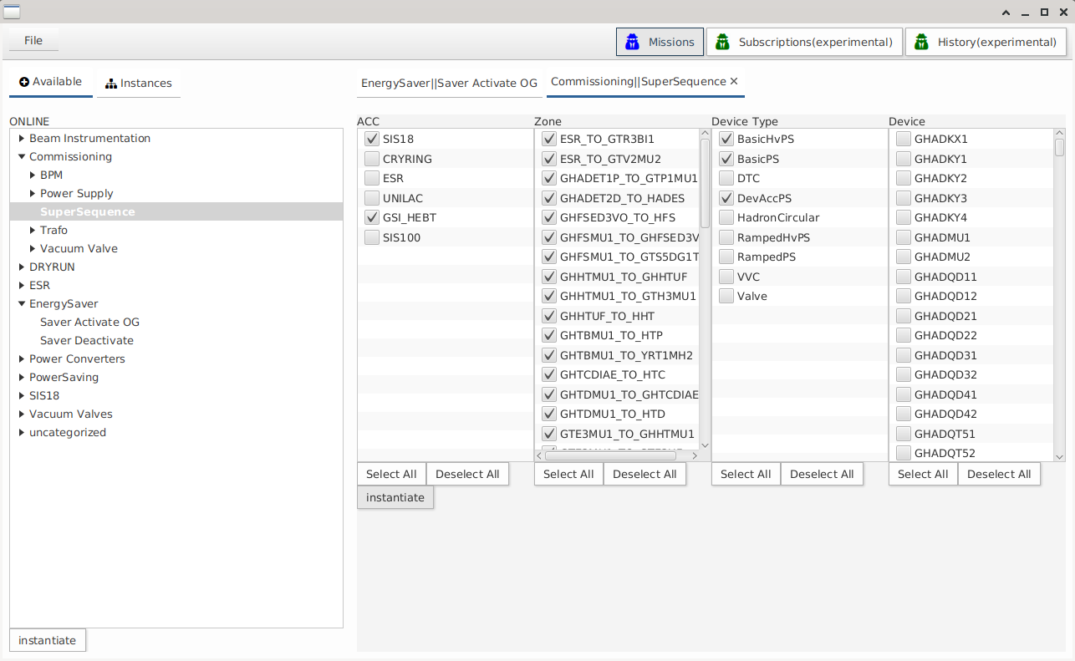
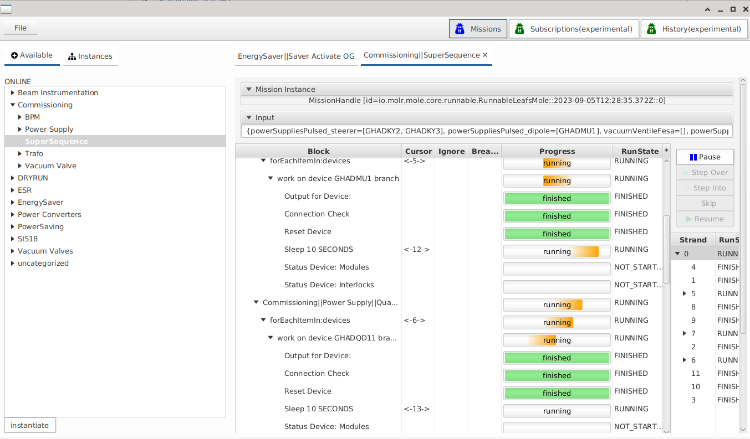
Sequencer Tool for automatisation of repetitive HW tasks
O. Geithner, S.Krepp, K.Fuchsberger, S.Reimann GSI Helmholtzzentrum für Schwerionenforschung, 64291 Darmstadt, Germany
o.geithner@gsi.de
Motivation
Accelerator operation is very manpower demanding. Control system tools could overtake repetitive tasks during commissioning and beamtime like device scanning, beam optimization or device steering nowadays. The larger is Accelerator Facility and amount of similar devices - the higher benefit yields an automatisation of the different task procedures. For this purpose, a Sequencer Tool has been developed at GSI. Figure 1 shows its Software Architecture.
Graphical User Interphase (GUI)
At the beginning, a user has to choose from the library the kind of test to perform. Afterwards, he/she selects what kind of Hardware to test (for details see Figure 2). When test types and the list of devices is chosen, the user starts the tests. A graphical user interface (GUI) allows monitoring all test steps per device, and the overall tests status. The GUI allows as well interaction during test steps (pause, skip, stop)
Figure 1 SW Architecture of the Sequencer Tool
Figure 2 Graphical User Interface of the Sequencer Tool
Possible Use Cases
As the remote control of devices included in Tool is automated, one should consider of all possible HW manipulations and use cases combinations. Here we present the most common ones we started with
Switch remote power on/off by facility area
Commissioning HW tests
Toggle power saving mode in case of longer accelerator failures
Specialized HW tests
Emergency controlled switch off
One larger test for all selected accelerator device types may include several smaller steps, specialized for every device type. For example, a commissioning HW test includes many types of devices like pulsed power supply, ramped power supply, vacuum valve, different beam diagnostic devices, etc. Pulsed power supply devices perform the following steps for commissioning:
Switch on power
Reset device
Check interlocks
Read out maximum possible current and driving set current
Check target/actual current
Read out minimum possible current and driving set current
etc…
Reporting
Test results need to be written down in reports. The Sequencer application creates automated reports and sends them via email. The format of the report is customized corresponding to the expert group’s demands: pdf, cvs, xls. Users can configure what kind of content to receive: either failed tests only or information about all tests performed. The structure of reports for rather complex tasks like commissioning HW tests is still under discussion.
Actual Work in Progress
As electricity costs became a topic of interest recent years, GSI investigates the possibilities of reducing power consumption even during beam times. For example, one possibility would be do activate an energy saving mode if an accelerator fails and a longer downtime for investigation and repair is planned. Two main types of devices were identified which have excessive energy consumption even in standby mode – pulsed power supplies and ring RF. Both types will be switched off for save mode. The main difficulty with pulsed magnets is their hysteresis. We investigate the influence of it on operation.

