Slide 1
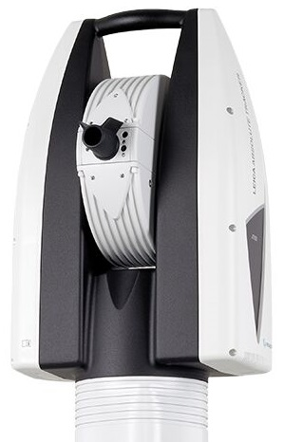
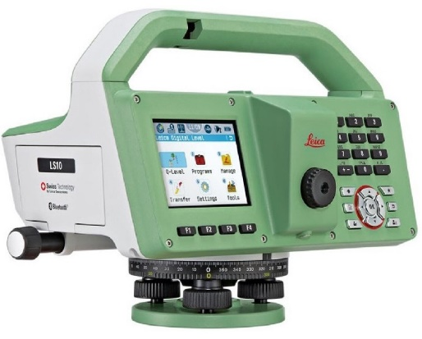
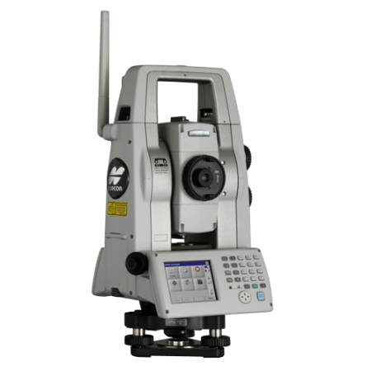
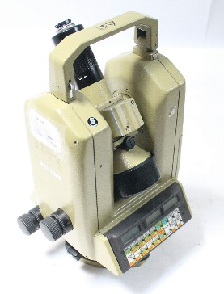
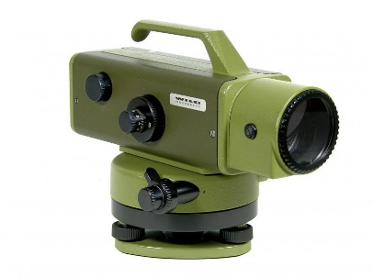
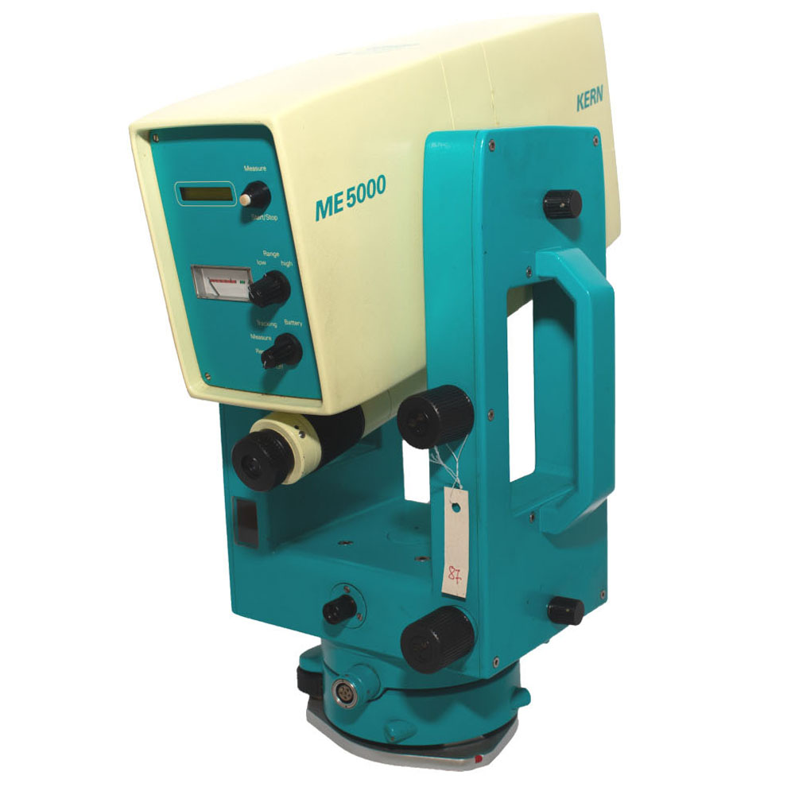
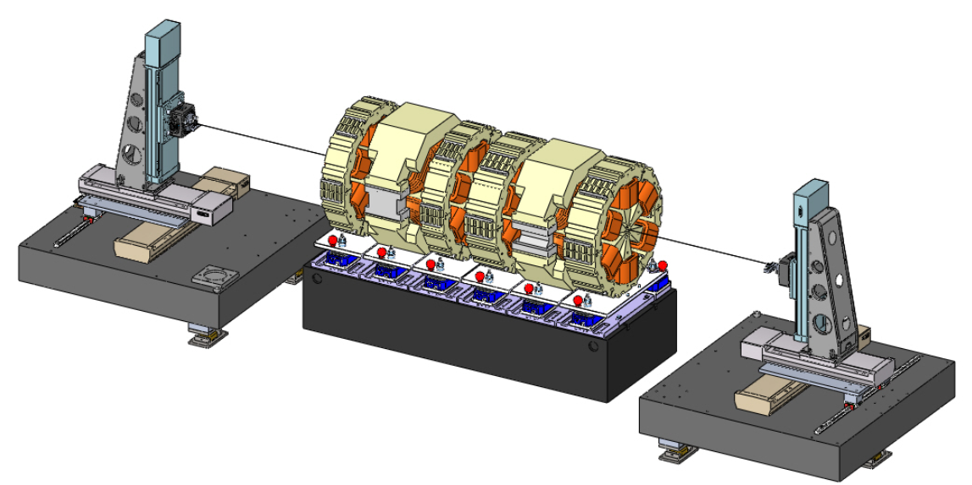
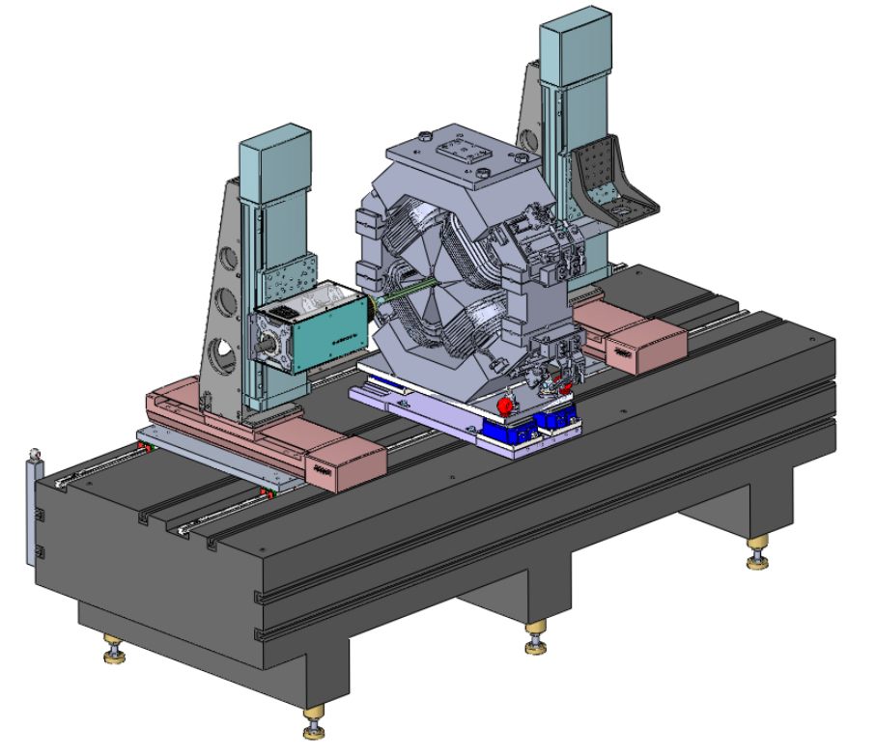
Alignment methods for Elettra and the new project Elettra 2.0
A.Coronica, P.Furlan, D.Vivoda, R.Sauro, D.Castronovo, D.Caiazza, A.Gubertini
Elettra Sincrotrone Trieste S.C.p.A, 34149 Basovizza, Trieste, Italy
For Elettra 2.0, the alignment will be more demanding than in the previous Synchrotron Radiation facility Elettra, installed at the beginning of 1990 and it is a very important activity during the assembly and installation of the new machine.
Elettra
Elettra 2.0
The alignment of Elettra was done using the North Star and the Southern Cross.
It’s a joke ☺ let’s try to really understand how the alignment was done in the early 1990s. Back to reality Elettra was aligned with a theodolite, a precision level and a
mekometer. As a starting point there were two references on two basaments in the
centre of the machine. For the correct transversal alignment of the magnets, level meters were used near the adjustable feet. There was no real time reading, there was no display to read the X, Y, Z coordinates. Every time it was necessary to post calculate them and then apply the corrections. At least six operators were therefore needed to work simultaneously in the tunnel. The theodolite was used on the cup of one bending and pointed to the target on the next bending. So a bundle axis was created. At this point we began to place one magnet at a time. Each magnet has two reference cups and these have to be on the beam axis and the same height using a precision level. These measurements involved a lot of effort on the eyes of the operators, so it was not possible to work more than many hours with these instruments.
Measurement accuracy achieved : 0,2 mm
Used equipment:
Theodolite Leica T3000 Precision level Leica Wild N3 Mekometer Kern ME5000
In Elettra 2.0 there will be eight independent girders for achromat as well as long straight sections. With the previous instrumentation it would be very difficult to proceed with the alignment. The new total station has therefore become fundamental, since it has the advantage to be positioned anywhere to make best-fit in an alignment network. Then through the use of a PC and a software you can finally have the reading axes X, Y, Z data in a real time (in absolute coordinates).
Measurement accuracy : 0,020mm
Used equipment:
Leica_Absolute AT930 Electronic level LS15 Topcon MS AXII
Software: SpatialAnalyzer
The alignment of Elettra 2.0 involves 3 phases
Rotating Coil bench
The individual magnets will be positioned on a coil bench inside a magnetic measurement laboratory. This measurements will have the purpose of determining the magnetic axis with respect to external references. The difference between the magnetic axis and the mechanical axis is expected to be small. The difference could be due to an inaccurate mechanical assembly, errors in the machining of the profile of the poles and the quality of the iron.
This phase is very challenging, so for this reason it was decided to make the least handling possible, positioning the laboratory near the storage ring.
A Spatial Analyzer software will be used for surveying the data collection, least square method adjustment, on-line coordinate measurements and error analysis. The temperature in the tunnel must be kept stable within -+0.5° range.
In order to specify the survey network of the Elettra 2.0 storage ring, several simulations will be performed with Spatial Analyzer software.
Once the girders with the relative magnets will be transported inside the storage ring, it will be necessary to proceed with their alignment within a relative accuracy of 0.03 mm. In the pre-alignment phase all the girders will be fixed in the designed position within ± 1 mm, with the total station Topcon MSAXII. The precise alignment will start after reaching the stability of the ambient temperature.
To do this operation is necessary to have the fiducial marks (FM), at least four for component. To ensure its stability over time it could be fixed or placed on mobile supports on which the alignment spheres (Corner Cube Reflector) will then be positioned, acting as FM. Alignment tollerances :
3) Last step: Alignment in the storage ring
The task is also very challenging due to the tight tolerances in the magnet position as well as space and time limitations.
Network :
Before the installation of the machine components, approximately 350-450 reference sights will be positioned, fixed on the vertical walls of the accumulation ring.
These sights with magnetic support will be used to install the machine components, for the installation of the new beamlines, and we’ll measure them regularly, so we’ll have the most accurate updated coordinates available.
The network points will play a particular role for the monitoring of the ground movements in the future.
The full network survey of Elettra 2.0, will involve measuring 1900 azimuthal and zenithal directions and 1900 distances using the high precision Leica Laser Tracker AT930.
2) Stretched wire bench
All the magnets will be placed on the bench according to the measurements made on the coil bench. The wire for magnetic field measurements is pulled and the magnetic axis is determined with centesimal millimetre precision.
Once the measurements are finished with a total station laser tracker, the entire girder (magnet + granite bench) will be fiducialized. At this point the girder will be moved from this laboratory to the storage ring.
Element Type | Parameter | Value | Unit
Dipoles | Dx | 20 | µm
 | Dy | 20 | µm
 | Dz | 300 | µm
 | Roll angle | 100 | µrad
 | DBl/Bl | 0.01 | %
Quadrupoles on the girder | Dx | 20 | µm
 | Dy | 20 | µm
 | Dz | 300 | µm
 | Roll angle | 50 | µrad
 | DBl/Bl | 0.03 | %
Sextupole /multipoles on the girder | Dx | 20 | µm
 | Dy | 20 | µm
 | Dz | 300 | µm
 | Roll angle | 50 | µrad
 | DBl/Bl | 0.03 | %
Correctors | Dz | 20 | µm
 | Roll angle | 100 | µrad
BPMs | Dx | 20 | µm
 | Dy | 20 | µm
 | Dz | 300 | µm
 | Roll angle | 100 | µrad
Girders | Dx | 50 | µm
 | Dy | 50 | µm
 | Dz | 300 | µm
 | Roll angle | 100 | µrad
Contacts:
alessandro.coronica@elettra.eu paolo.furlan@elettra.eu davide.vivoda@elettra.eu alessandro.gubertini@elettra.eu
roberto.sauro@elettra.eu davide.castronovo@elettra.eu
domenico.caiazza@elettra.eu

