Slide 1
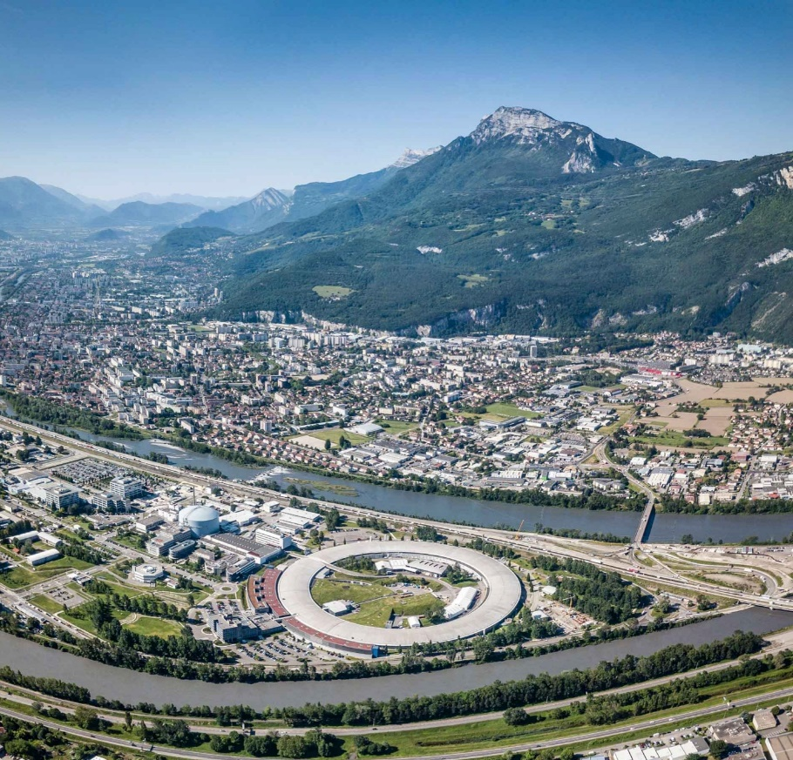
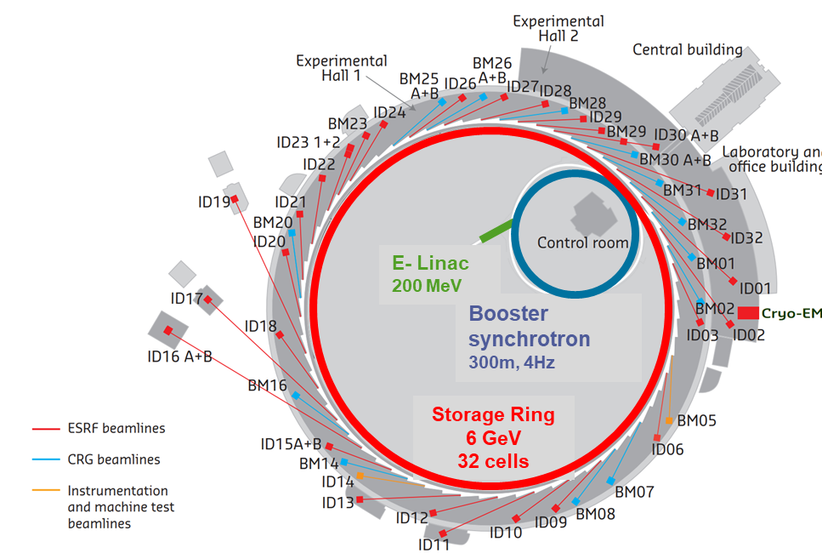
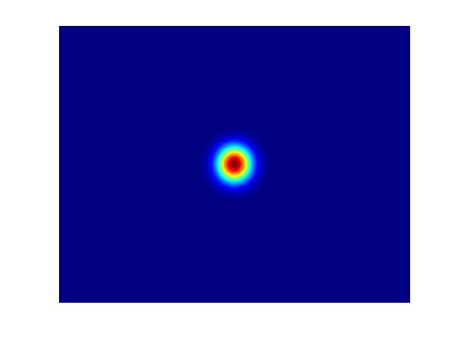
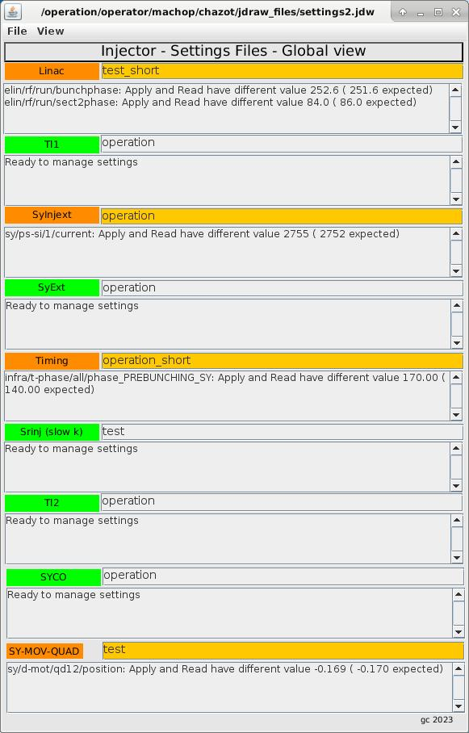
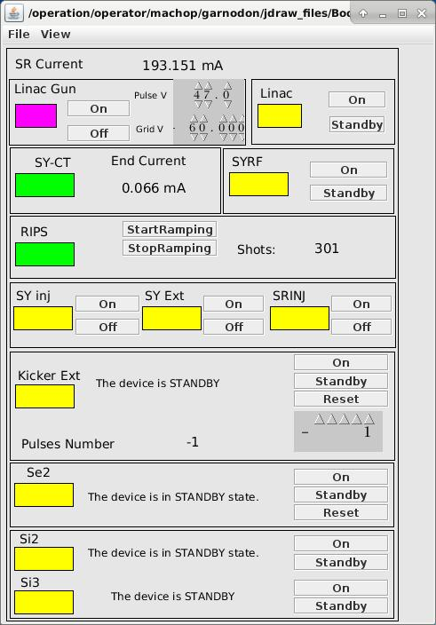
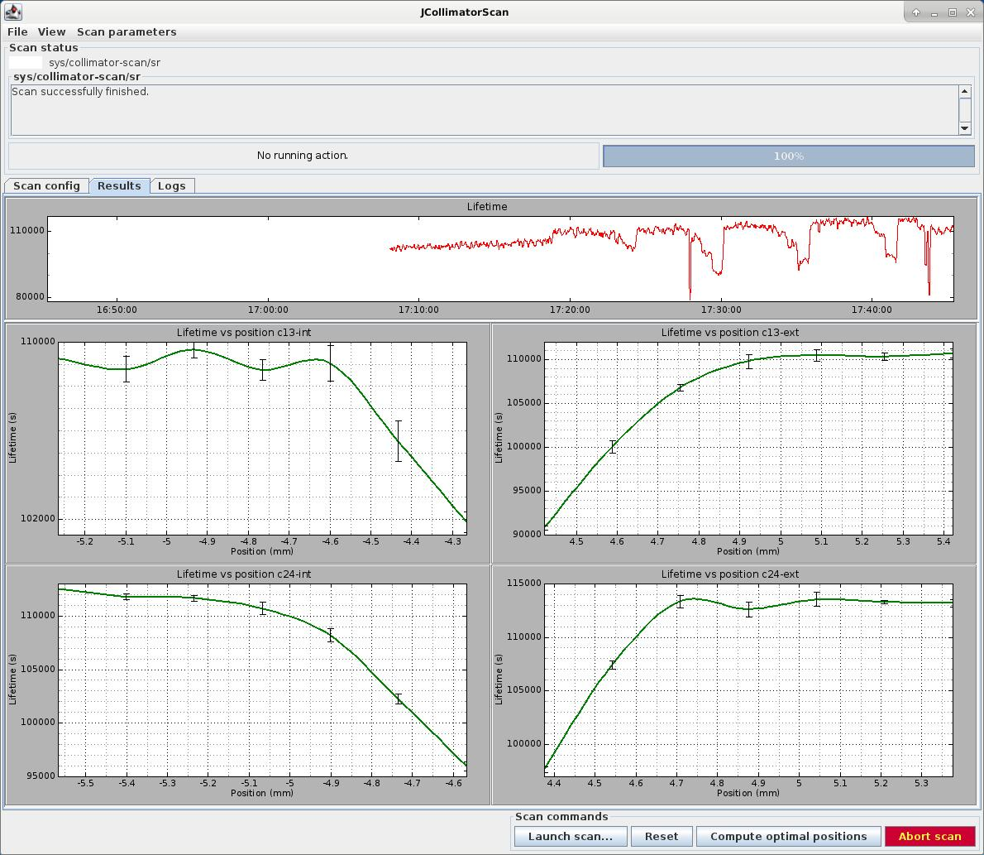
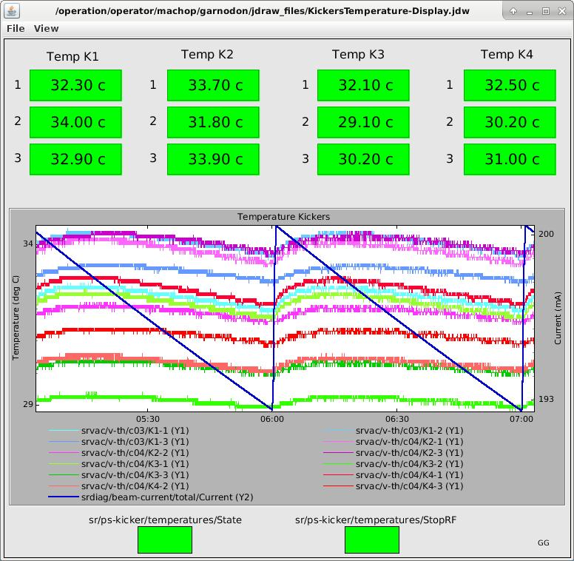
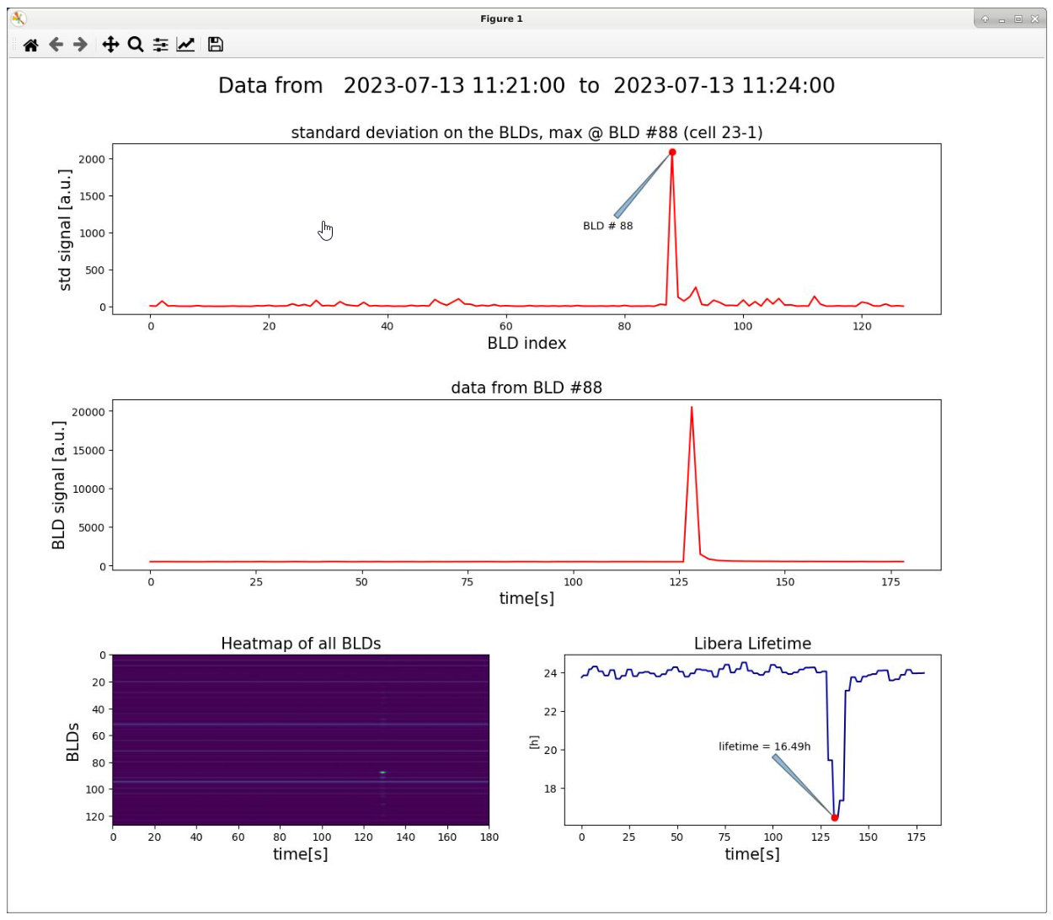
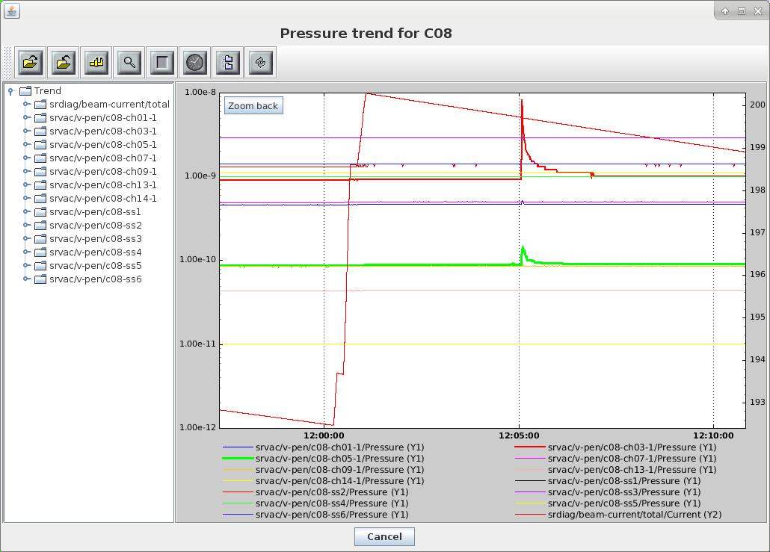
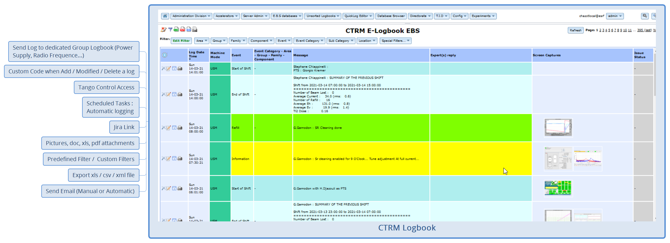
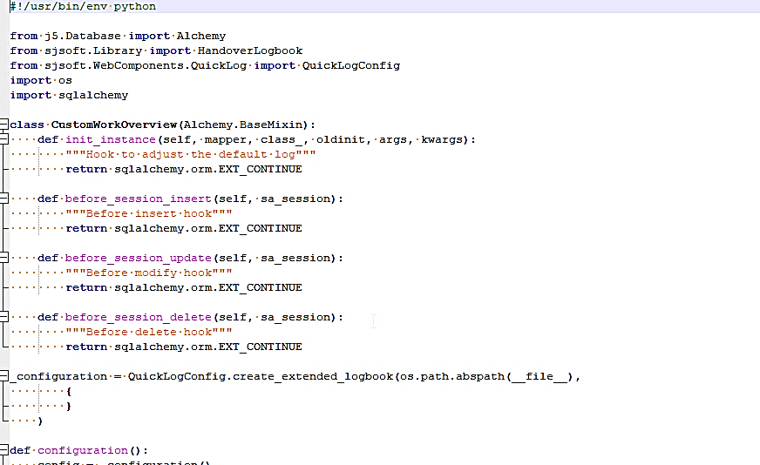
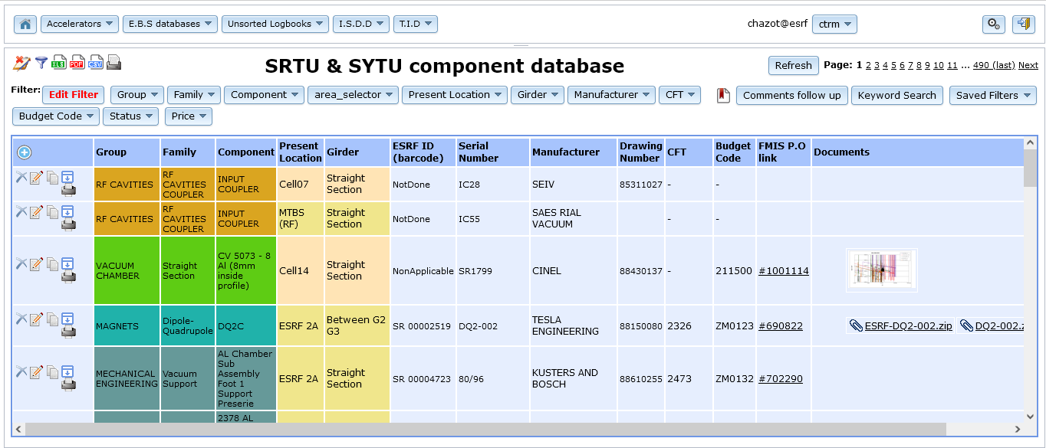
Tools / Developments done by the on Shift Operators
G. Chazot on behalf of the ESRF operator's team : G Garnodon, P Guerin, P Jodar, R Karakas, M. Rodrigues, S. Chiappinelli, B. Vedder
The European Synchrotron Radiation Facility - Extremely Brilliant Source (ESRF-EBS) is a facility upgrade allowing its scientific users to take advantage of the first high-energy 4th generation storage ring light source. Since years, some developments have been made by the operators to follow up the accelerators components, monitoring on line, or post mortem analysis, the machine parameters, in complement of the dedicated standard application developed by the Accelerator Control Unit. Some examples described here were developed in Java, Python or using application builder provide by the Tango community
22 partner nations
Annual budget: 100 million euros
Staff: 630 people, 40 different nationalities
Legal status: Private civil company subject to French law
 | Units | ESRF | ESRF-EBS
Energy | GeV | 6 | 6
Circumference | m | 844.4 | 844
Lattice |  | DBA | HMBA
Current | mA | 200 | 200
Lifetime | h | 50 | 23
Emittance H | pm rad | 4000 | 133
Emittance V | pm rad | 4 | 10*
G.U.I using “Jdraw”
Devices state and control
Devices Settings follow up
Java C++ GUI/Server
Jdraw is a Tango tools to build a simple GUI (Control Command, monitoring) without knowledge of programming language.
Easy to setup (~1h) for a short or long term GUI. It could be a solution to setup a new device, awaiting a dedicated application written by Accelerator Control Unit group..
This is a Java application for Automatic measurements done during procedures to find a working point with the collimators position…
ESRF
ESRF_EBS
Temperature monitoring
90 mA
Python to track lifetime accident origin
PyTango is a Python binding to Tango for accessing the Devices Historical Database…
Following a lifetime accident the operator launch the application giving the date , time of the events, then some plots were produced to show the localization of the losses.
Python for the e-logbook and the Database components system (J5)
Python code in the J5 server space is used to add logics between tables in particular on log entry (add, modify, delete) in the ctrm-logbook (the main logbook shared between operators, technician, ingenieur, scientist)
Implementation of PyTango in this system, allow logbook entry that record devices values (current, voltage, pressure…)
Other Developments in progress
Server and GUI to get with a high time stamp the origin of a beamlost
Automatic Report from the CTRM e-logbook for failures statistics
Electronic PTW for Accelerators Tunnels (J5)
13th Workshop on Accelerator Operations, Tsukuba, Japan, 10th - 15th September 2023 ESRF – The European Synchrotron – 71 Avenue des Martyrs, Grenoble, FRANCE - Tel +33 (0)4 76 88 20 00

